Slide 1
Basic Qualities of Light
Power/Intensity
Color/Frequency
Direction
Reflectivity
Broadness/Diffusion

Slide 2
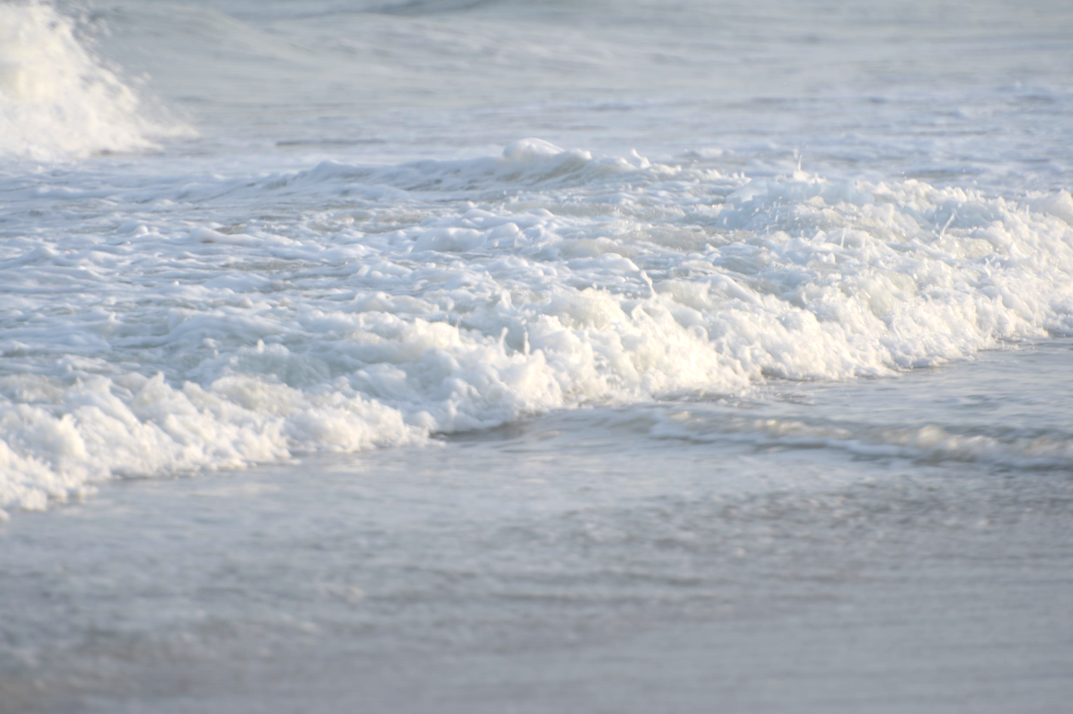
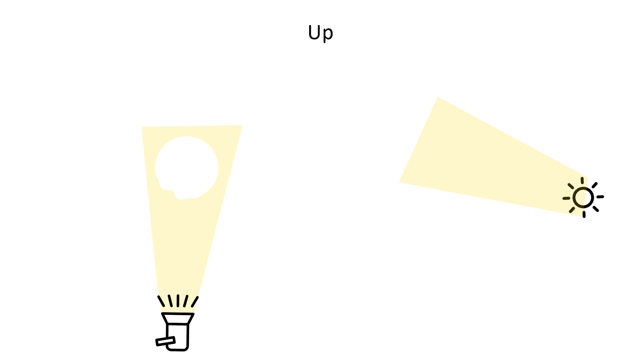
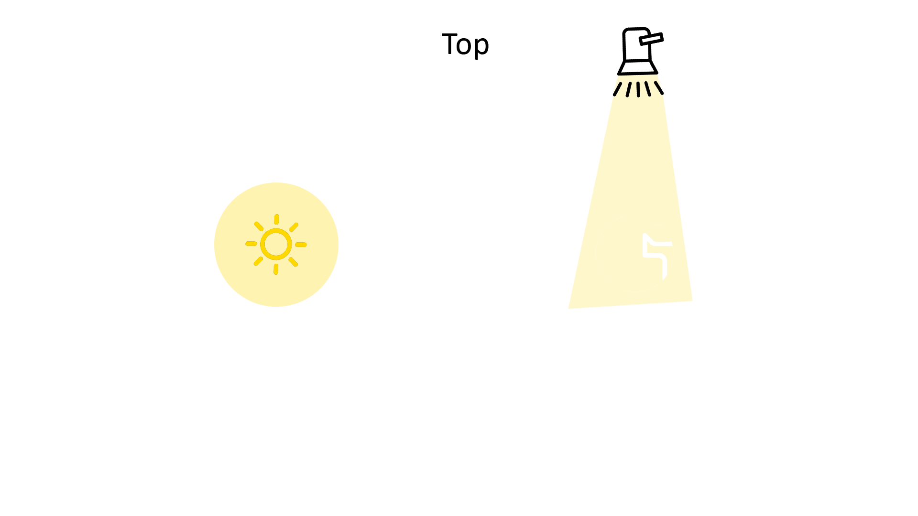
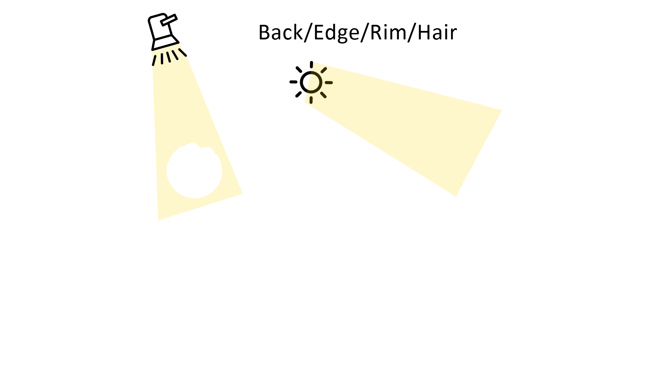
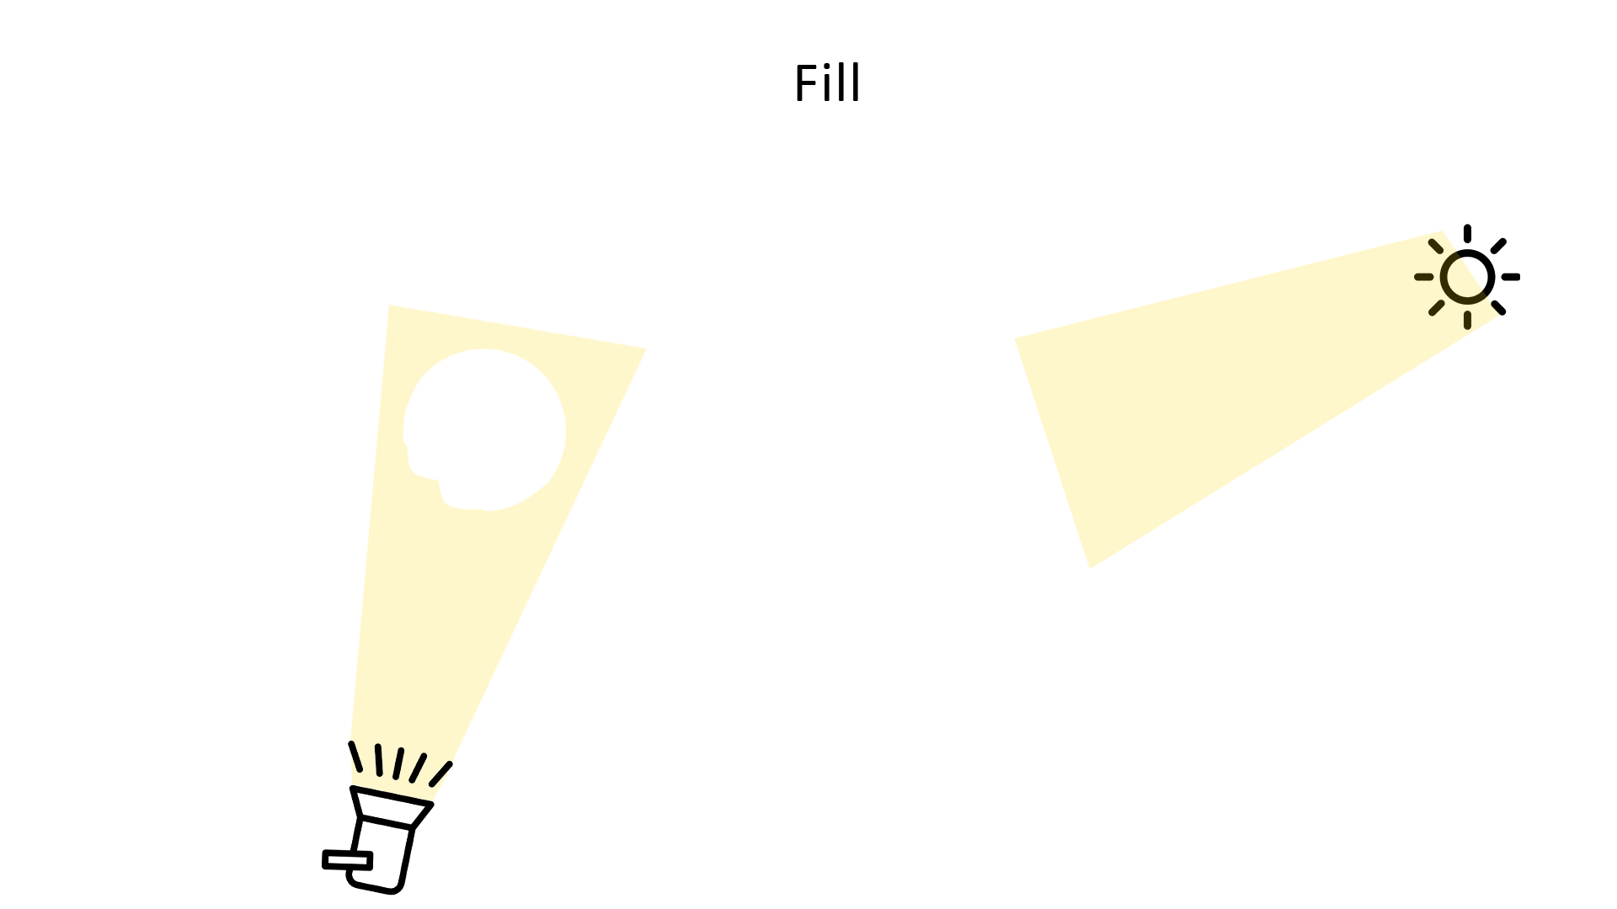
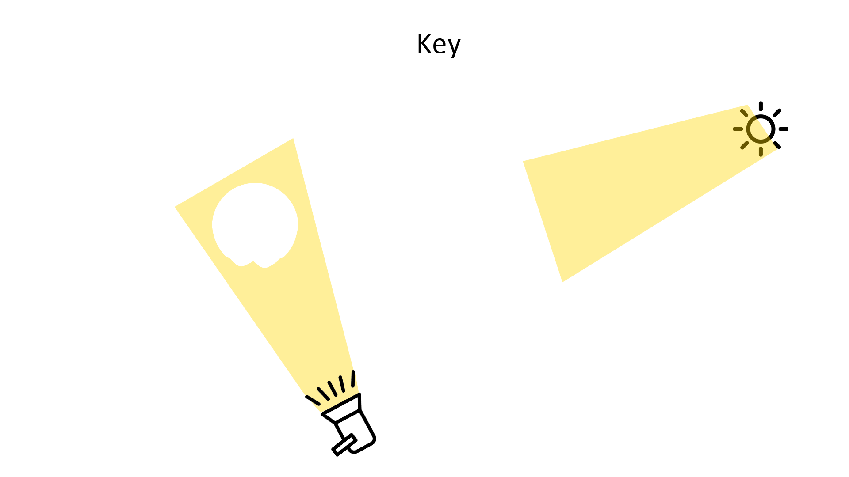
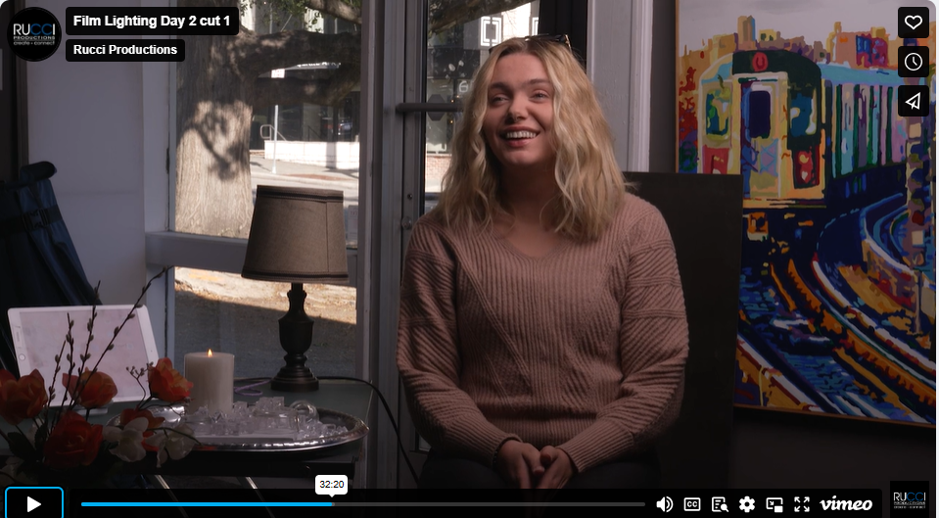
Direction
Let’s give it try

Slide 3
Outside using sun
Notes:
Demo with model, and practicals/windows for motivation, control techniques for flare.

Slide 4
Wrapping of key and edges Vary fill and edge level
Notes:
Demo with model, and practicals/windows for motivation, control techniques for flare.

Slide 5
Motivation
Notes:
Demo with model, and practicals/windows for motivation, control techniques for flare.

Slide 6
Patterns, focus
Notes:
Demo with model, and practicals/windows for motivation, control techniques for flare.

Slide 7
Flare
Notes:
Demo with model, and practicals/windows for motivation, control techniques for flare.

Slide 8
Motion
Notes:
Demo with model, and practicals/windows for motivation, control techniques for flare.

Slide 9
Notes:
Video example 1-2 of lights in motion Also – demo with fire/tv fx for lights in motion
Flare – show samples of creative use

Slide 11
Reflectivity
Effective interaction between setting and lighting
Reflective qualities of materials
Use of bounce & negative fill
Specular highlights
Lighting a reflective surface
Notes:
Demo with model, and practicals/windows for motivation, control techniques for flare.

