Slide 1
Fixture types

Slide 2
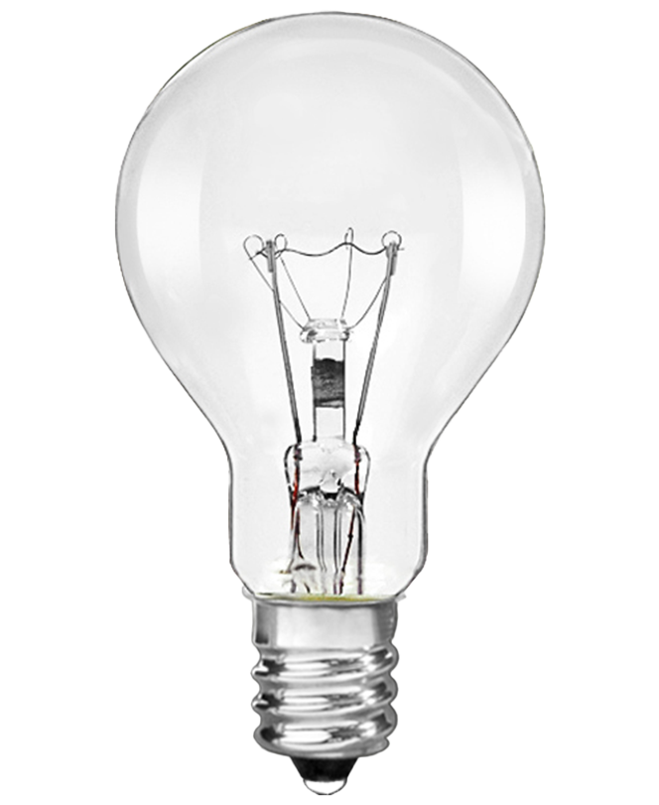
Fixture types
Raw source
Minimal control
Spreads all directions

Slide 3
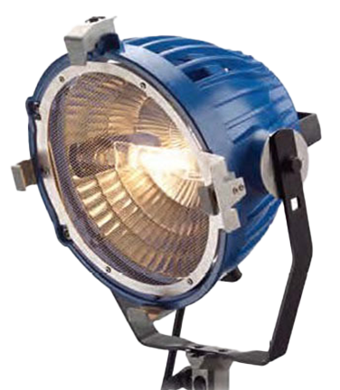
Fixture types
Open Face/PAR
Reflector in back
Open in front
Focusable
Scoop is simple non- focusable form

Slide 4
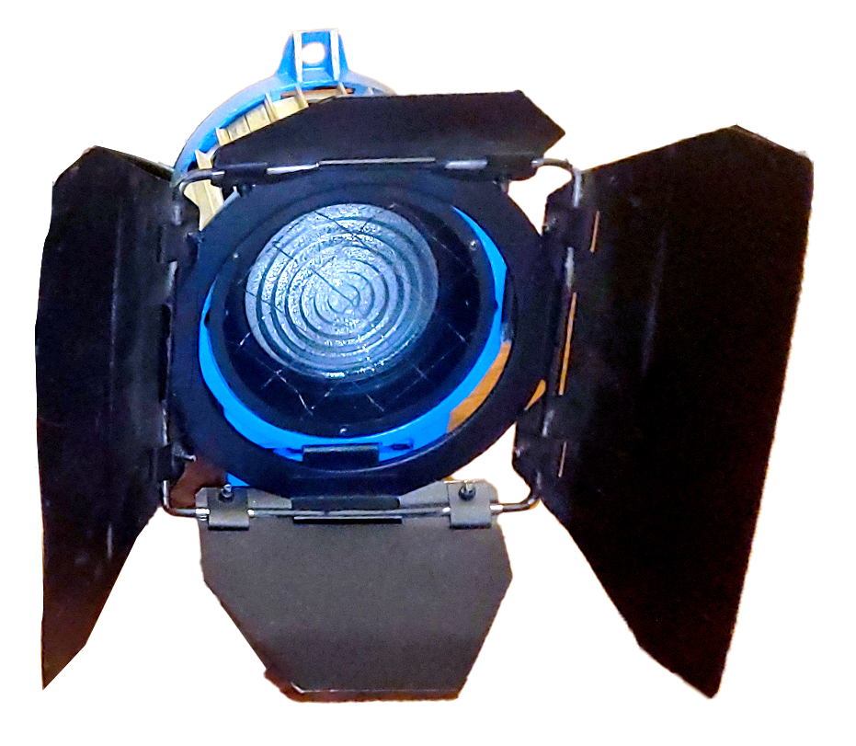
Fixture types
Fresnel
Reflector in back
Segmented lens
Focusable

Slide 5
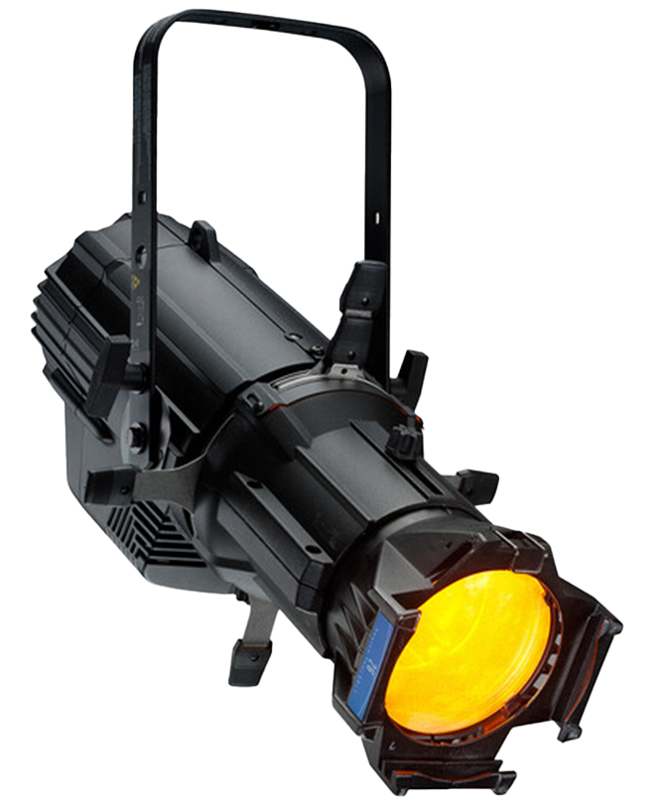
Fixture types
Ellipsoidal
Reflector in back
Solid internal movable lens
Focusable, some zoomable

Slide 6
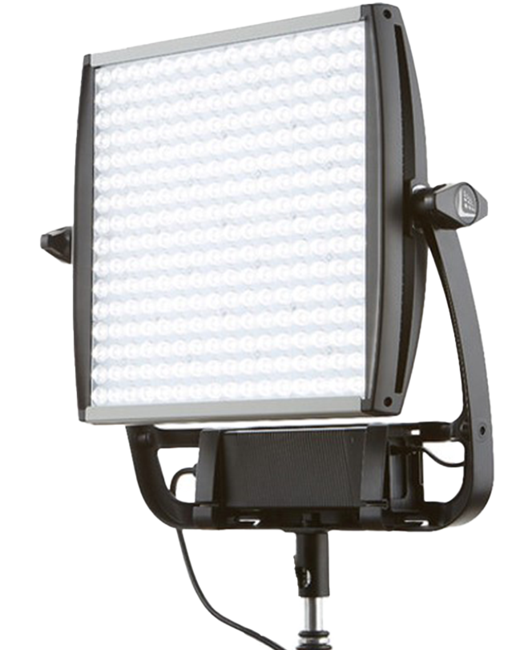
Fixture types
Panel
Many sources in a field
Can intersperse colors
Incorporate diffusion
Dimmable
Can be flexible

Slide 7
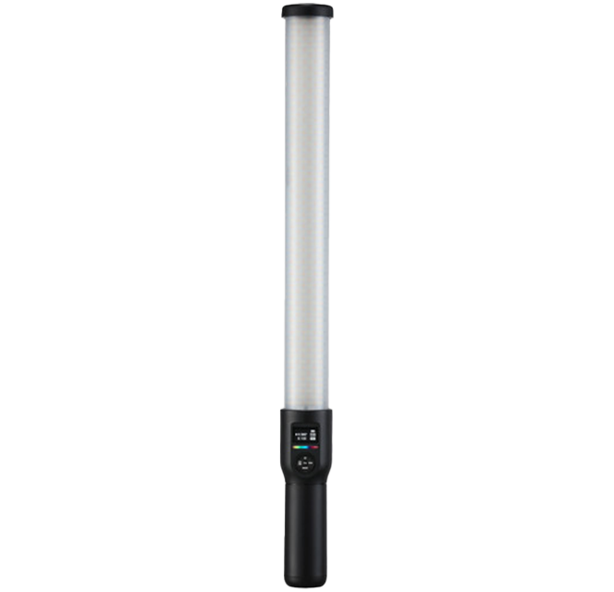
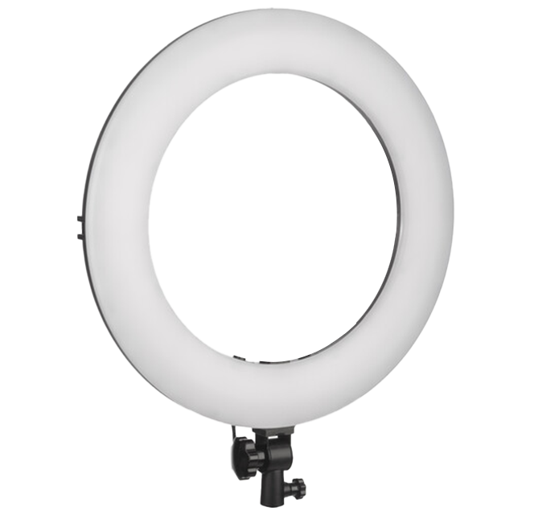
Fixture types
Wand/ring
Type of panel in a unique shape

Slide 8
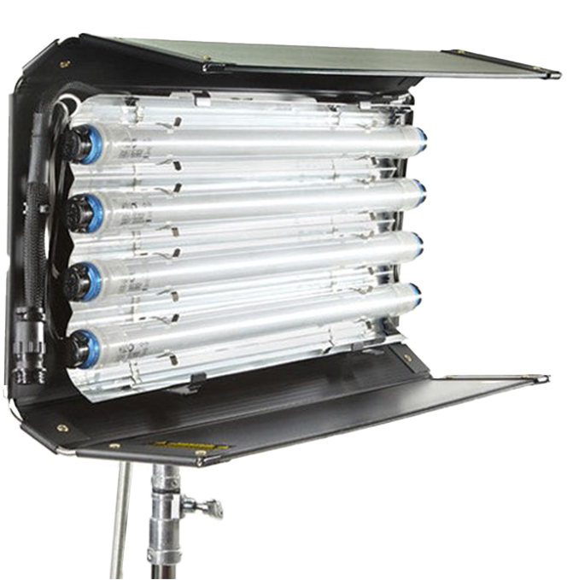
Fixture types
Tube
One or more
Mounted or loose
Various colors
Dimmable

Slide 9
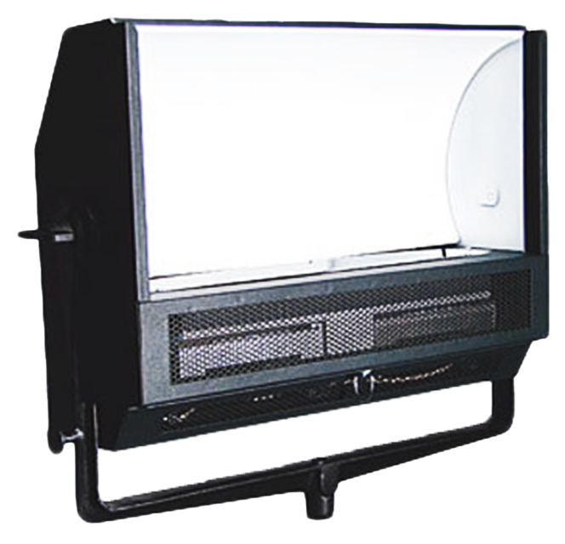
Fixture types
Indirect softlight
Source bounces off white surface
Lamp is not visible

Slide 10
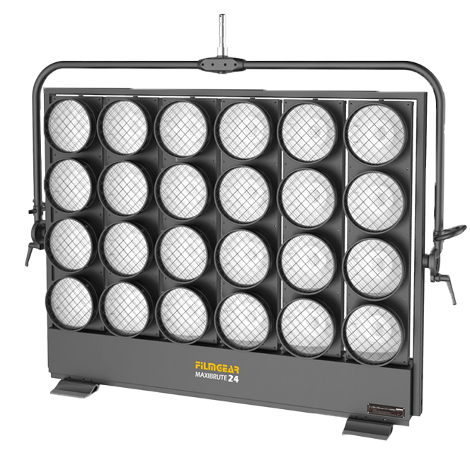
Fixture types
Array
Individually aimable
Dimmable

Slide 11
Lighting sources
LED
Fluorescent
Tungsten
Arcs (HMI, Carbon, Xenon)
Strobe
Reflector
Silk
Natural light
Flame
Practicals (ex: lamp, lightbulb, etc.)
Notes:
G.1

Slide 12
Monsieur Soleil
world’s largest light source
nuclear fusion powered

Slide 13
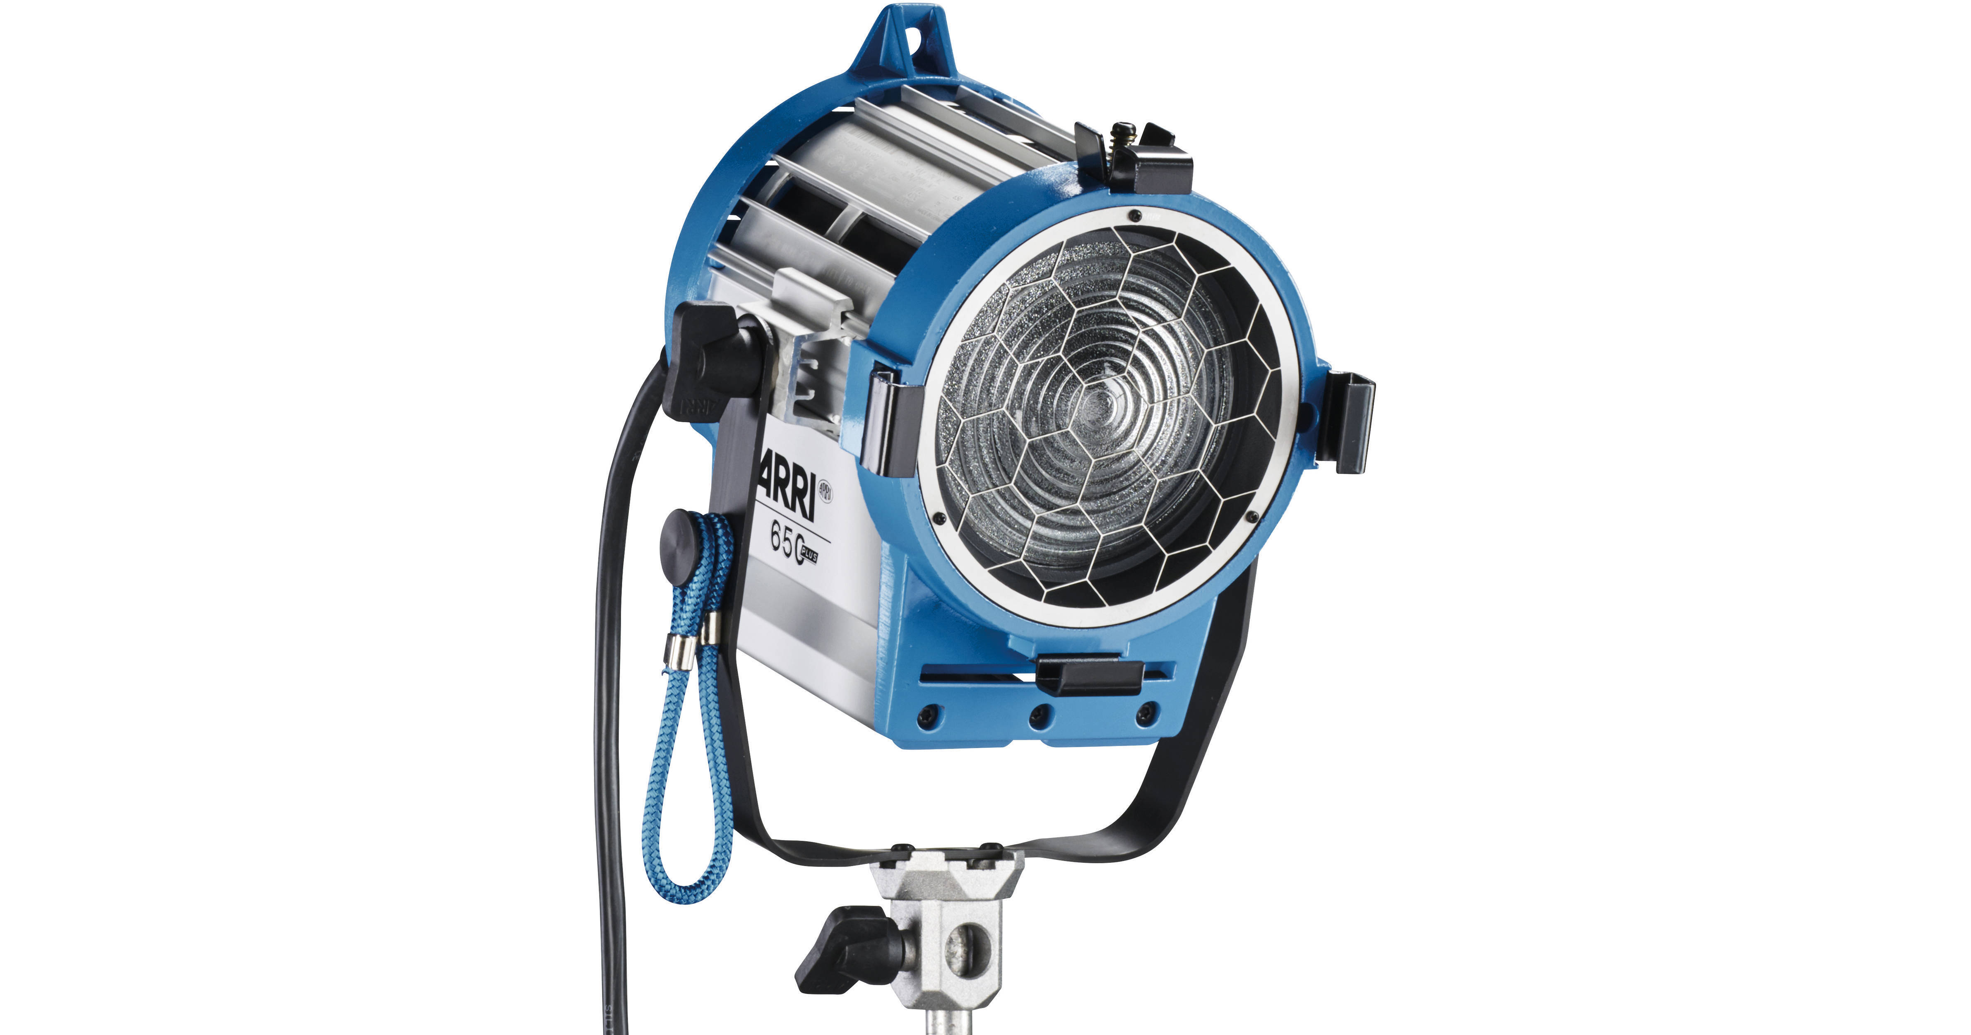
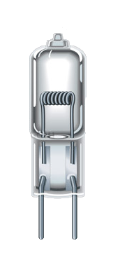
Tungsten
high power consumption
high heat
warm color
electricity passes through a metal filament
Notes:
G.1.c

Slide 14
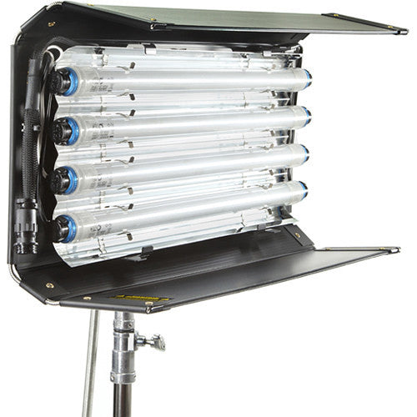
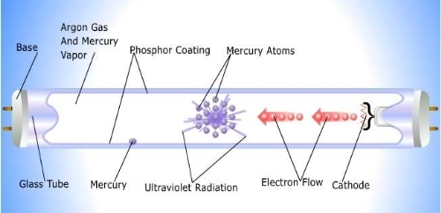
Flourescent
lower power consumption
low heat
various colors
high voltage electricity passes through a gas igniting a plasma
Notes:
G.1.b

Slide 15
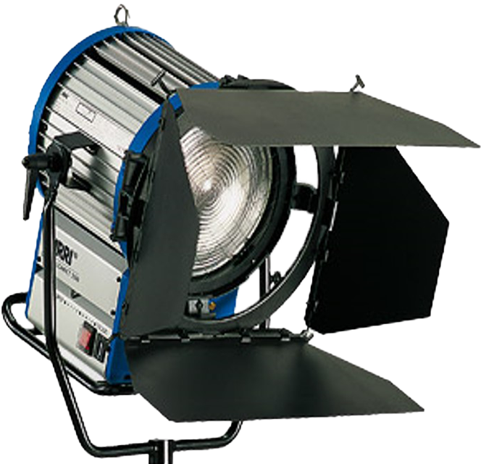
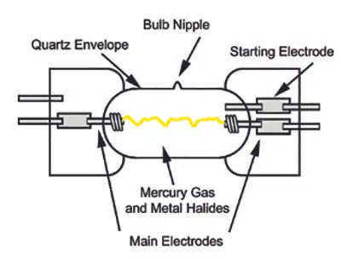
HMI
efficient use of power
moderate heat
cool color
high voltage electrical arc in a gas-filled chamber
Notes:
G.1.d

Slide 16
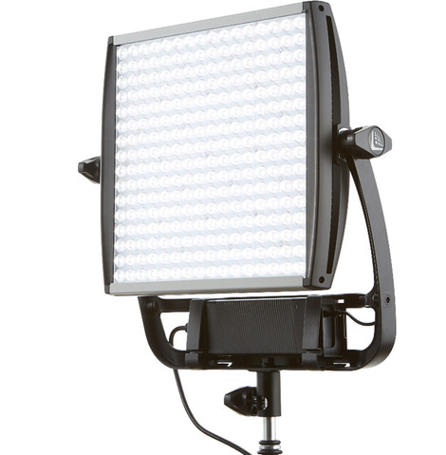
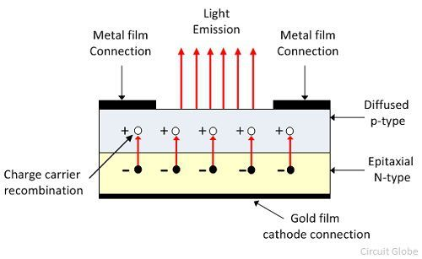
LED
low power consumption
moderate heat
various colors
electricity passes through a special semiconductor diode, producing photons
Notes:
G.1.a

Slide 17
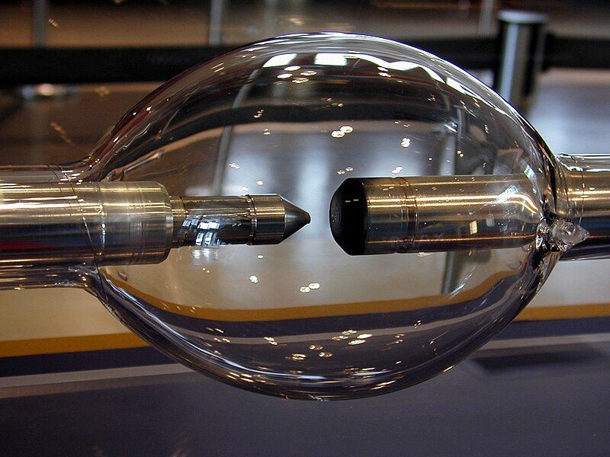
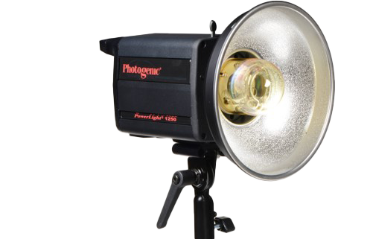
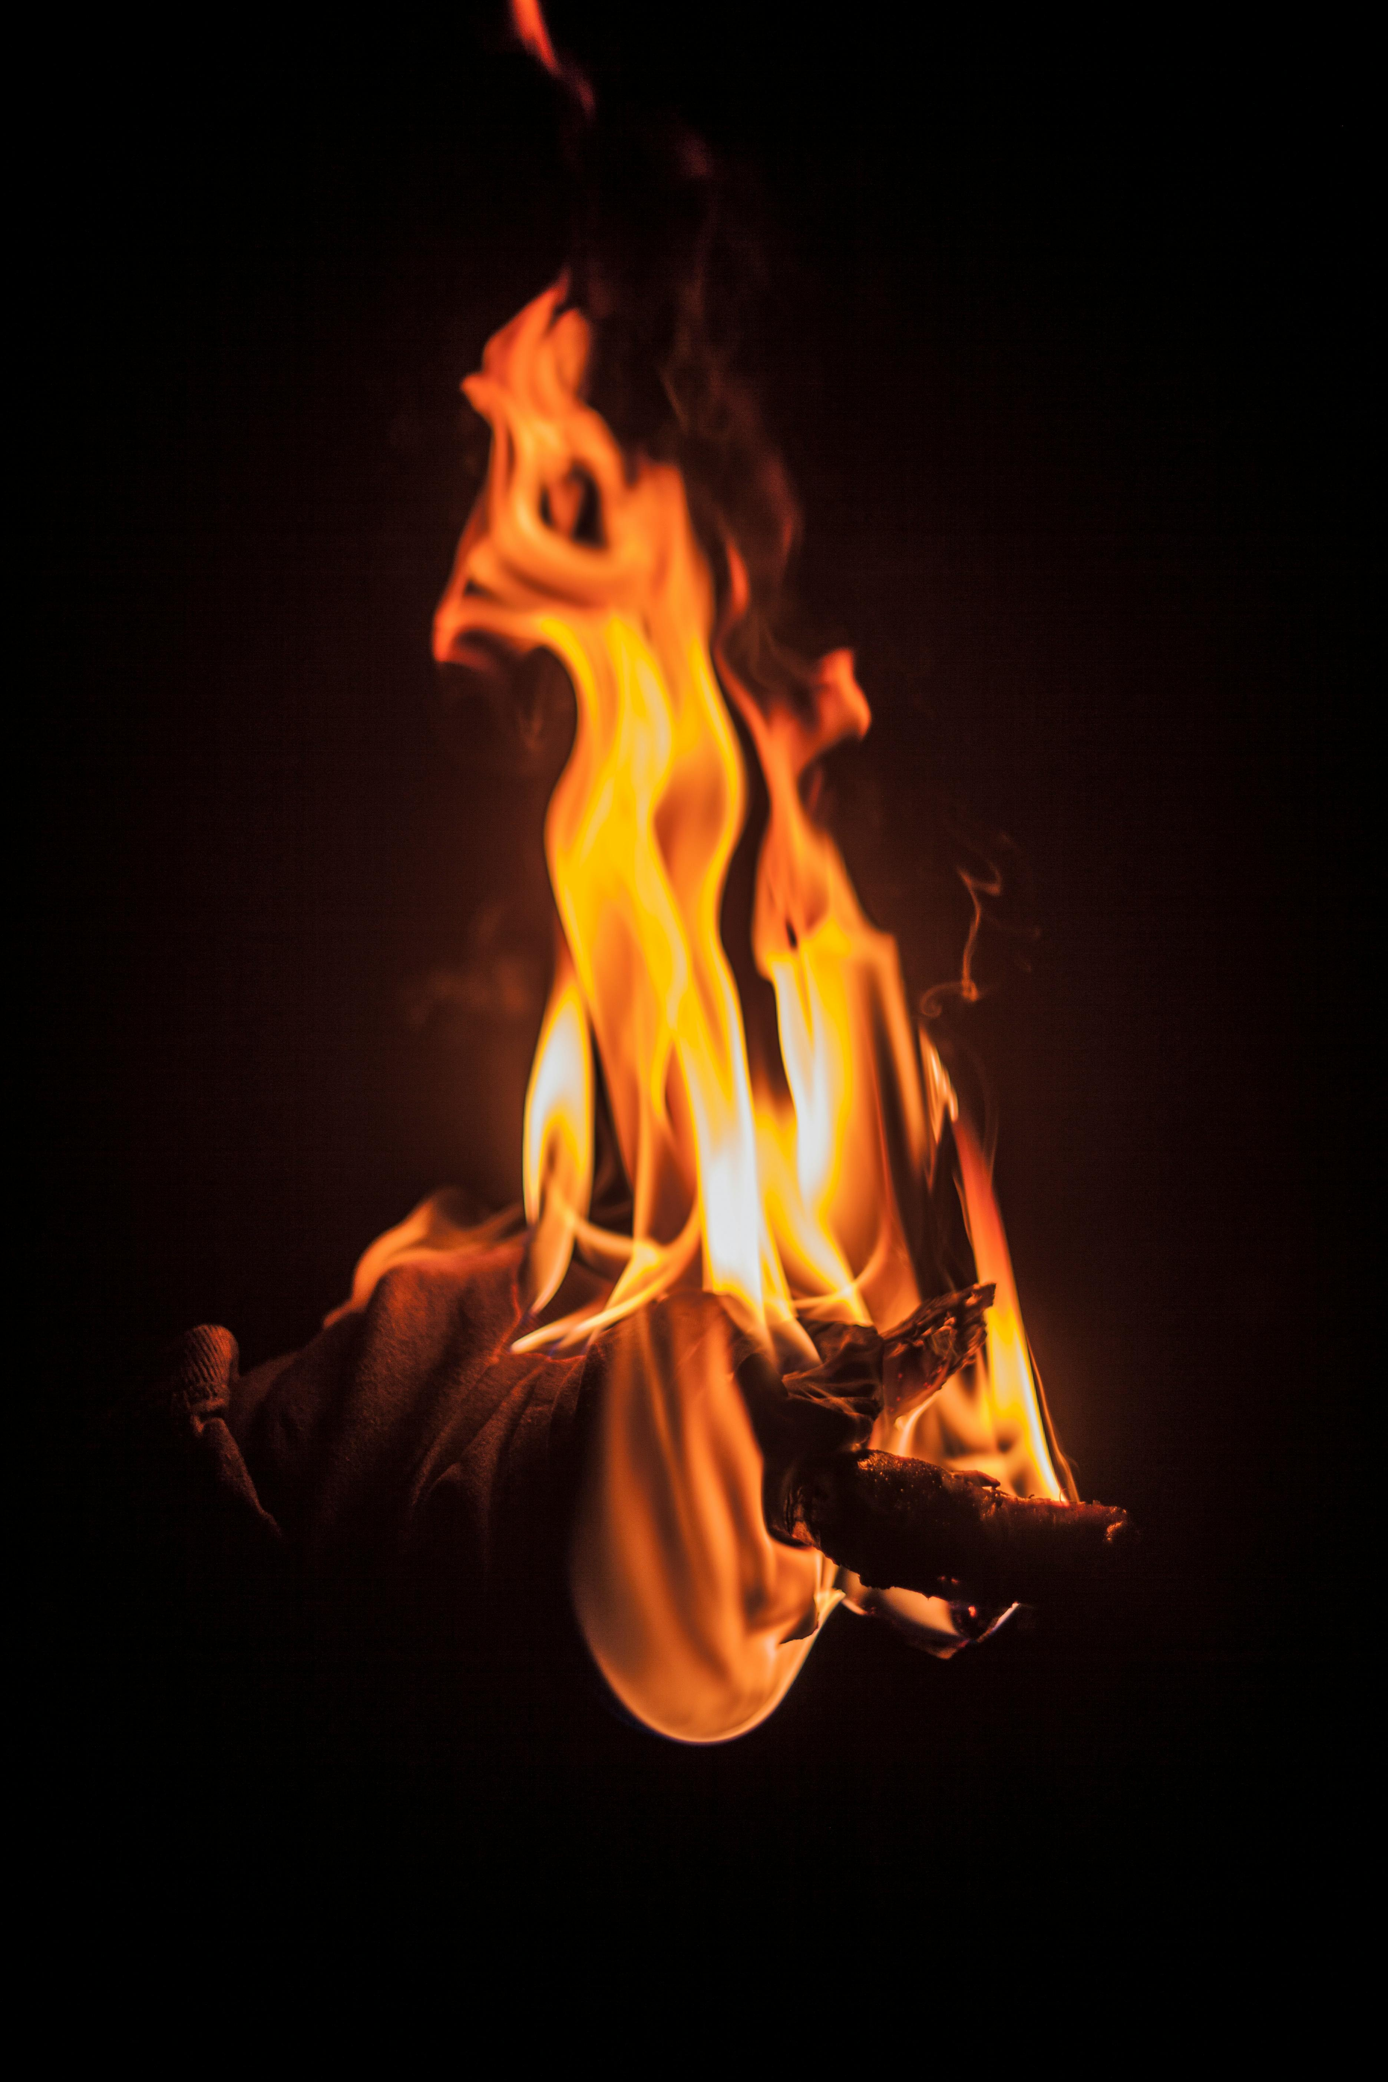
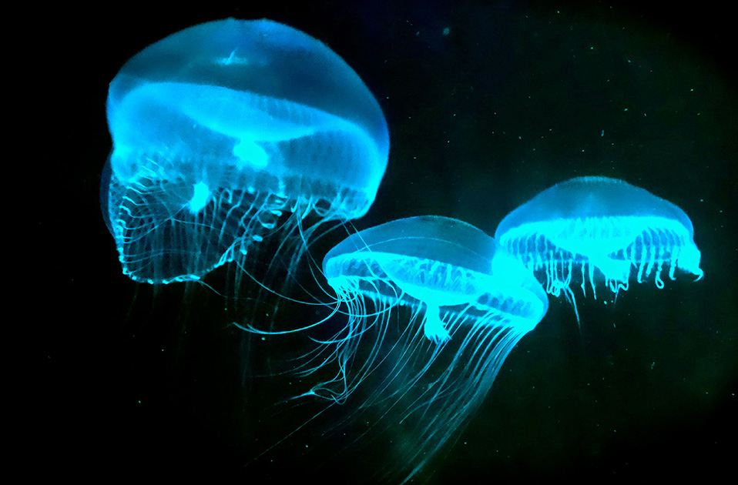
Other
strobe
arc- carbon, xenon, mercury vapor
laser
flame
chemical/bioluminescence
Notes:
G.1.e Next two slides: Natural light + flame + lamp/practicals

Slide 18
They all have their
pros/cons/unique characteristics
Notes:
G.2

Slide 19
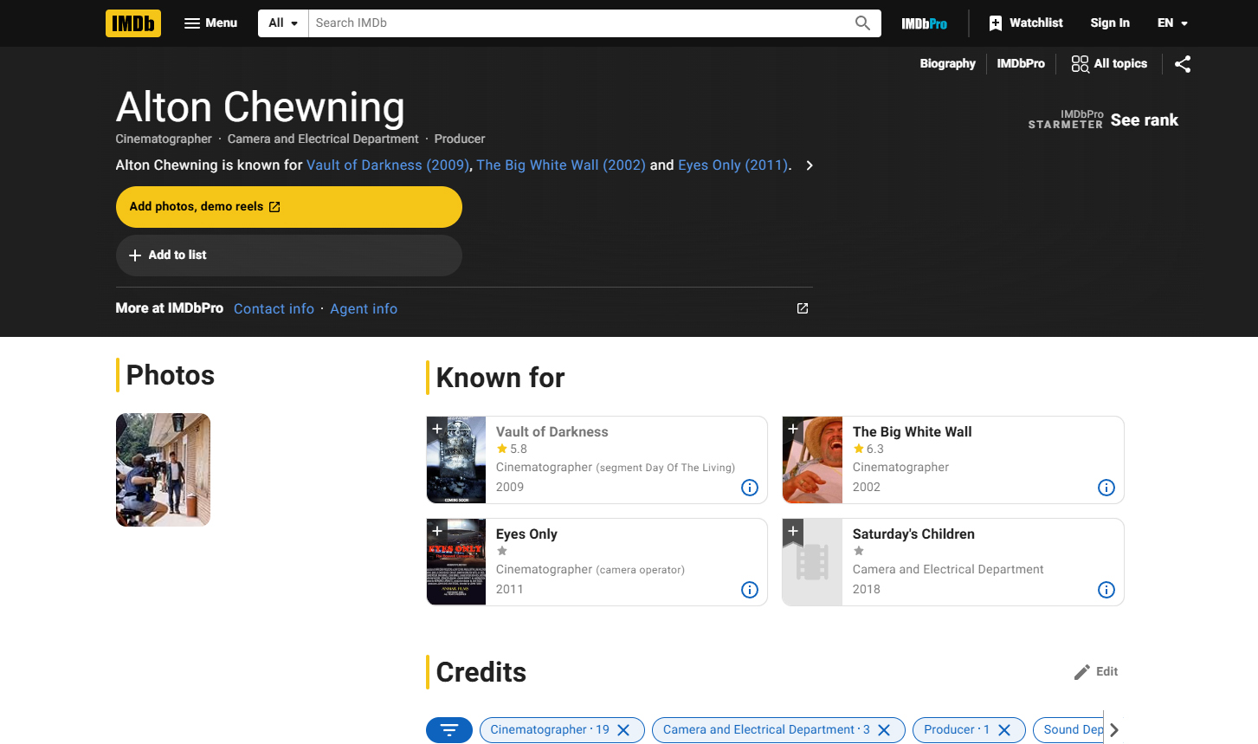
Guest Speaker
Alton Chewning
Director of Photography

