Slide 1
Getting Started
practice, practice, practice
Practice observation and analysis
Work on a crew
Hire a crew
Work at a rental house
Intern
Volunteer
Take more classes
Rent gear
Buy gear
Notes:
H. 3, 4

Slide 2
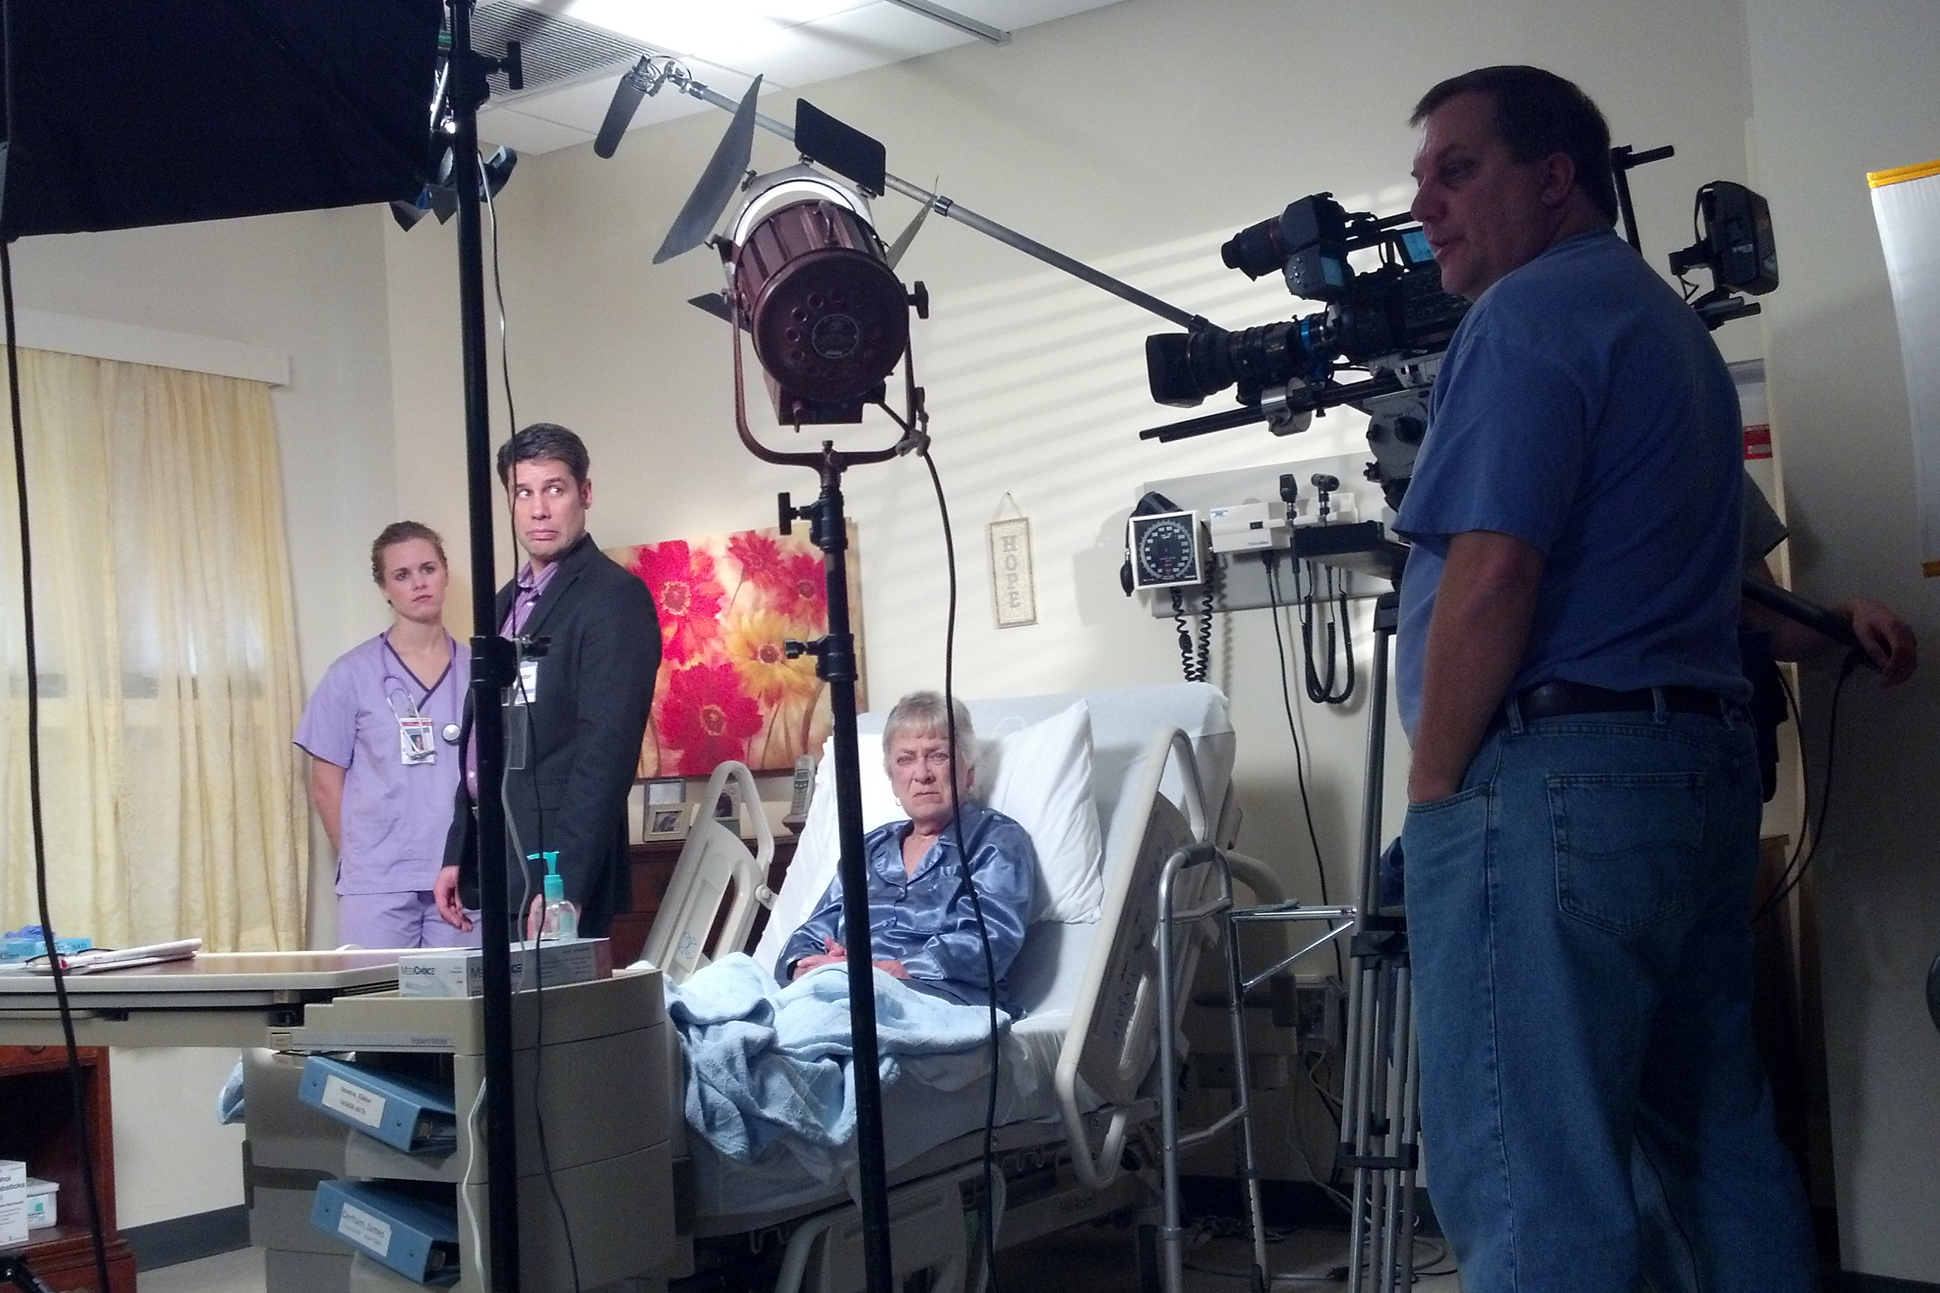
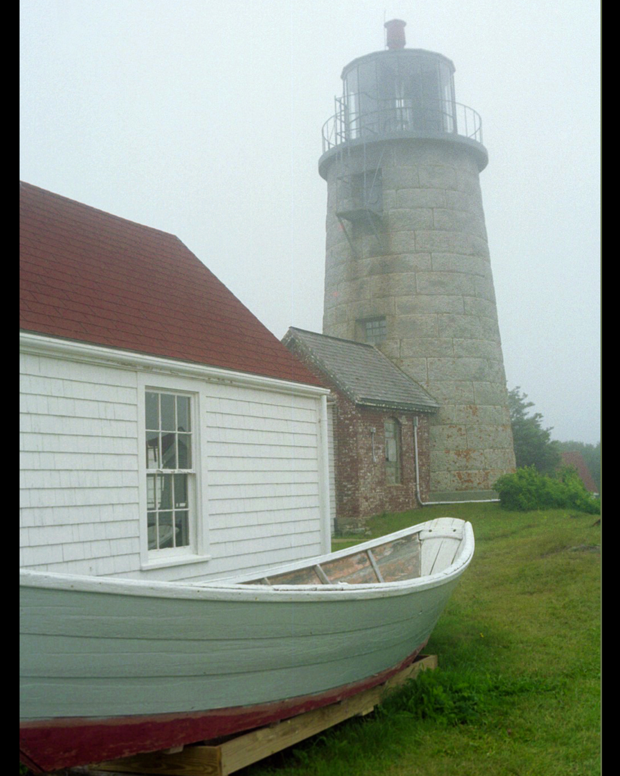
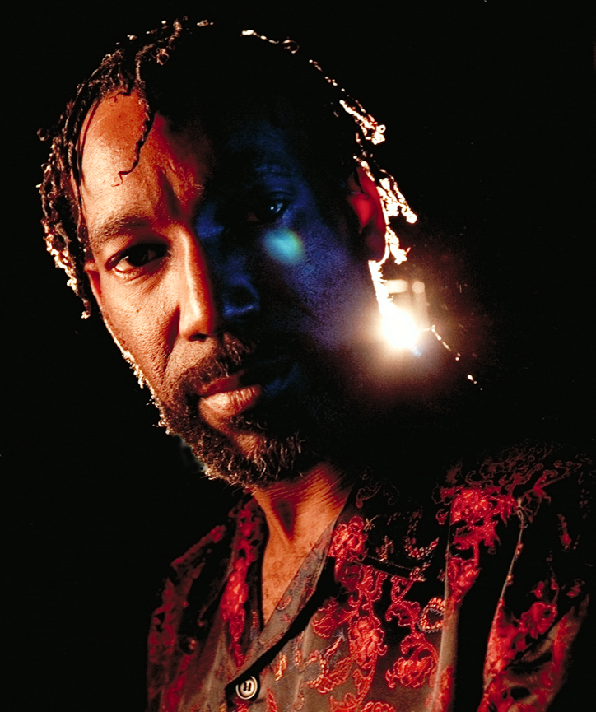
Getting Started
Observe
Analyze
Apply
Direction
Color
Soft/hard
Contrast
Reflectivity
practice, practice, practice
Practice observation and analysis
Work on a crew
Hire a crew
Work at a rental house
Intern
Volunteer
Take more classes
Rent gear
Buy gear
Find a scene/photo/painting you like
Determine how the light is working
Decide on the look for your scene
Determine what lighting can be used to achieve that look
Compare your results with your goal, adjust, try changes
Notes:
H. 3, 4

Slide 3
Getting Started
practice, practice, practice
Practice observation and analysis
Work on a crew
Hire a crew
Work at a rental house
Intern
Volunteer
Take more classes
Rent gear
Buy gear
rinse and repeat
Notes:
H. 3, 4

Slide 4
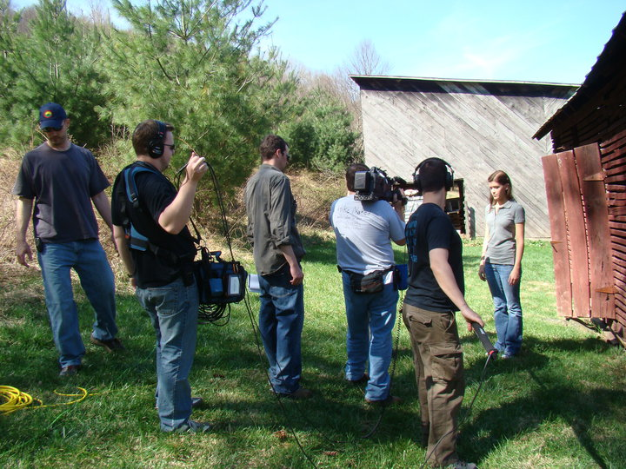
Getting Started
Networking
Directories
practice, practice, practice
Practice observation and analysis
Work on a crew
Hire a crew
Work at a rental house
Intern
Volunteer
Take more classes
Rent gear
Buy gear
Notes:
H. 3, 4

Slide 5
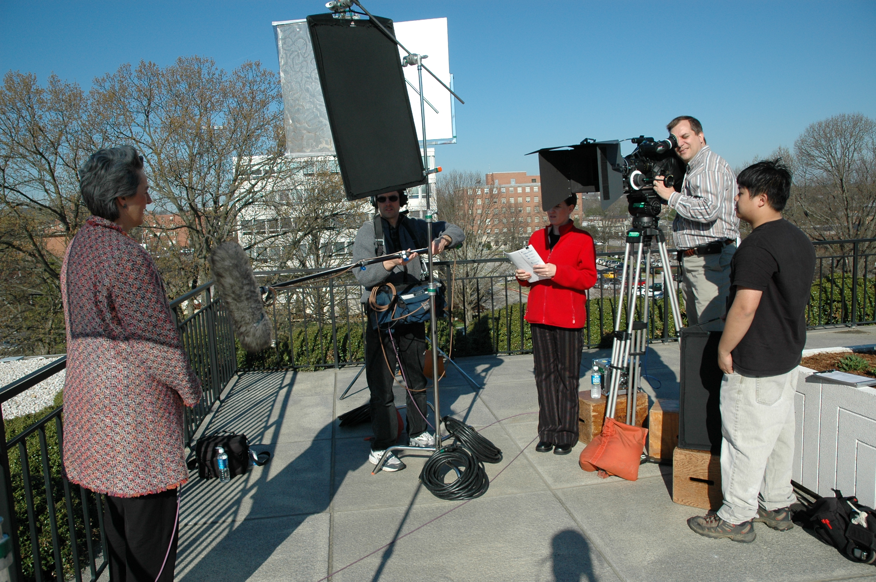
Getting Started
Production Companies
Agencies
Directories
Rental houses
Word of mouth
Budgeting
practice, practice, practice
Practice observation and analysis
Work on a crew
Hire a crew
Work at a rental house
Intern
Volunteer
Take more classes
Rent gear
Buy gear
Notes:
H. 3, 4

Slide 6
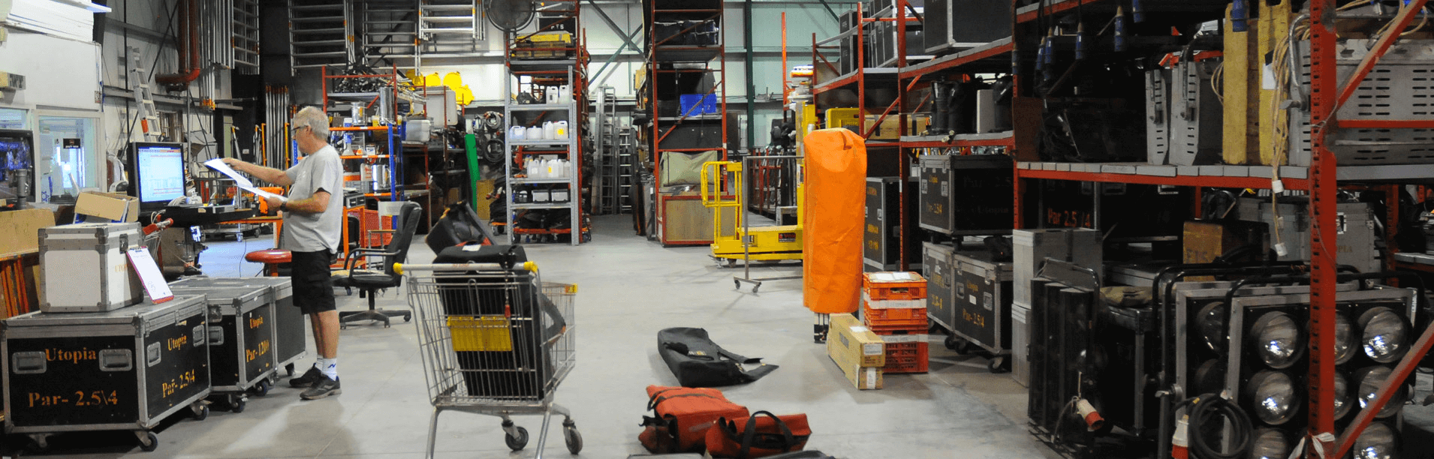
Getting Started
Internship
Part time/full time
Cleaning, checking, inventor, low pay
Learn the equipment
Get to know people
practice, practice, practice
Practice observation and analysis
Work on a crew
Hire a crew
Work at a rental house
Intern
Volunteer
Take more classes
Rent gear
Buy gear
Notes:
H. 3, 4

Slide 7
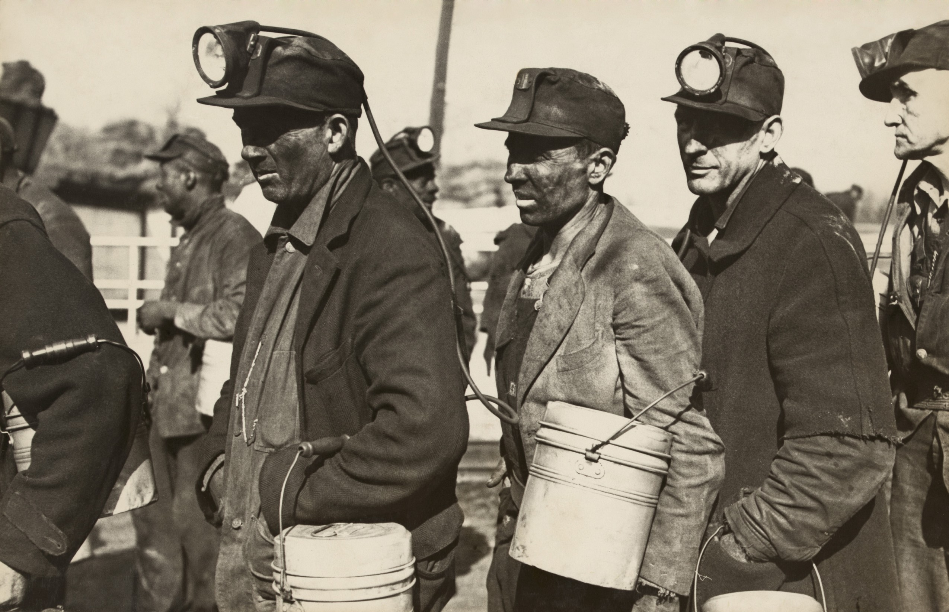
Getting Started
Little or no pay
Meet people
Can turn into paid work
practice, practice, practice
Practice observation and analysis
Work on a crew
Hire a crew
Work at a rental house
Intern
Volunteer
Take more classes
Rent gear
Buy gear
Notes:
H. 3, 4

Slide 8
Getting Started
Build relationships
Strengthen skills
Be creative
practice, practice, practice
Practice observation and analysis
Work on a crew
Hire a crew
Work at a rental house
Intern
Volunteer
Take more classes
Rent gear
Buy gear
Notes:
H. 3, 4

Slide 9
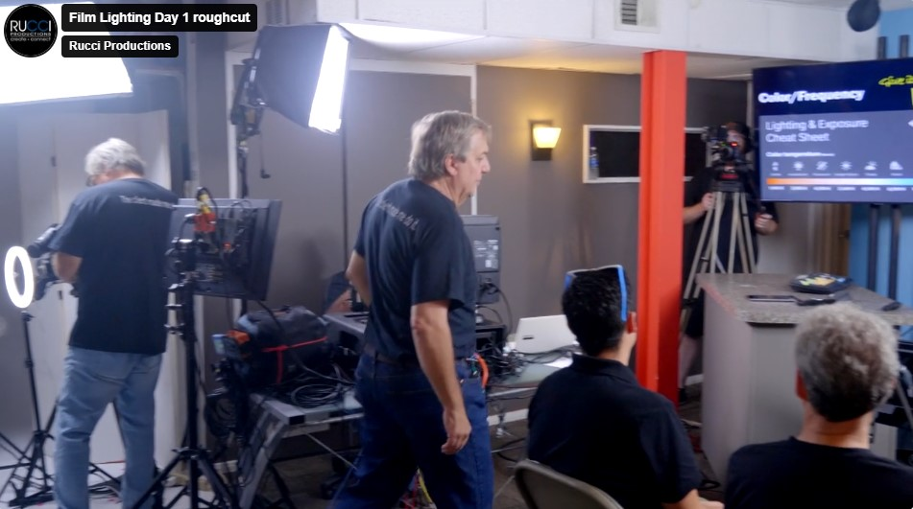
Getting Started
Workshops
Community Colleges
Universities
Studios
Online
practice, practice, practice
Practice observation and analysis
Work on a crew
Hire a crew
Work at a rental house
Intern
Volunteer
Take more classes
Rent gear
Buy gear
Notes:
H. 3, 4

Slide 10
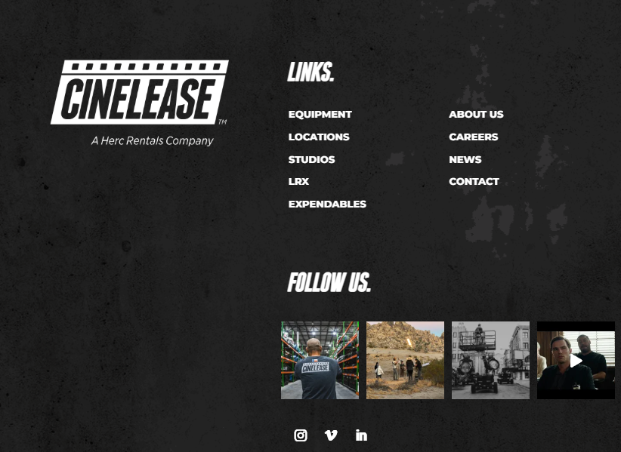
Getting Started
As part of paid client job
For testing
practice, practice, practice
Practice observation and analysis
Work on a crew
Hire a crew
Work at a rental house
Intern
Volunteer
Take more classes
Rent gear
Buy gear
Notes:
H. 3, 4

Slide 11
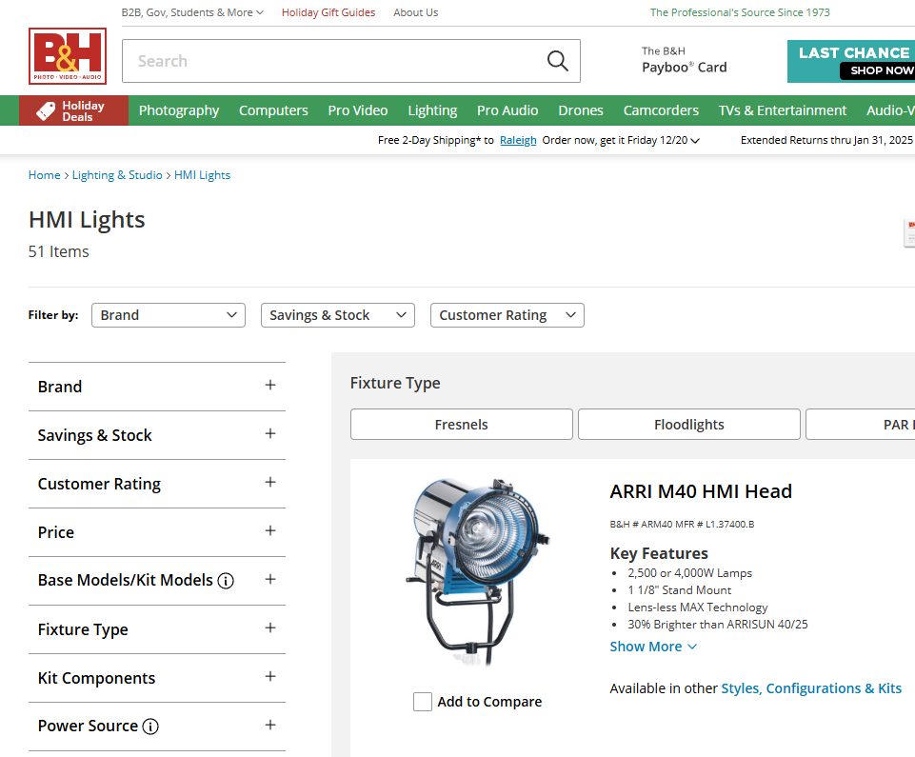
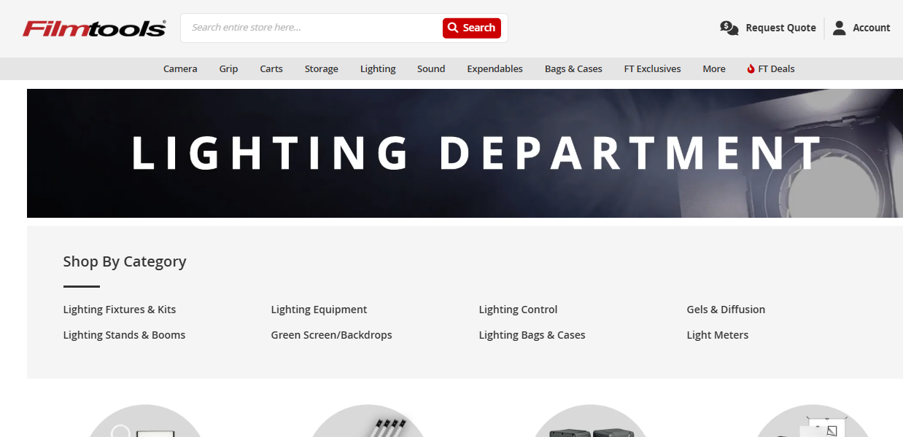
Getting Started
New
Used
Trade
practice, practice, practice
Practice observation and analysis
Work on a crew
Hire a crew
Work at a rental house
Intern
Volunteer
Take more classes
Rent gear
Buy gear
Notes:
H. 3, 4

Slide 12
Let’s try it
Observe
Find a scene/photo/painting you like
Determine how the light is working
Decide on the look for your scene
Determine what lighting can be used to achieve that look
Compare your results with your goal, adjust, try changes
I just watched Dune
It’s mystical and ethereal with layers of soft warm colors and shimmering highlights
A magic dreamlike cove
Low key, warm, high contrast, soft
Let’s not go there
Analyze
Apply
Notes:
H. 3, 4

