Slide 1
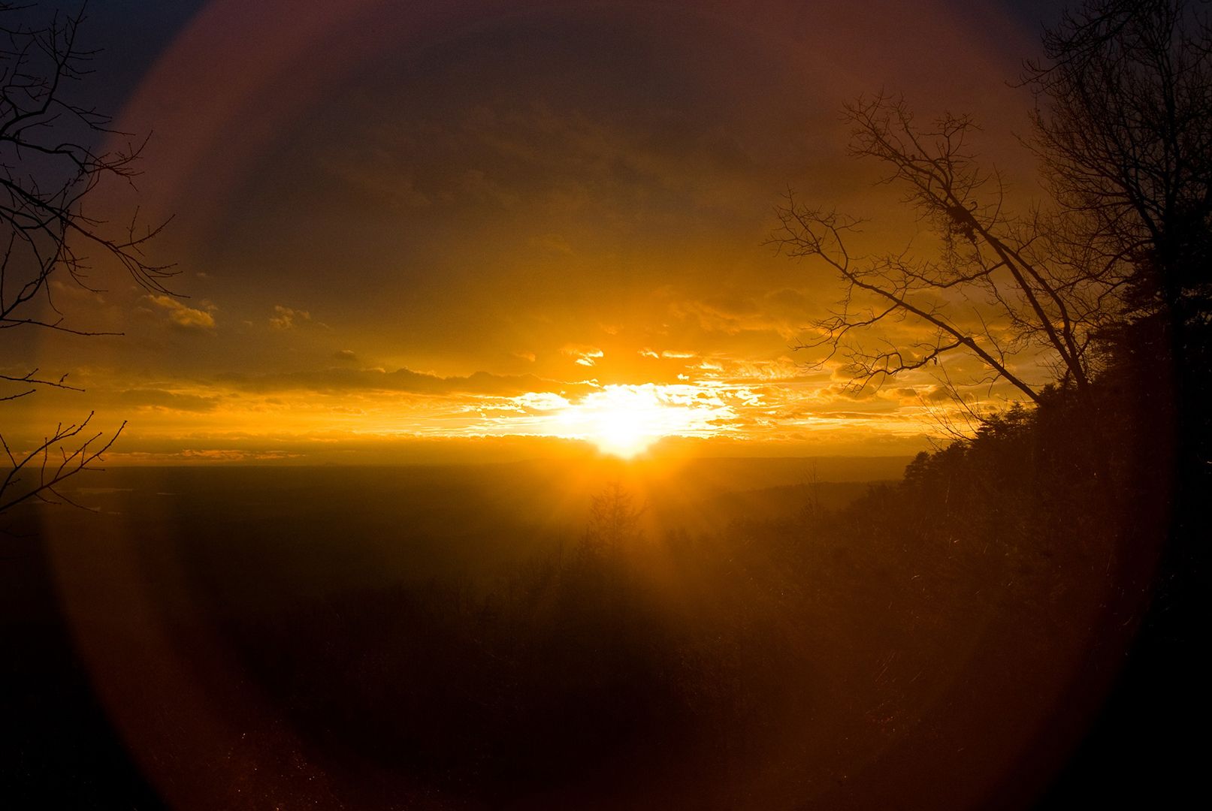
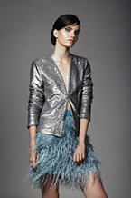
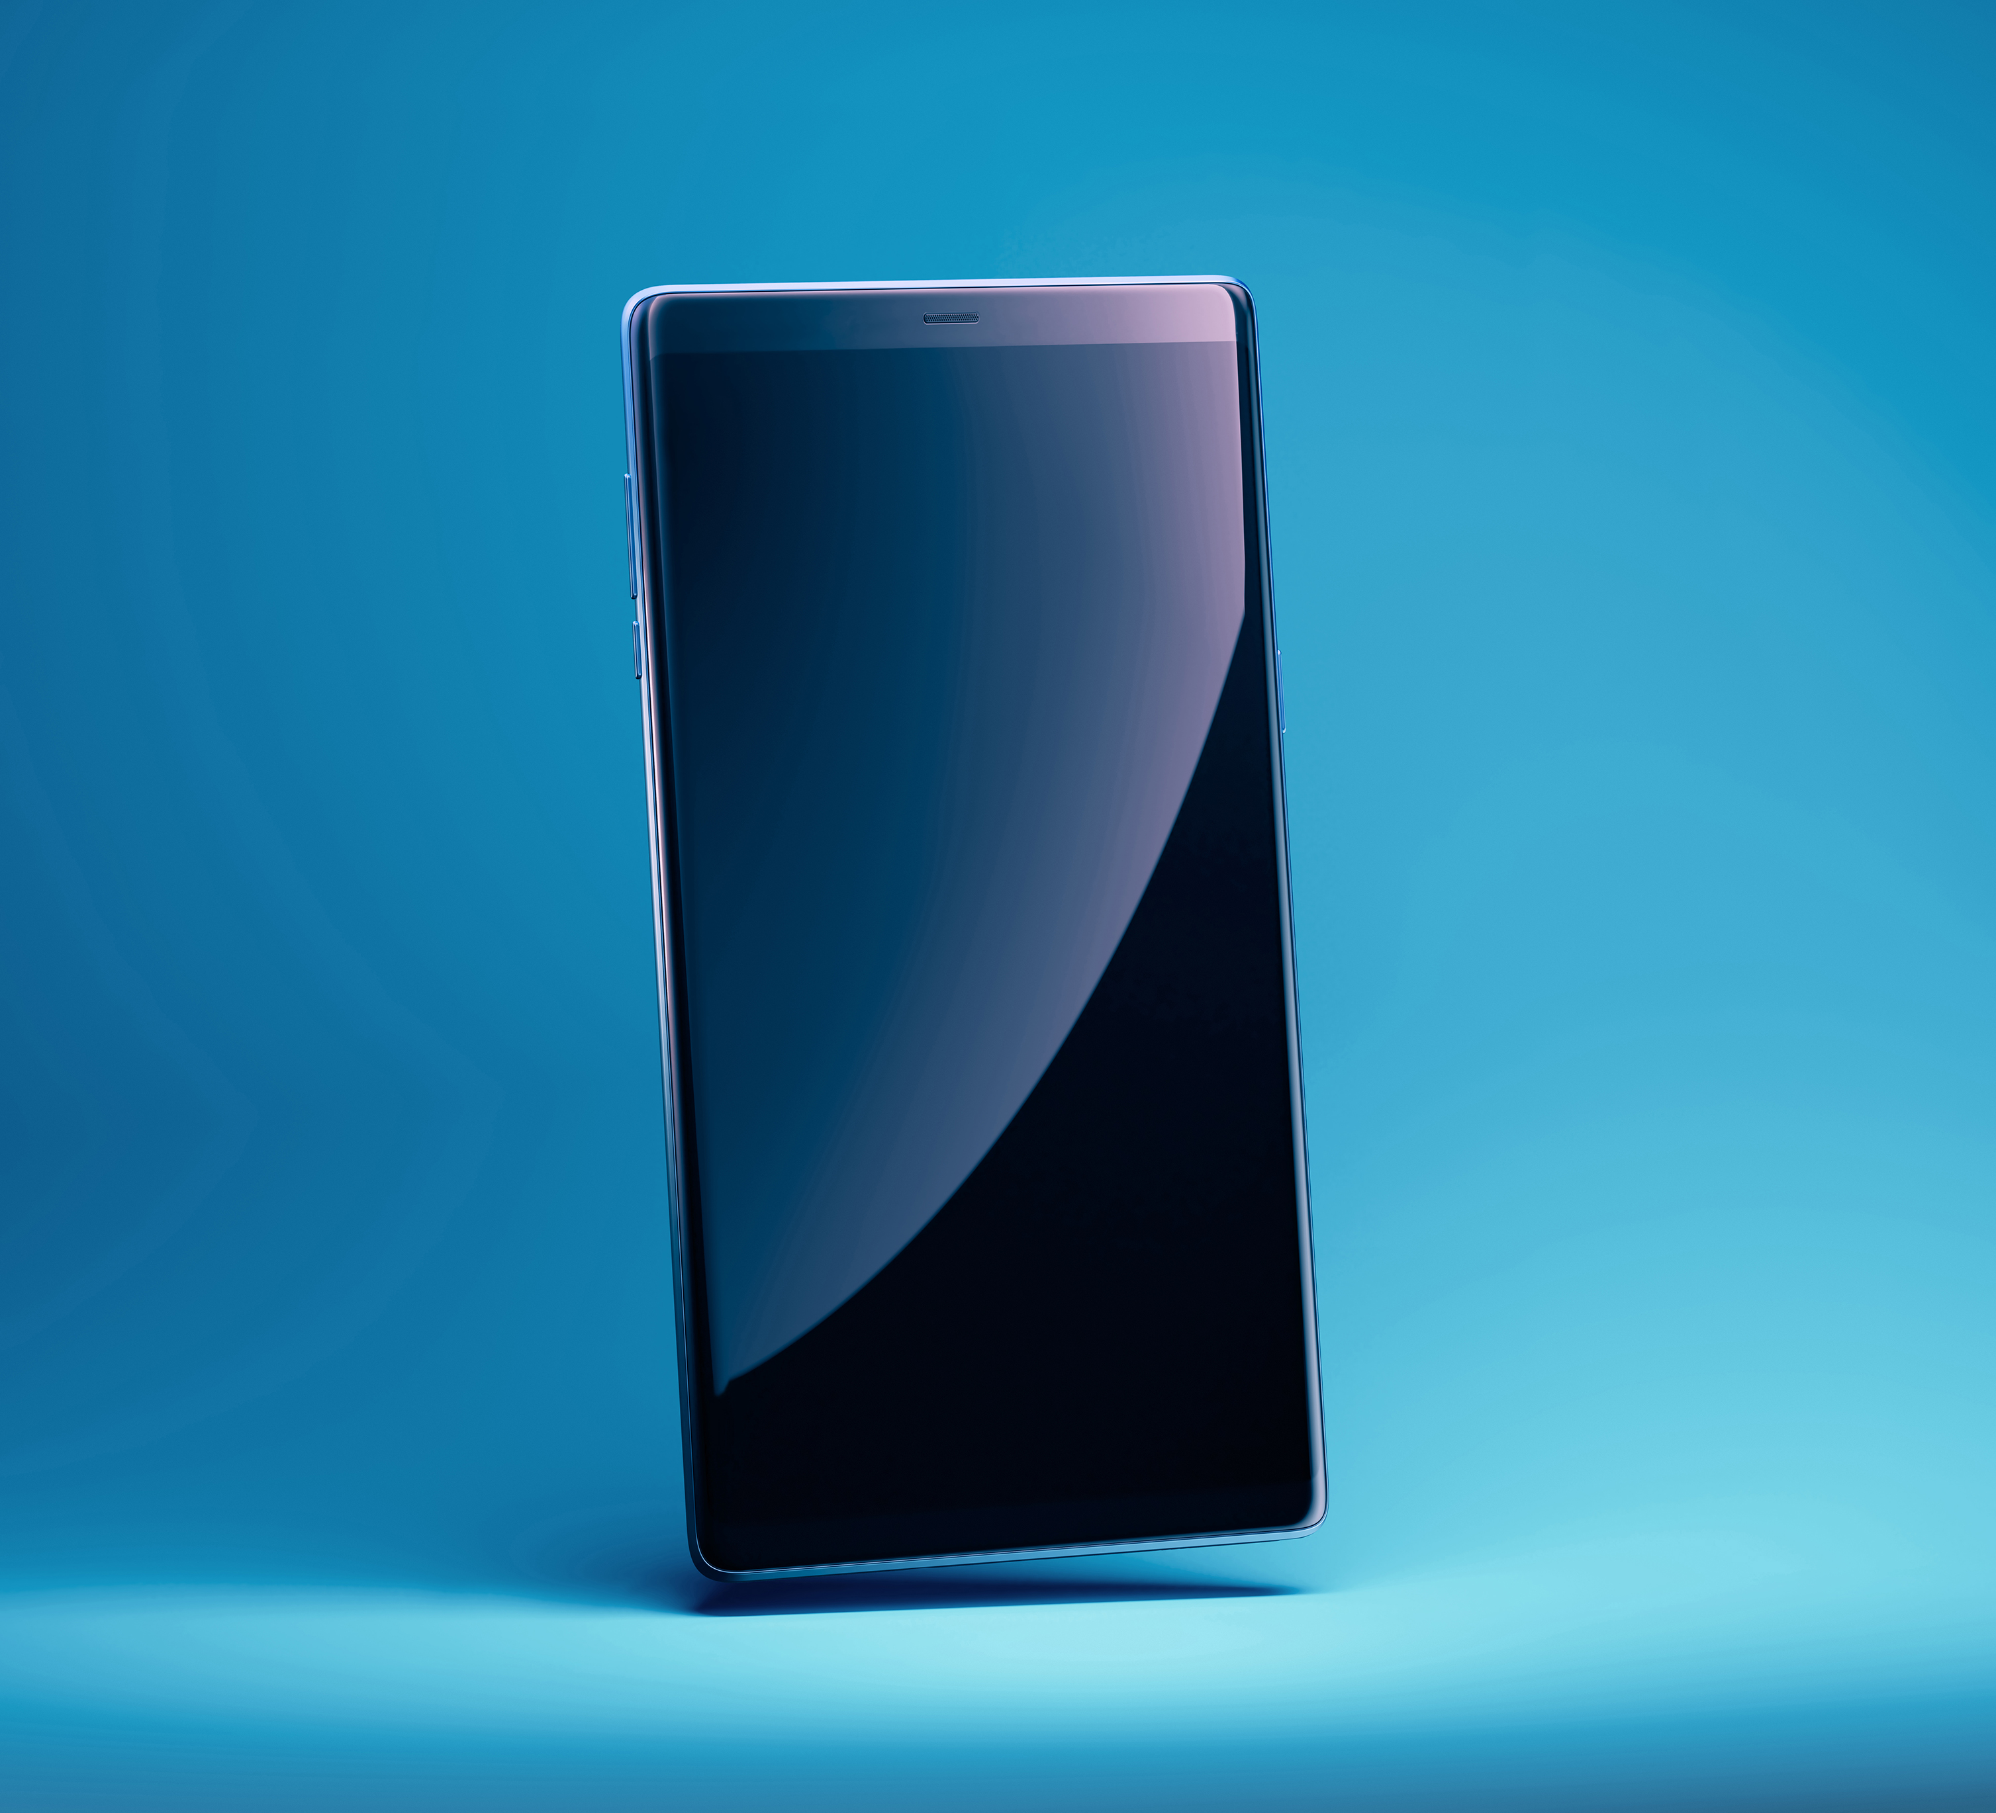
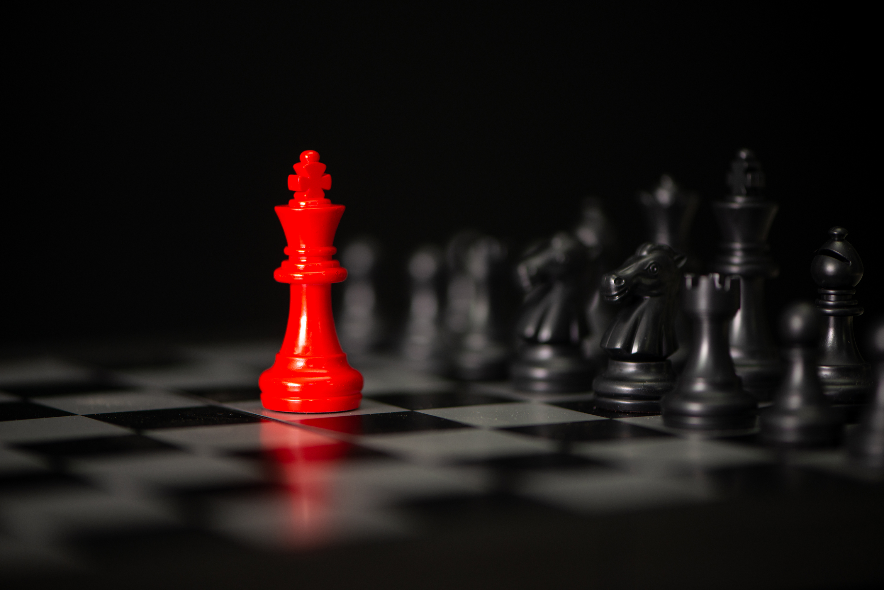
What’s it take to make a photographic image?

Slide 2
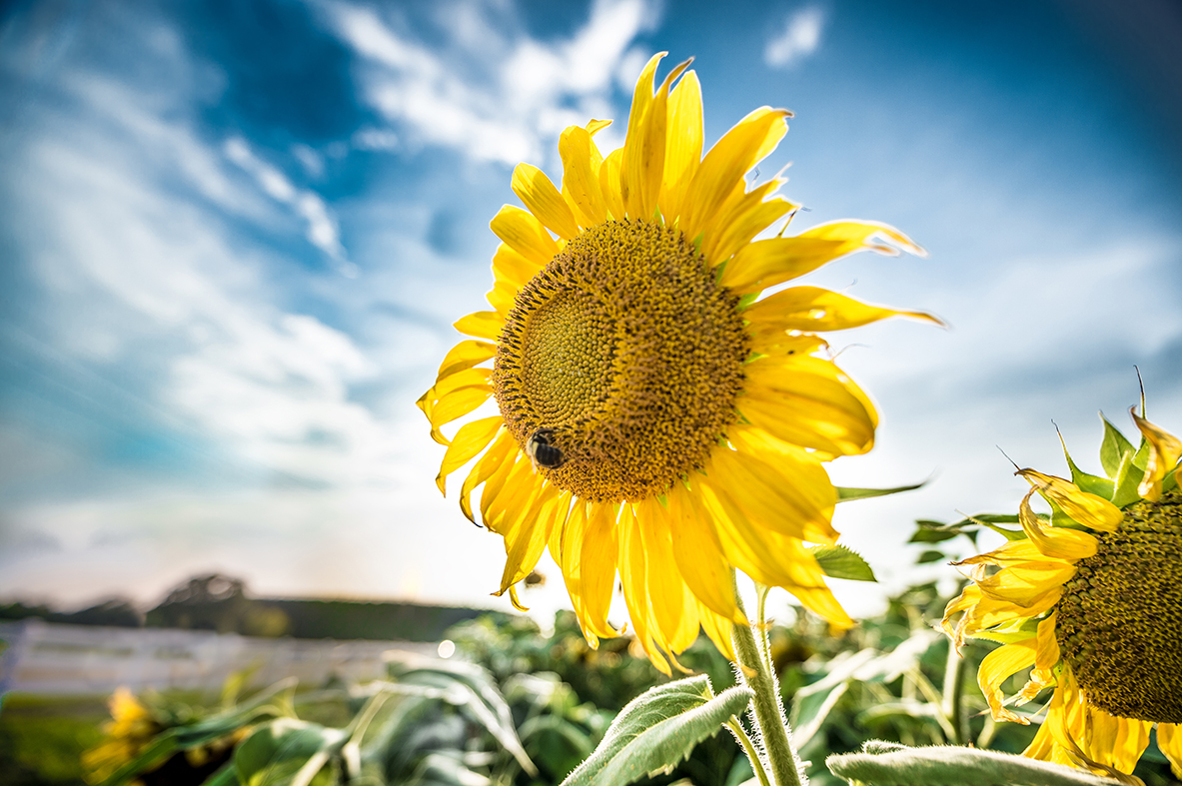
With light
Without light
Notes:
1. d

Slide 3
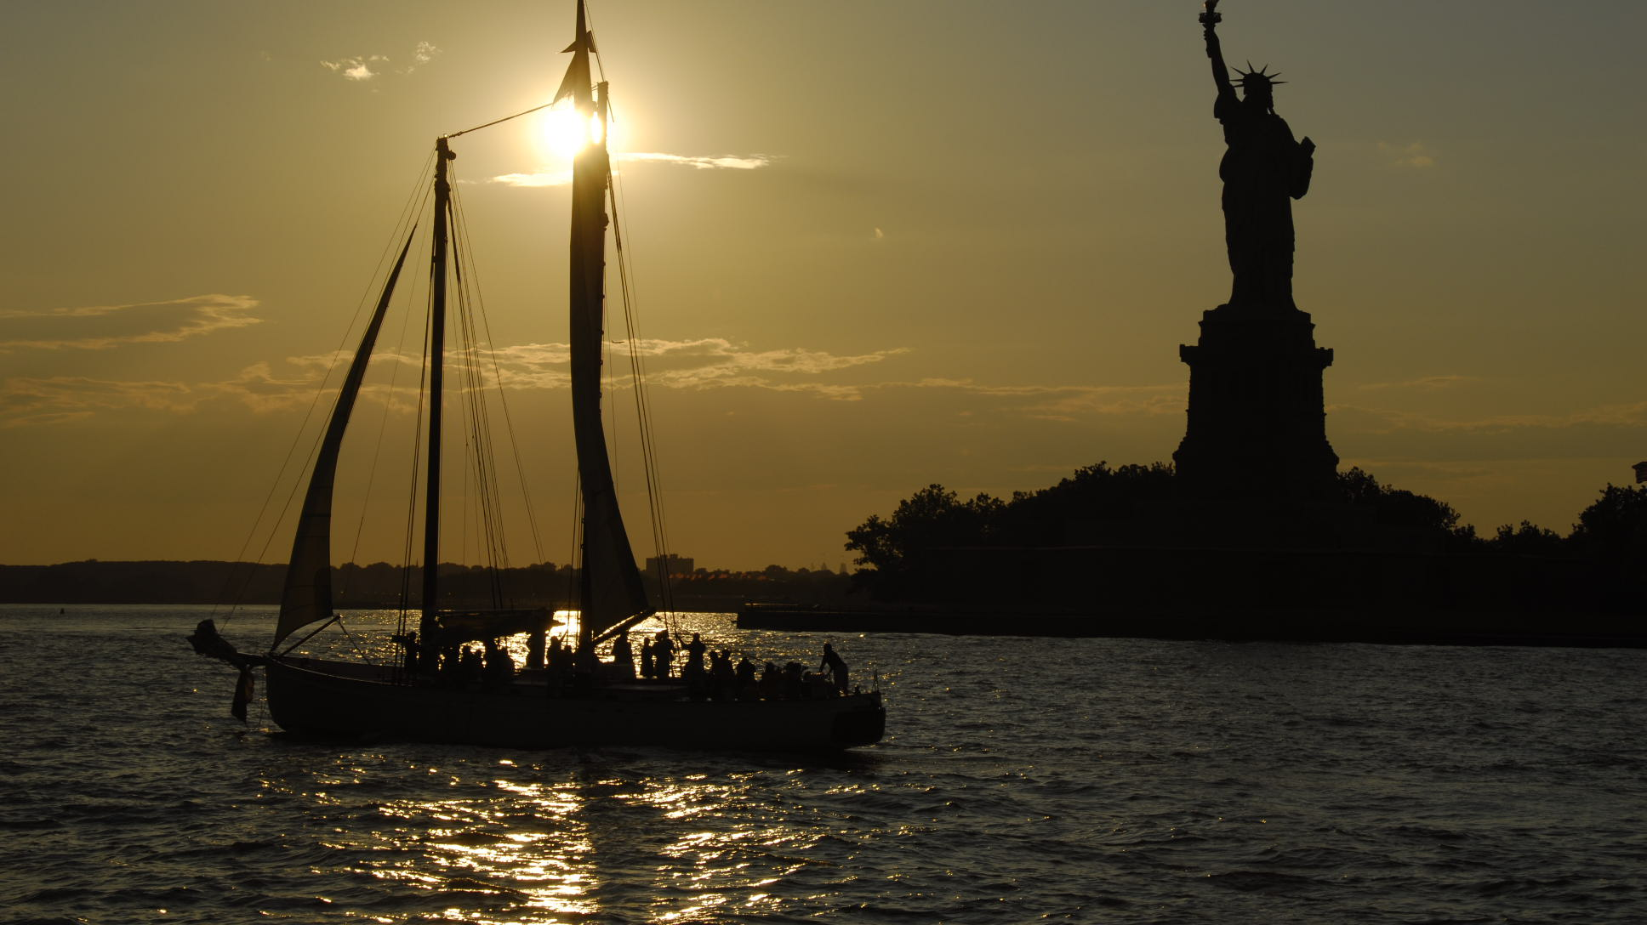
Source(s) Where Reacting with subject Variances in sources Effect

Slide 4
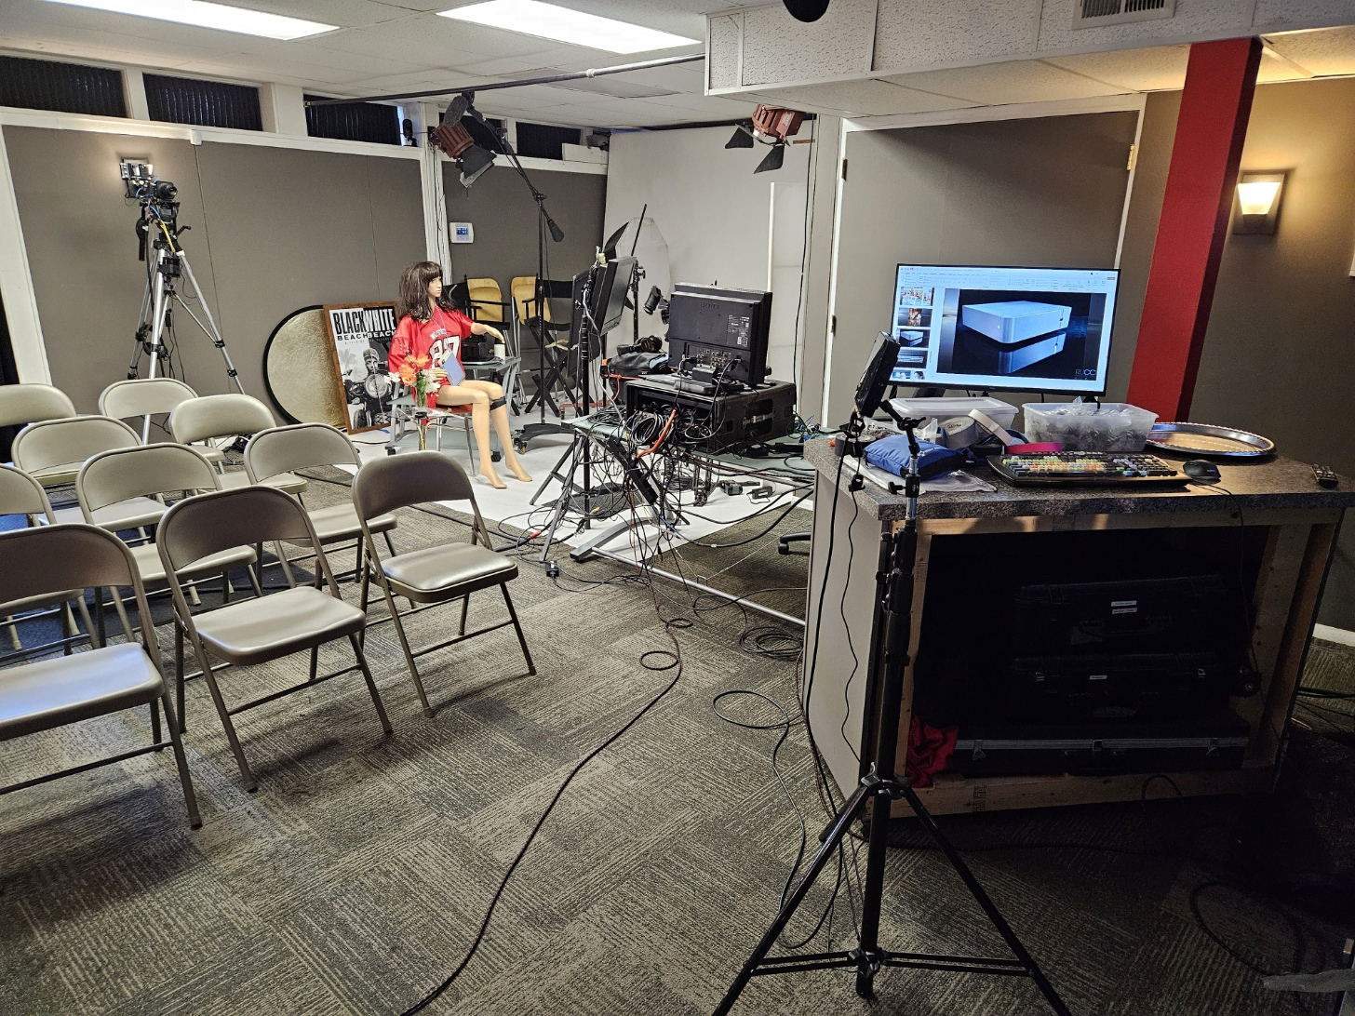
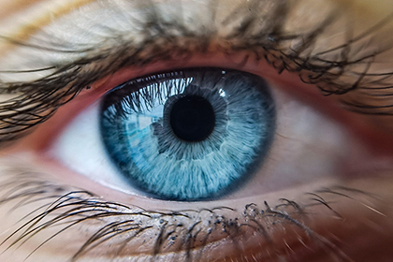
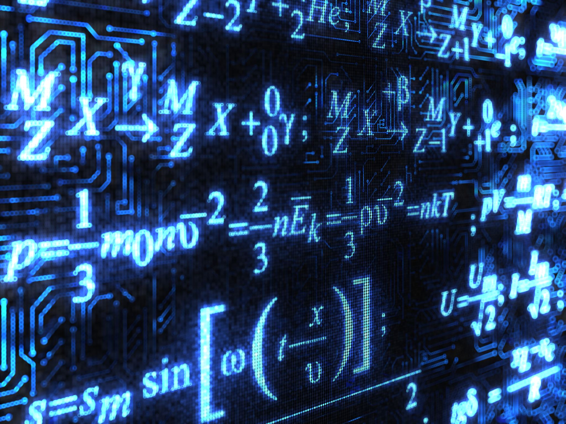
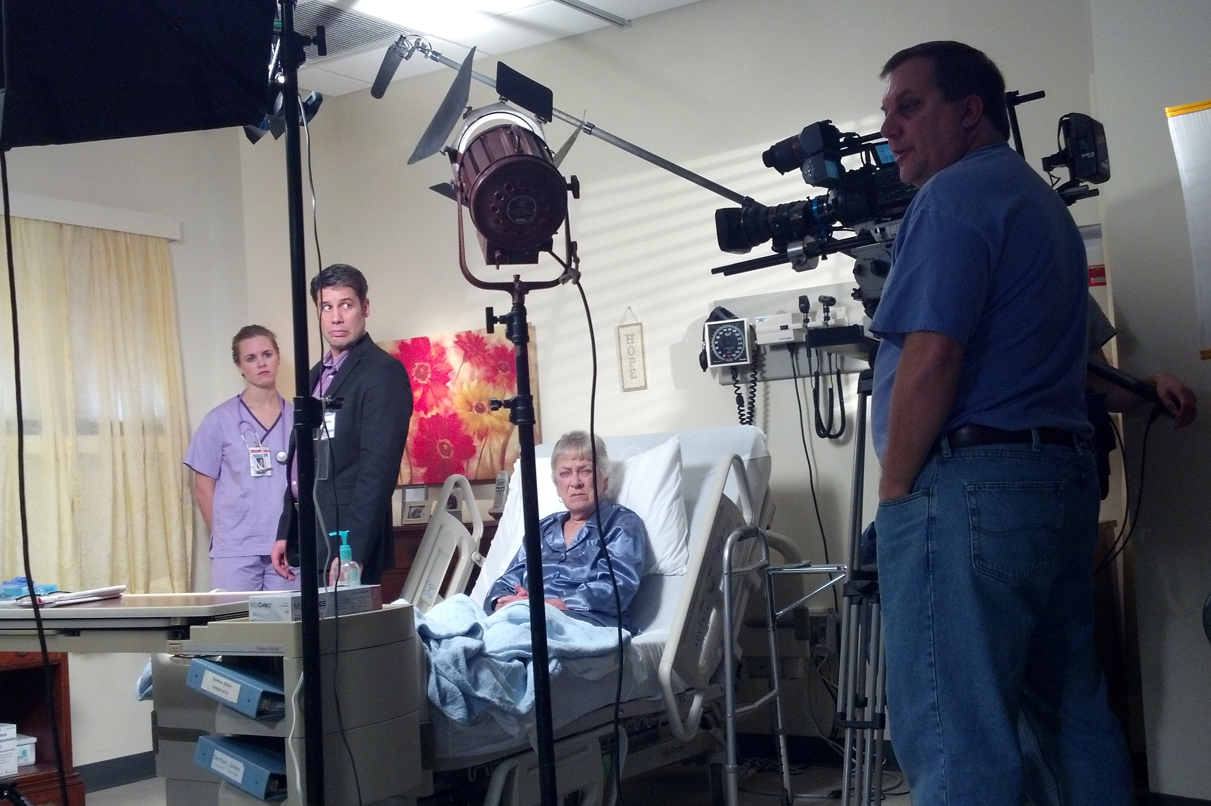
Observe
OBJECTIVES
Analyze
Apply
Notes:
To be able to understand how light affects the world & how it affects everything we and the camera see.
How we can control lighting & various methods of control.
Complete understanding of why we do what we do when it comes to lighting.
Really understanding lighting & applying the principles to any sort of project.
Once you learn lighting, you can observe it anywhere & analyze it. Without light, there is nothing.
Lighting enhances everything & plays a critical role in everything when it comes to film & photography.
Attributes, observation, analysis, application!

Slide 5
Part One: What are the Basic Qualities of Light?
Key Discussion Points:
Power/Intensity
Color/Frequency
Direction
Reflectivity
Broadness/Diffusion

Slide 6
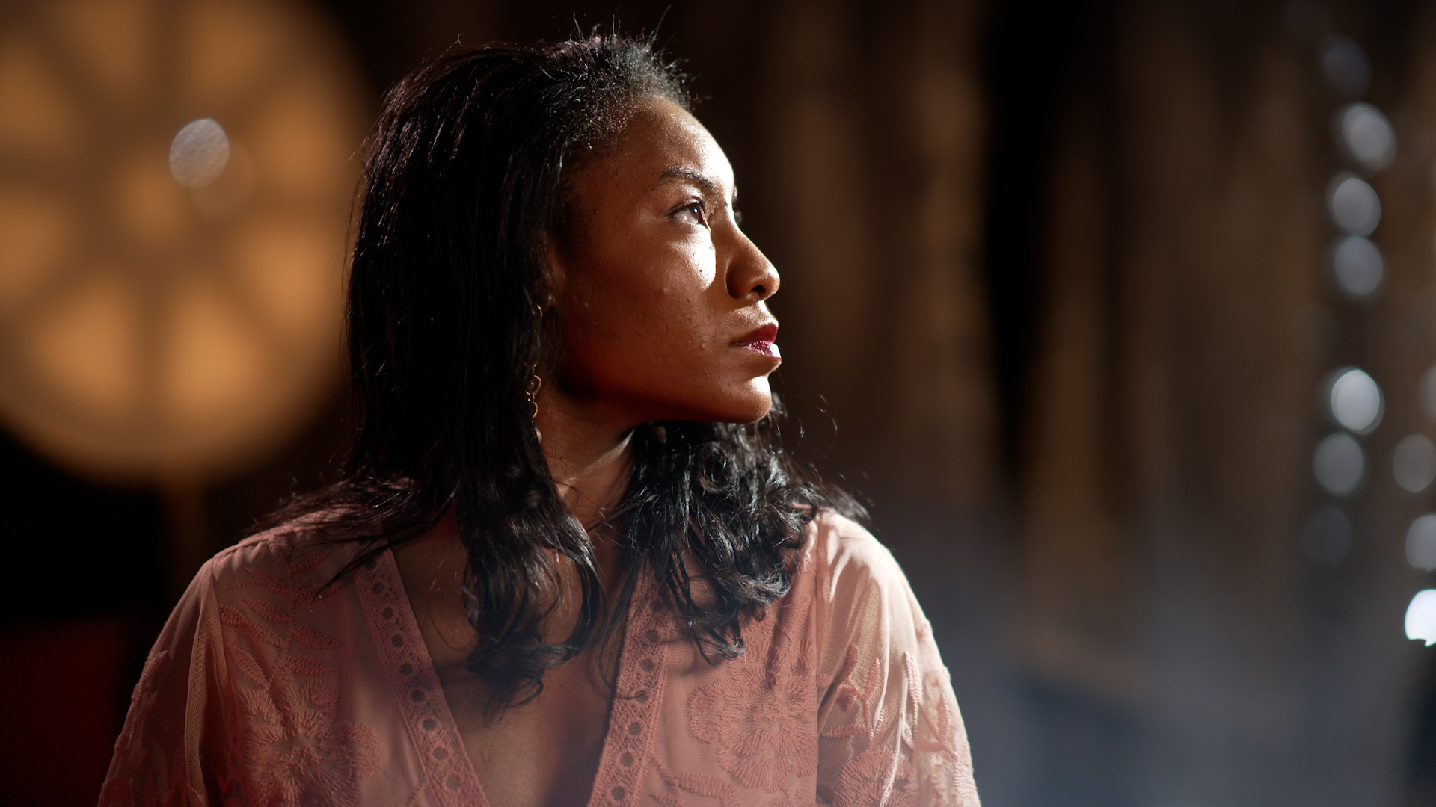
Is there color contrast and how does that affect the scene?
How does the reflectivity of the objects in the scene effect the exposure of those objects and the overall contrast of the scene?
What hard or soft light sources do you see?
How is the light being controlled or shaped to confine what it hits and what is left in shadow?
How does the motion of elements in the scene change the overall effect?
What is the overall mood created by this lighting?
How does the motion of elements in the scene change the overall effect?
What is the overall mood created by this lighting?
This slide and video is available in the addendum resources if you’d like to review it later.
Notes:
Here’s a scene from one of our final classes (note my voice is magically better). When we get there, we’ll go light by light and build up the scene. In the meantime, look at what’s going on here and see what kind of analysis you can make of the lighting in this scene.
This slide and video is available in the addendum resources if you’d like to review it later.

Slide 7
How many light sources are there?
What direction is the light coming from?
What are the relative intensities of the lights and the resulting contrast ration of the various parts of the scene?
What color are the lights?
Is there color contrast and how does that affect the scene?
How does the reflectivity of the objects in the scene effect the exposure of those objects and the overall contrast of the scene?
What hard or soft light sources do you see?
How is the light being controlled or shaped to confine what it hits and what is left in shadow?
How does the motion of elements in the scene change the overall effect?
What is the overall mood created by this lighting?
How does the motion of elements in the scene change the overall effect?
What is the overall mood created by this lighting?
This slide and video is available in the addendum resources if you’d like to review it later.
Notes:
Here’s a scene from one of our final classes (note my voice is magically better). When we get there, we’ll go light by light and build up the scene. In the meantime, look at what’s going on here and see what kind of analysis you can make of the lighting in this scene.
This slide and video is available in the addendum resources if you’d like to review it later.

Slide 8
How many light sources are there?
What direction is the light coming from?
What are the relative intensities of the lights and the resulting contrast ration of the various parts of the scene?
What color are the lights?
Is there color contrast and how does that affect the scene?
How does the reflectivity of the objects in the scene effect the exposure of those objects and the overall contrast of the scene?
What hard or soft light sources do you see?
How is the light being controlled or shaped to confine what it hits and what is left in shadow?
How does the motion of elements in the scene change the overall effect?
What is the overall mood created by this lighting?
How does the motion of elements in the scene change the overall effect?
What is the overall mood created by this lighting?
This slide and video is available in the addendum resources if you’d like to review it later.
Notes:
Here’s a scene from one of our final classes (note my voice is magically better). When we get there, we’ll go light by light and build up the scene. In the meantime, look at what’s going on here and see what kind of analysis you can make of the lighting in this scene.
This slide and video is available in the addendum resources if you’d like to review it later.

Slide 9
How many light sources are there?
What direction is the light coming from?
What are the relative intensities of the lights and the resulting contrast ration of the various parts of the scene?
What color are the lights?
Is there color contrast and how does that affect the scene?
How does the reflectivity of the objects in the scene effect the exposure of those objects and the overall contrast of the scene?
What hard or soft light sources do you see?
How is the light being controlled or shaped to confine what it hits and what is left in shadow?
How does the motion of elements in the scene change the overall effect?
What is the overall mood created by this lighting?
How does the motion of elements in the scene change the overall effect?
What is the overall mood created by this lighting?
This slide and video is available in the addendum resources if you’d like to review it later.
Notes:
Here’s a scene from one of our final classes (note my voice is magically better). When we get there, we’ll go light by light and build up the scene. In the meantime, look at what’s going on here and see what kind of analysis you can make of the lighting in this scene.
This slide and video is available in the addendum resources if you’d like to review it later.

Slide 10
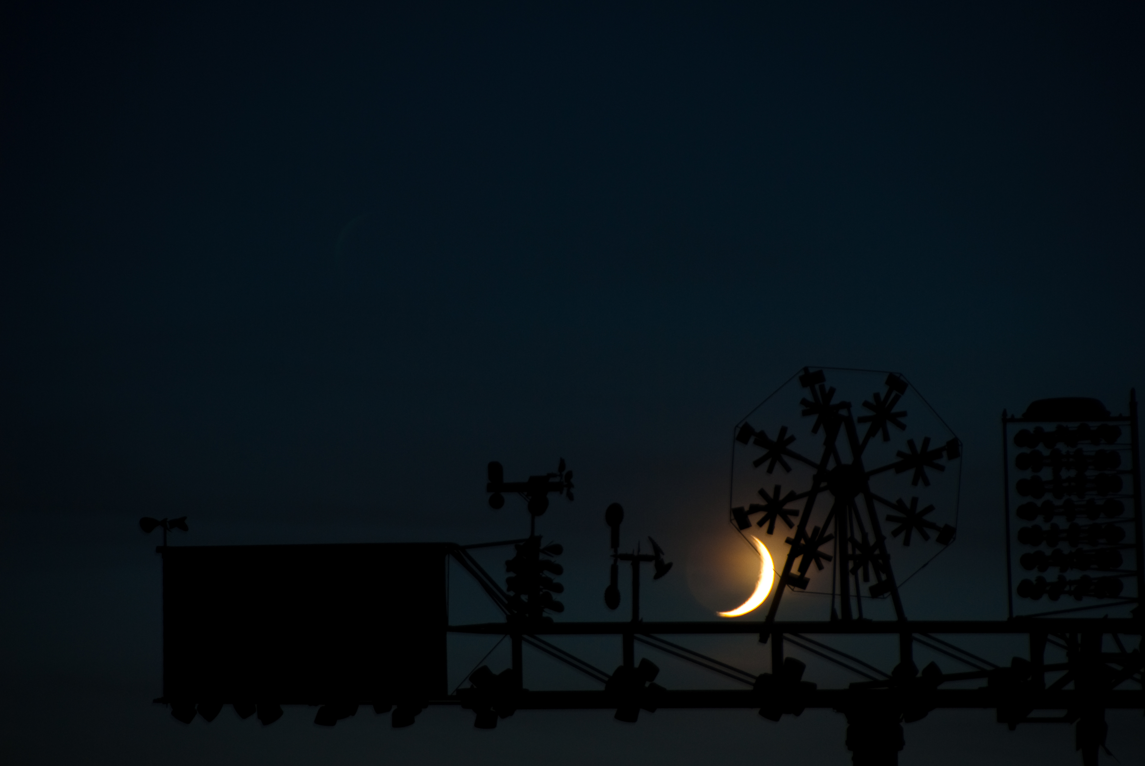
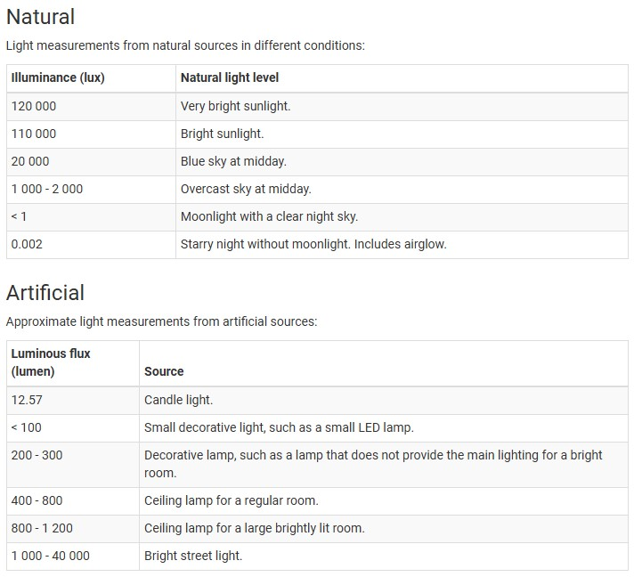
Volume/ Intensity
Film Lights:
Musco Light – 5,850,000 lumens
18K HMI Light – 150,558 lumens
Astera 600d – 62,187 lumens
Arri Skypanel: 51,809 lumens
Gemini Light Panel – 23,000 lumens
Ring Light: 2,500 lumens
Notes:
3. a
Link to Specs for Comparison:
https://www.bhphotovideo.com/c/compare/Godox_FH50BI_vs_Rotolight_Titan+X1/BHitems/1781743-REG_1602930-REG

Slide 11
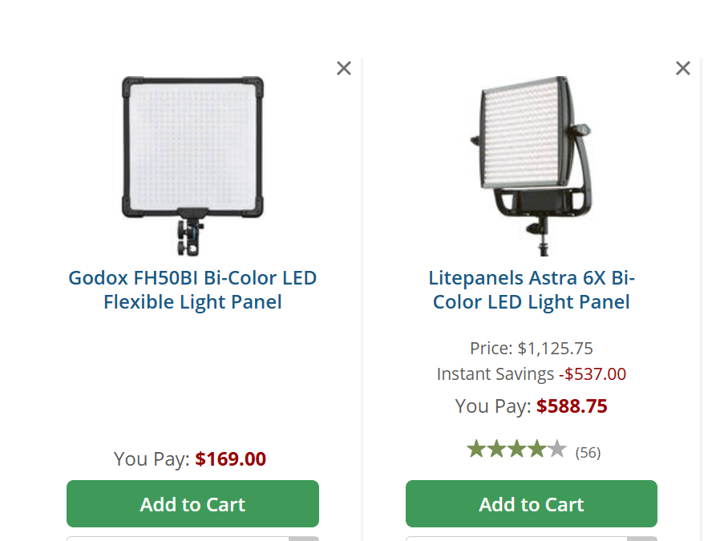
Volume/Intensity
Notes:
3. a
Link to Specs for Comparison:
https://www.bhphotovideo.com/c/compare/Godox_FH50BI_vs_Rotolight_Titan+X1/BHitems/1781743-REG_1602930-REG

Slide 12
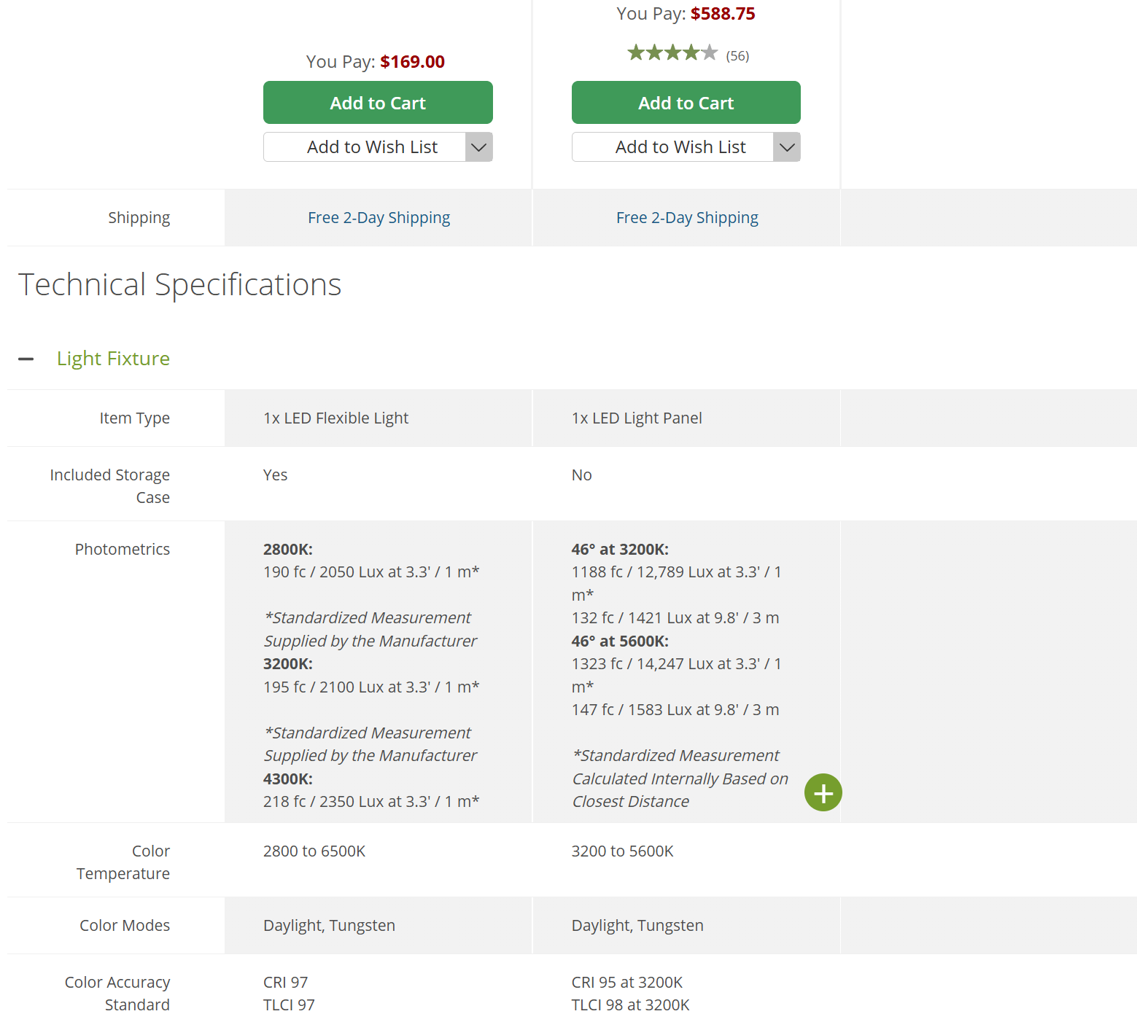
Volume/Intensity
Notes:
3. a
Link to Specs for Comparison:
https://www.bhphotovideo.com/c/compare/Godox_FH50BI_vs_Rotolight_Titan+X1/BHitems/1781743-REG_1602930-REG

Slide 13
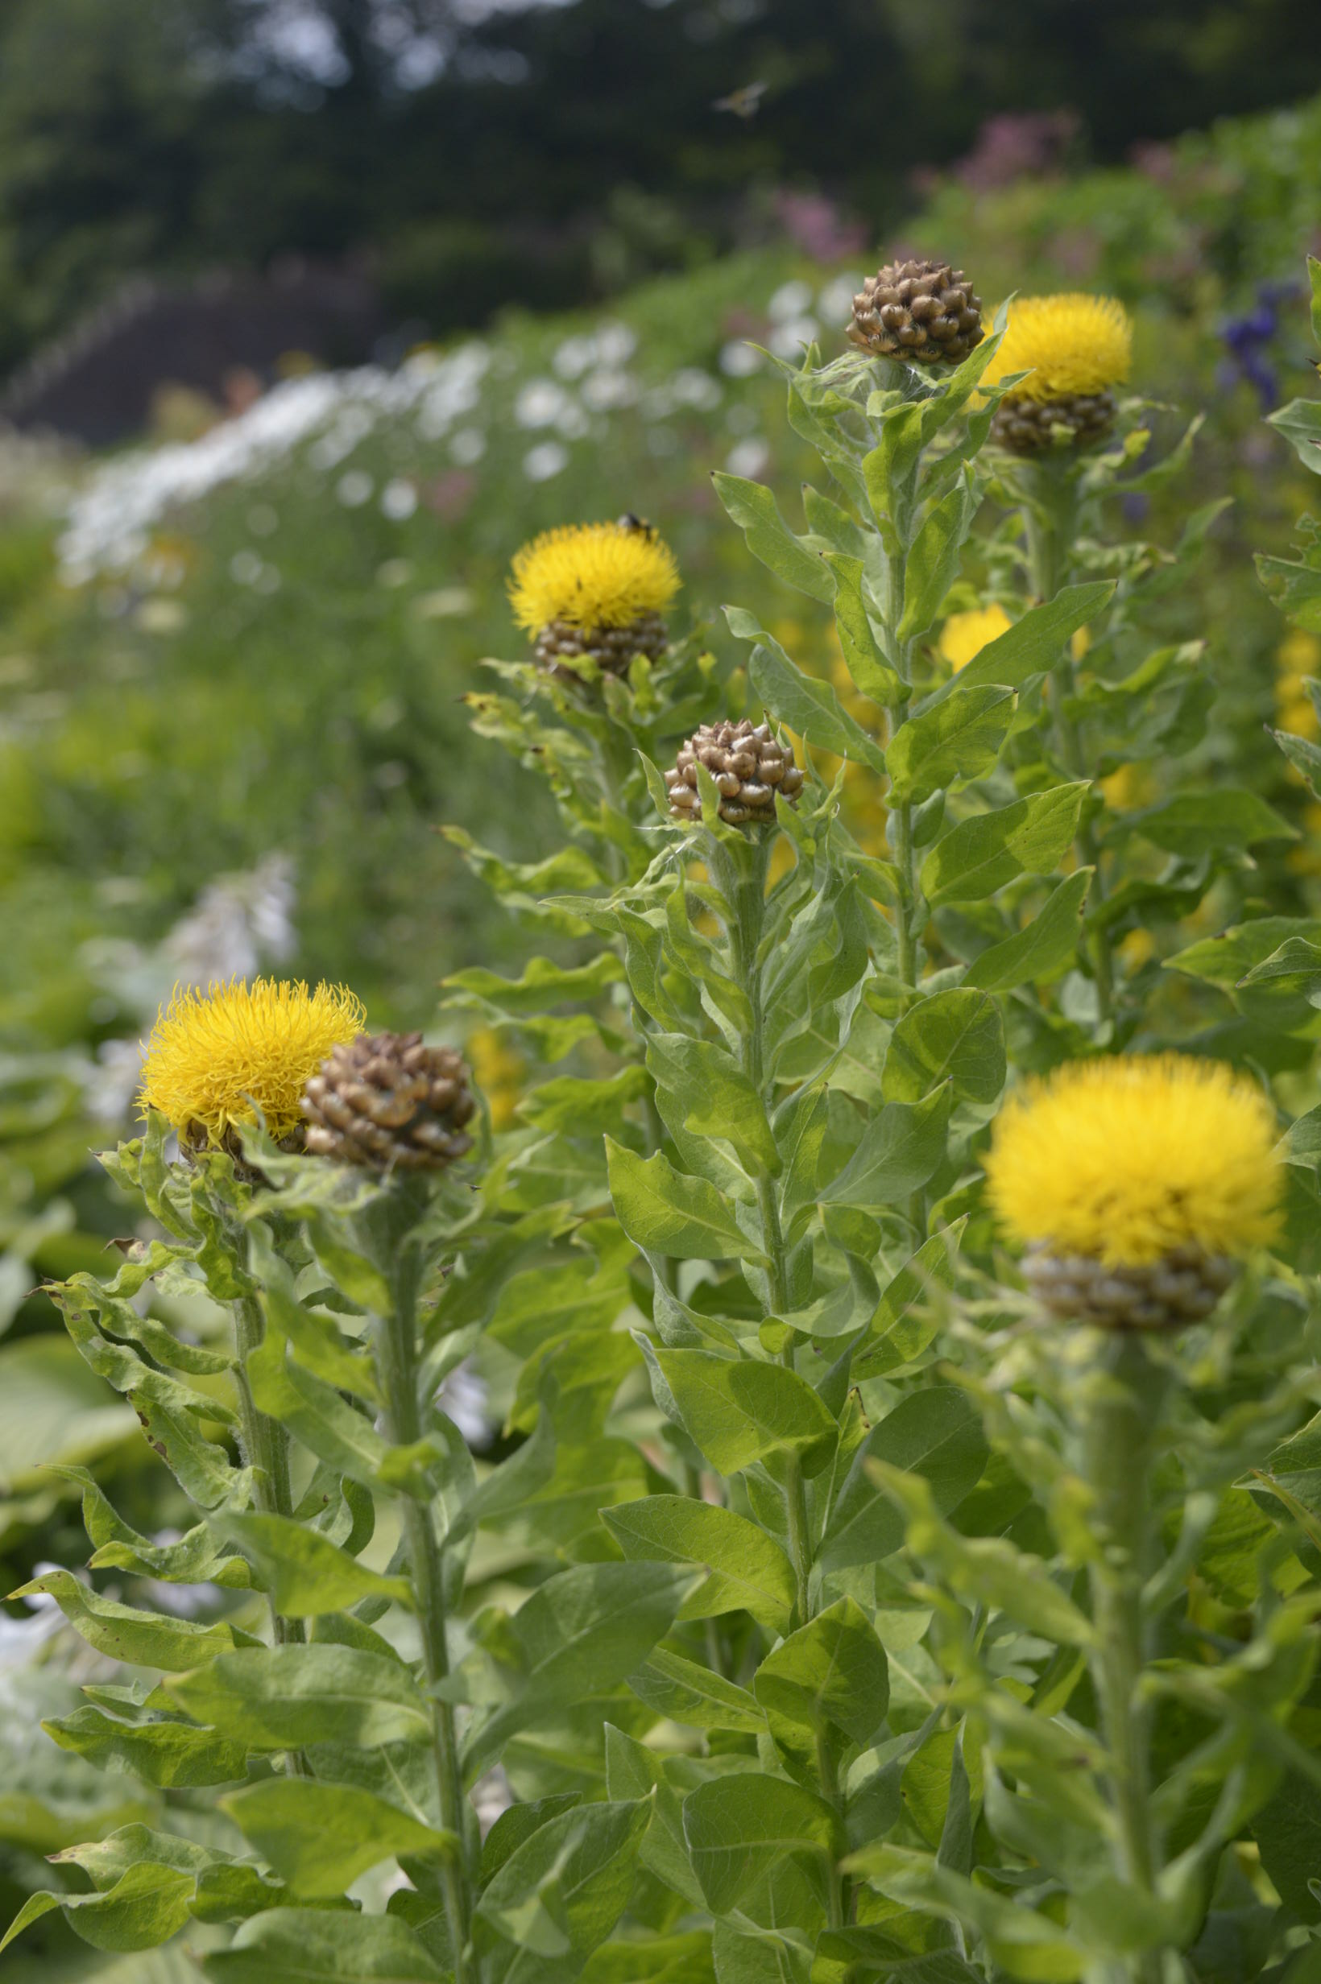
Step outside

Slide 14
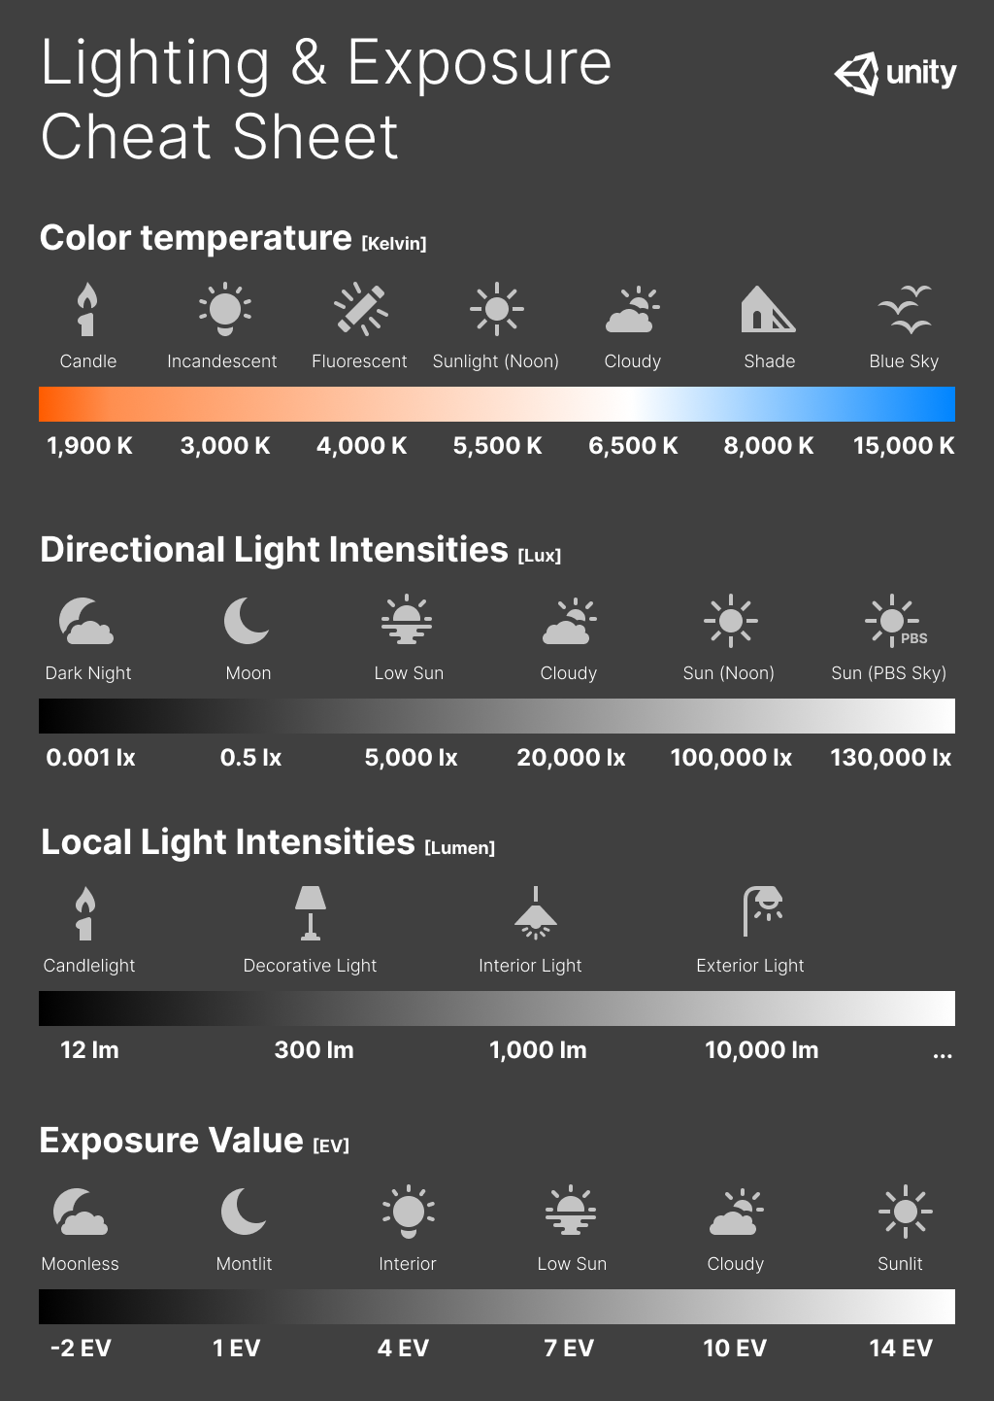
Give it a try
Color/Frequency

Slide 15
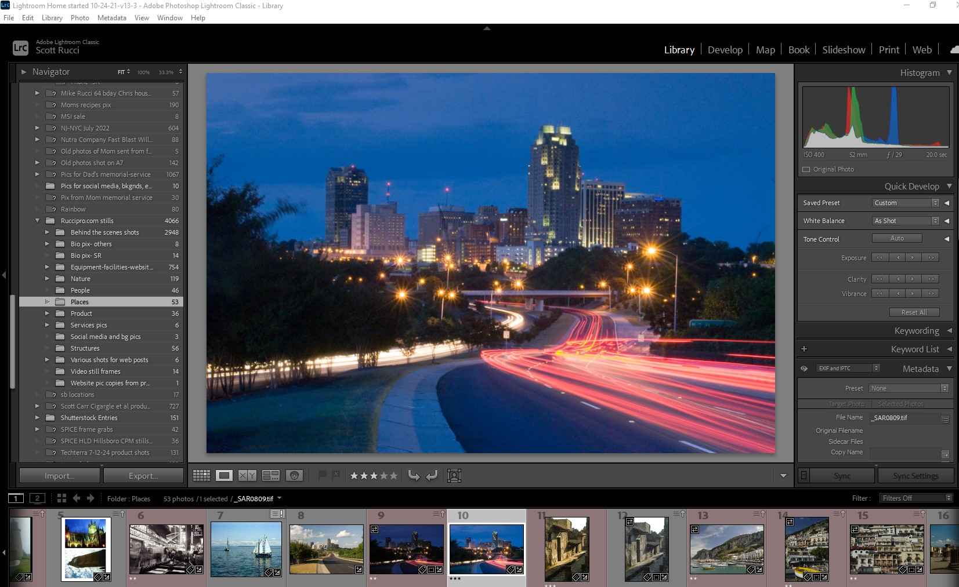
Color/Frequency
Notes:
3. b
Demo: 2 Adobe Lightroom demo with int/ext shots/white balance

Slide 16
Dir
ection
Notes:
3. b
Demo: 2 Adobe Lightroom demo with int/ext shots/white balance

Slide 17
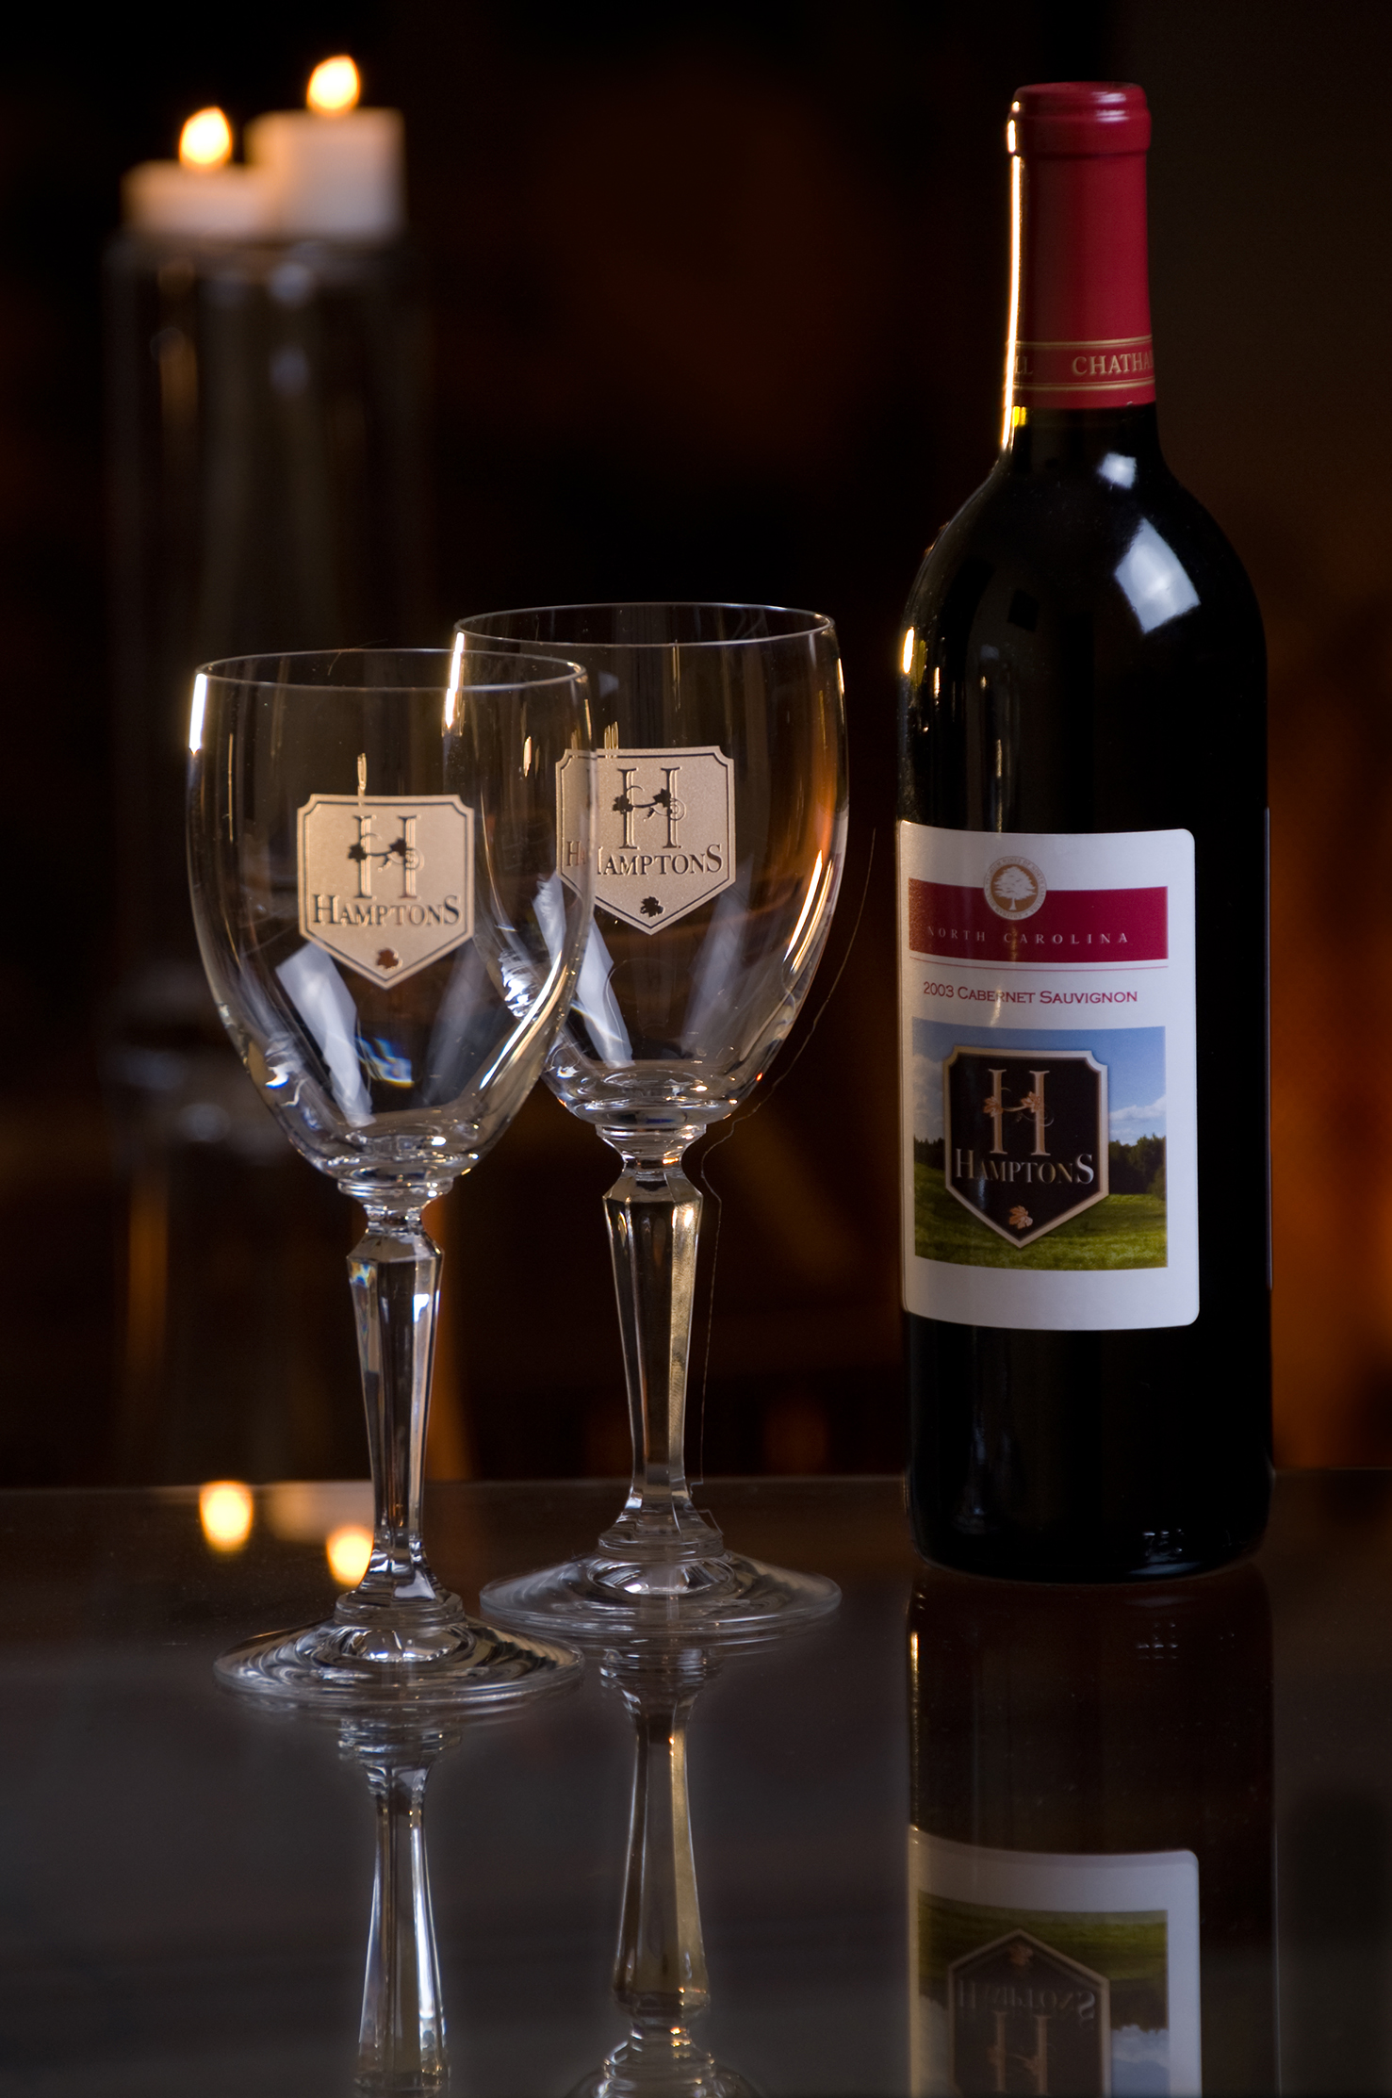
Notes:
3. c

Slide 18
Notes:
3. c
Talk about Lighting Direction

Slide 19
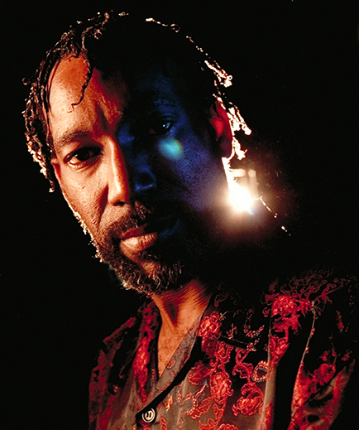
Notes:
3. c

Slide 20
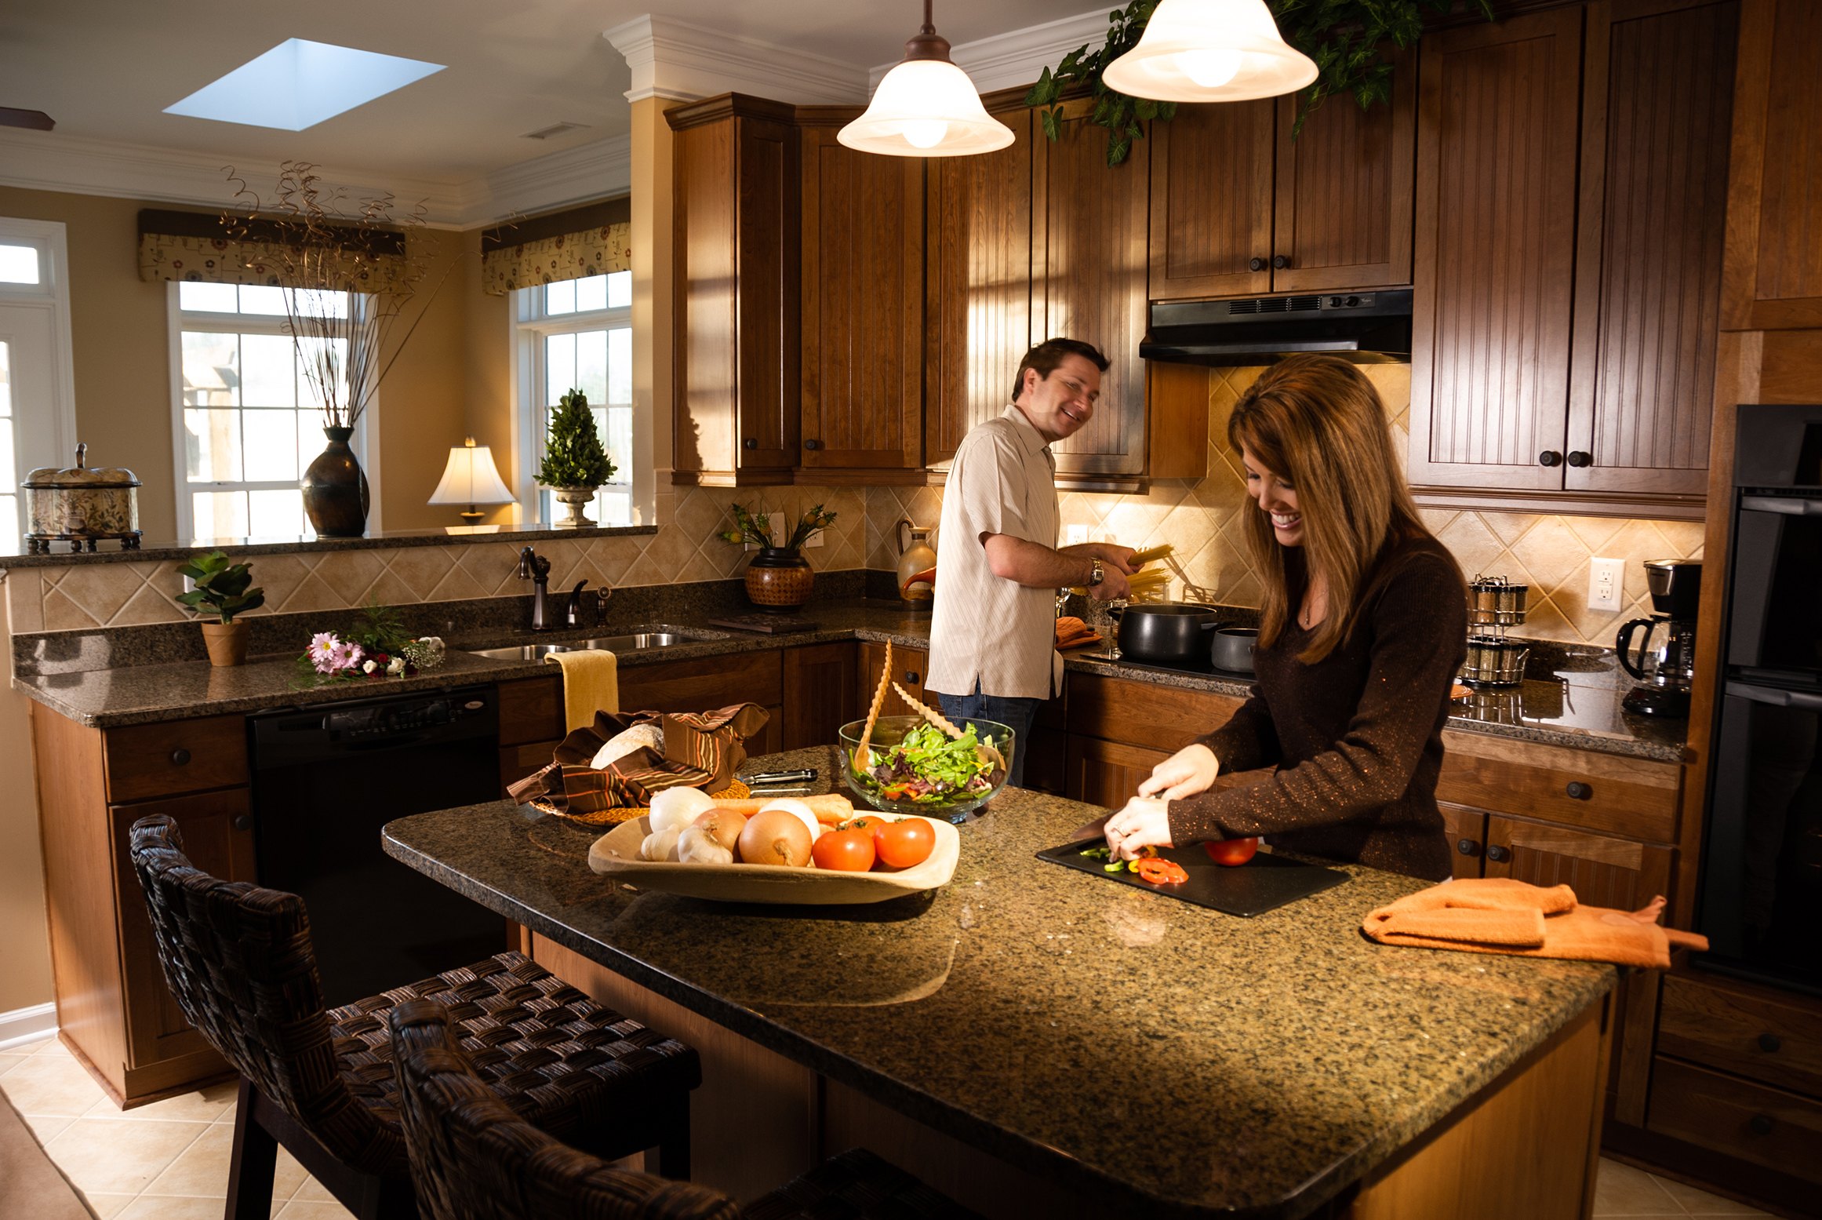
Notes:
3. c

Slide 21
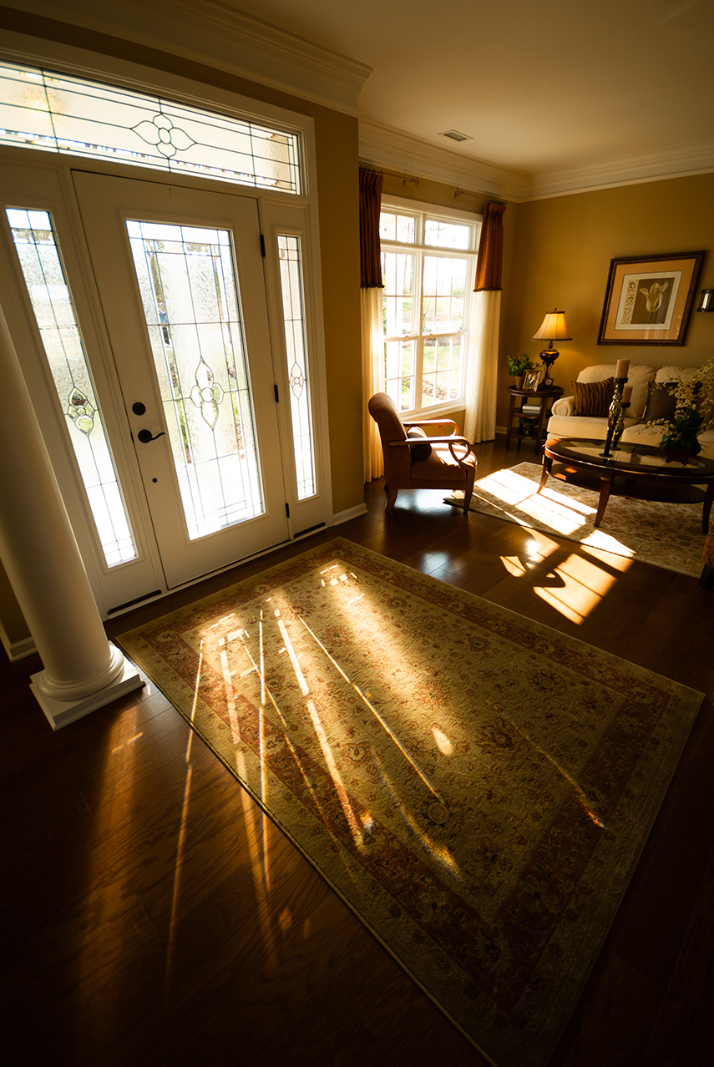
Notes:
3. c

Slide 22
Notes:
3. c

Slide 23
Reflectivity
Notes:
3. d

Slide 24
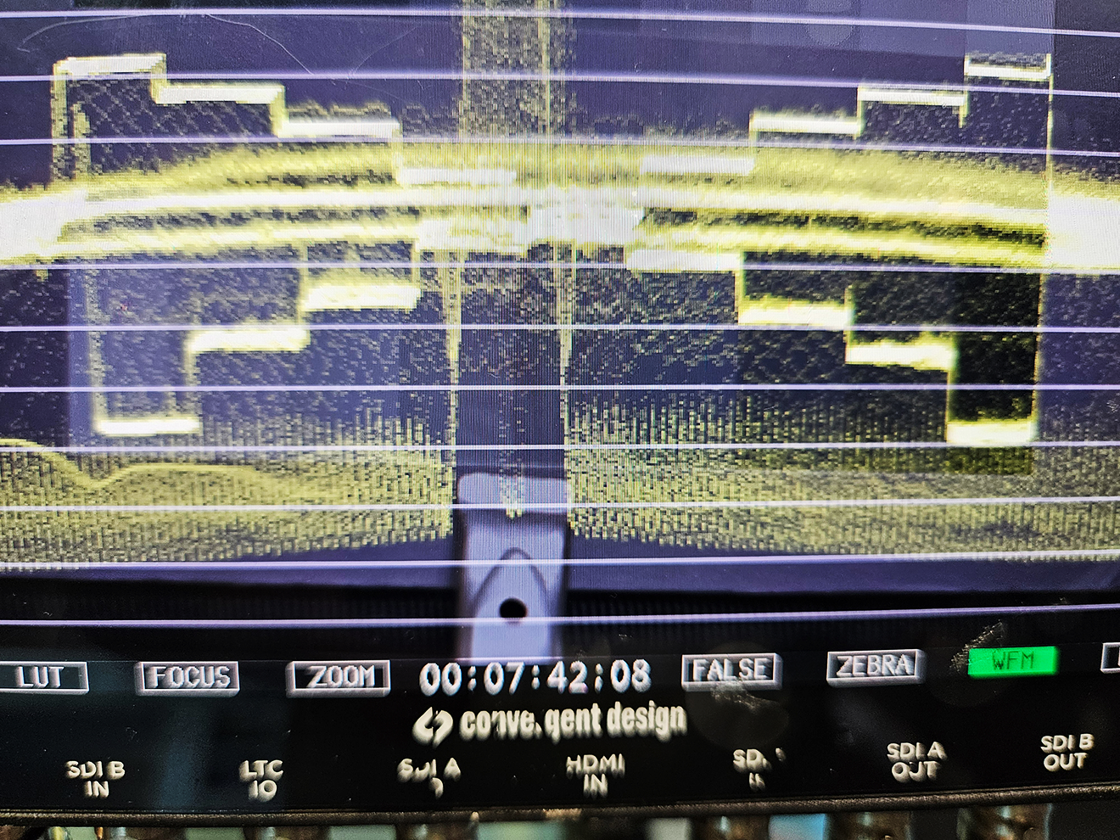
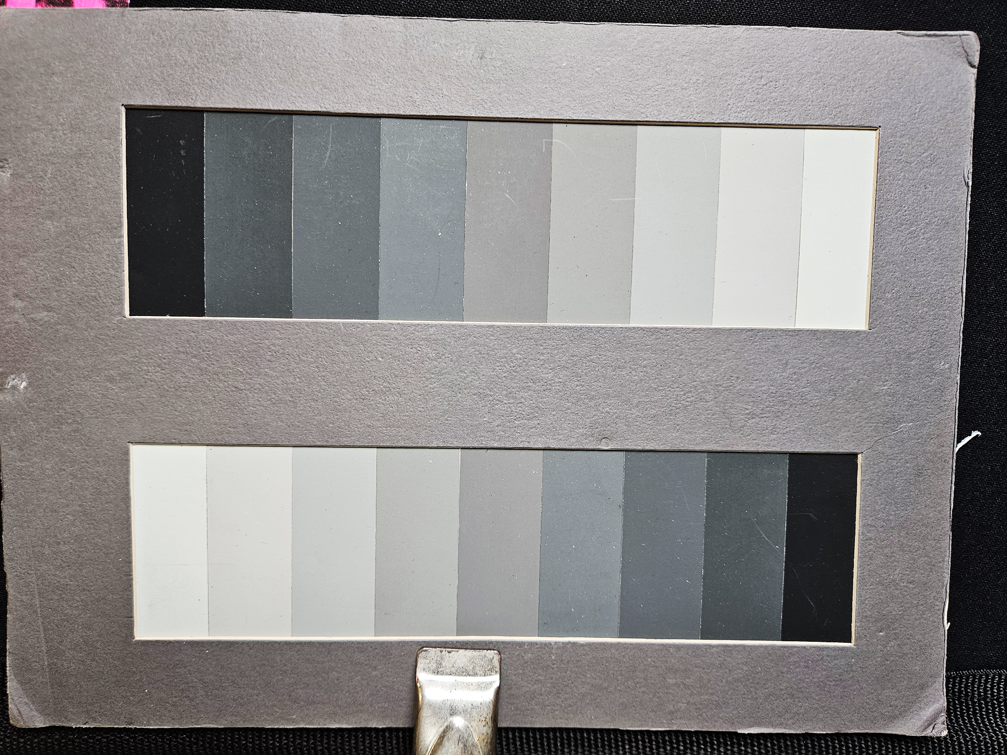

Slide 25
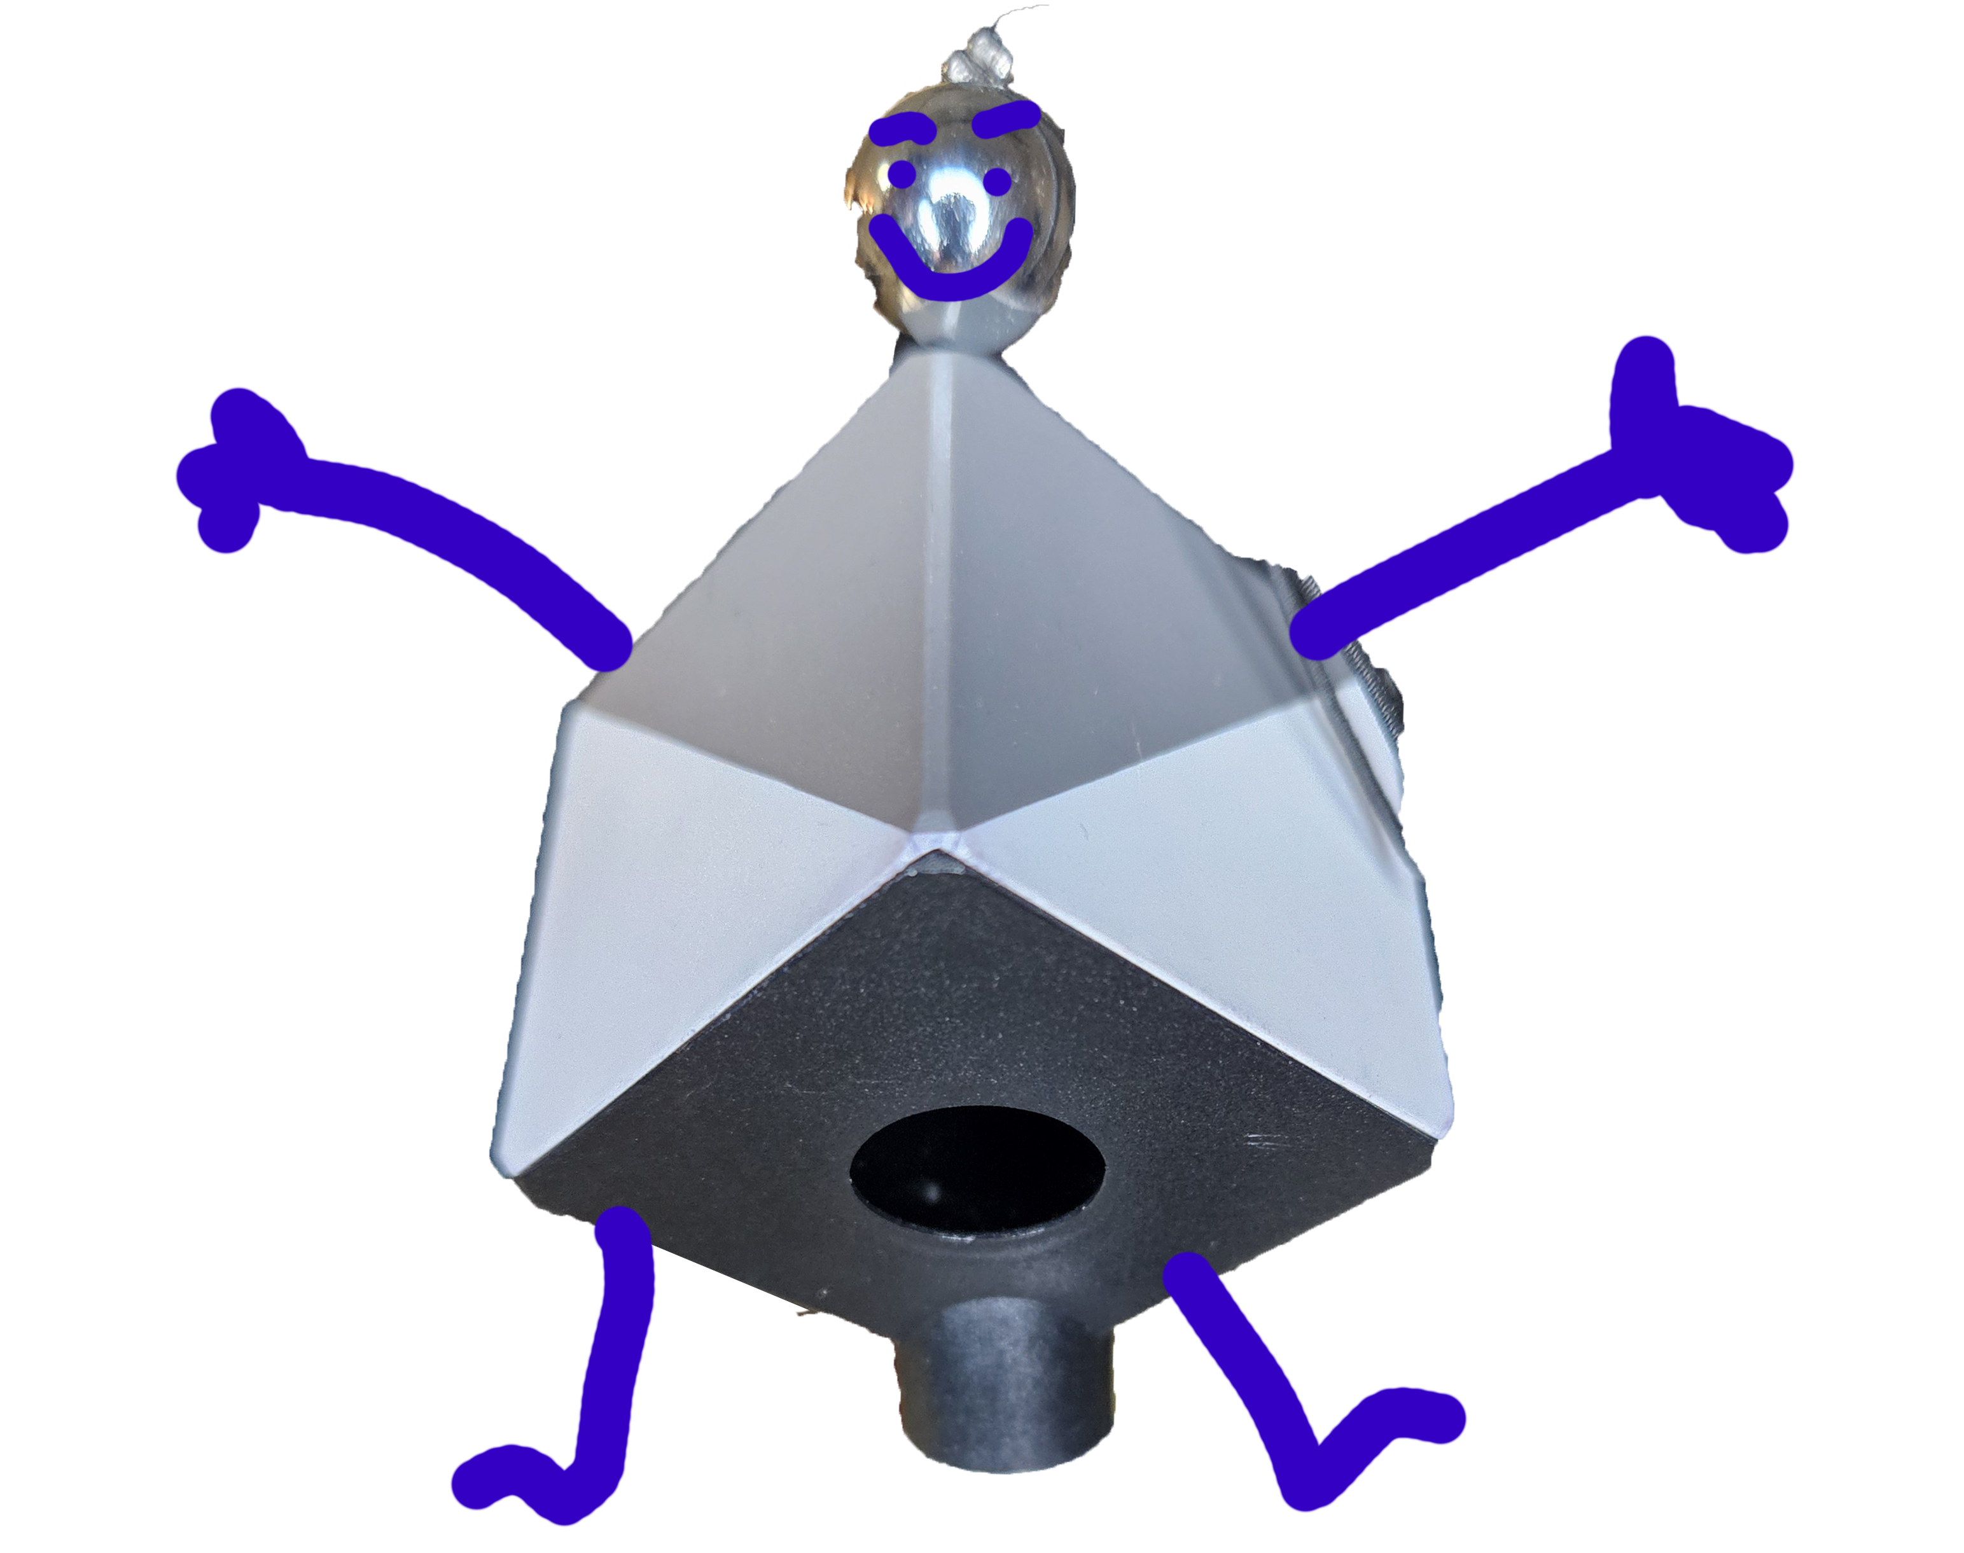

Slide 26
Notes:
3. d

Slide 27
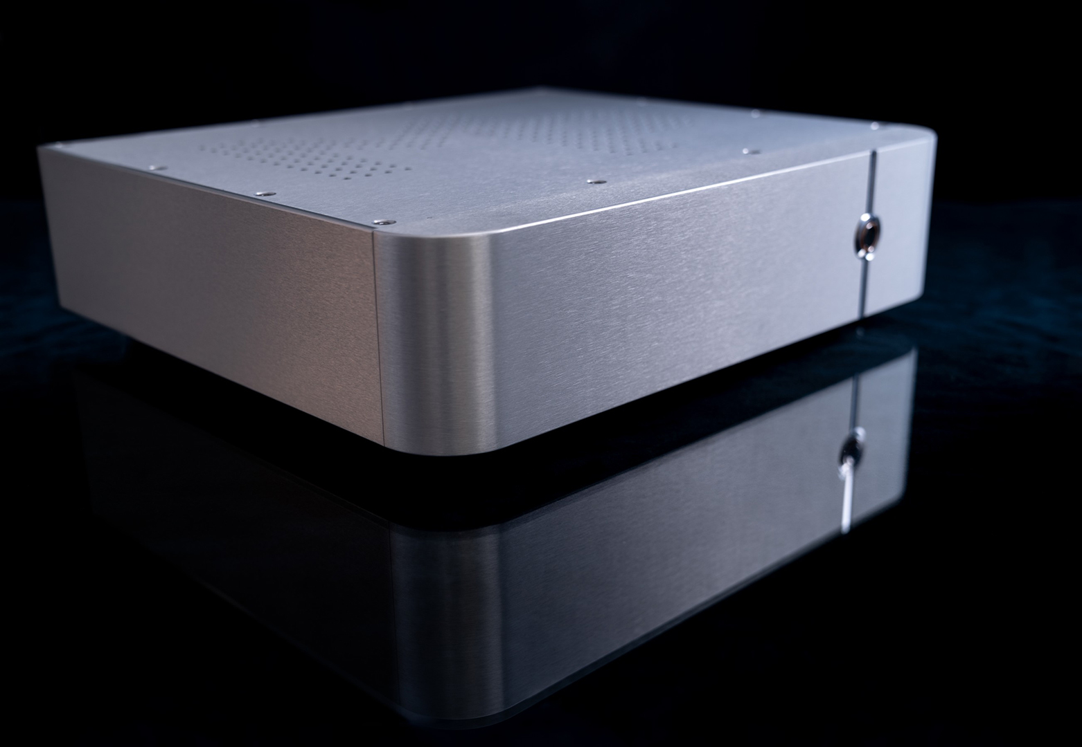
Notes:
3. d

Slide 28
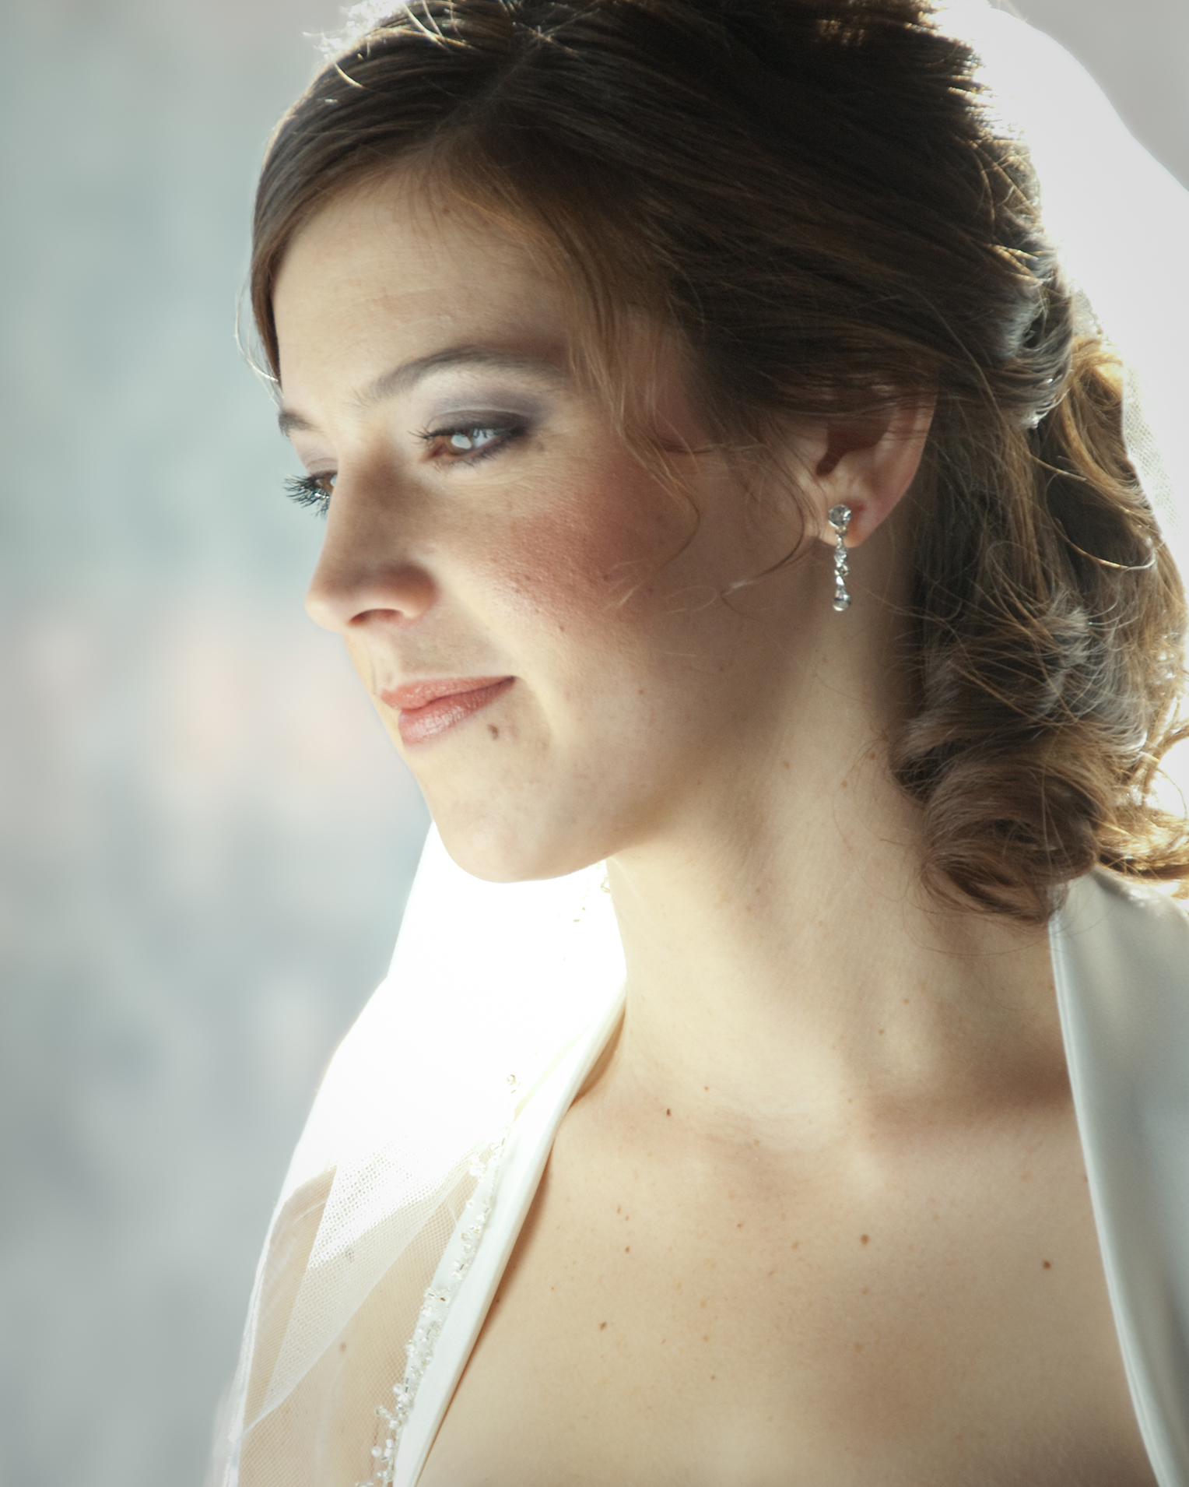
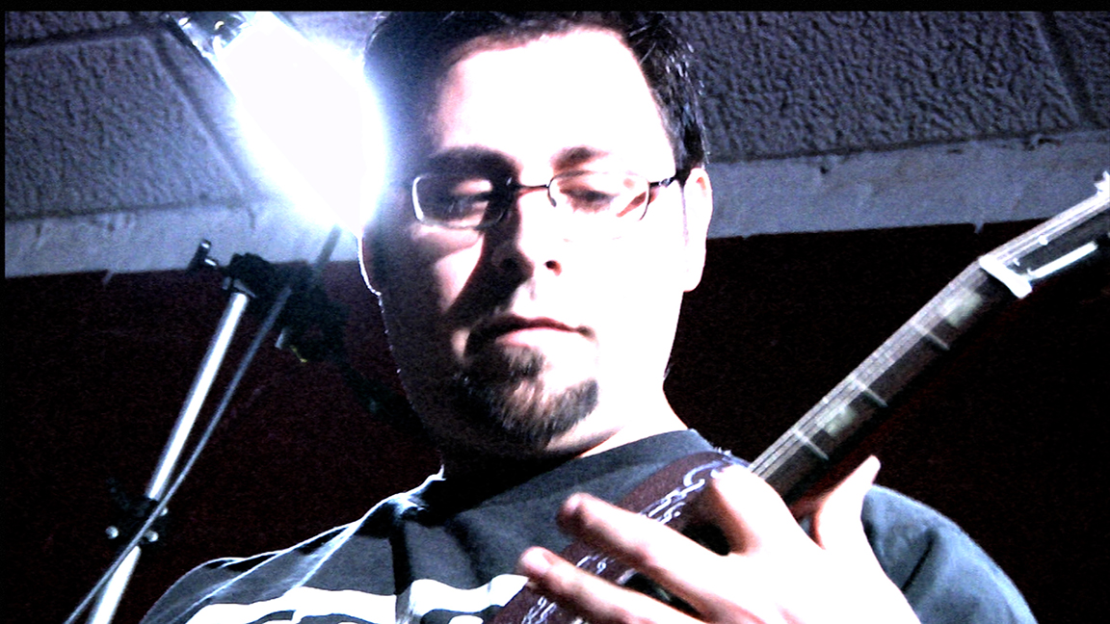
Broadness/Diffusion
Notes:
3. e

Slide 29
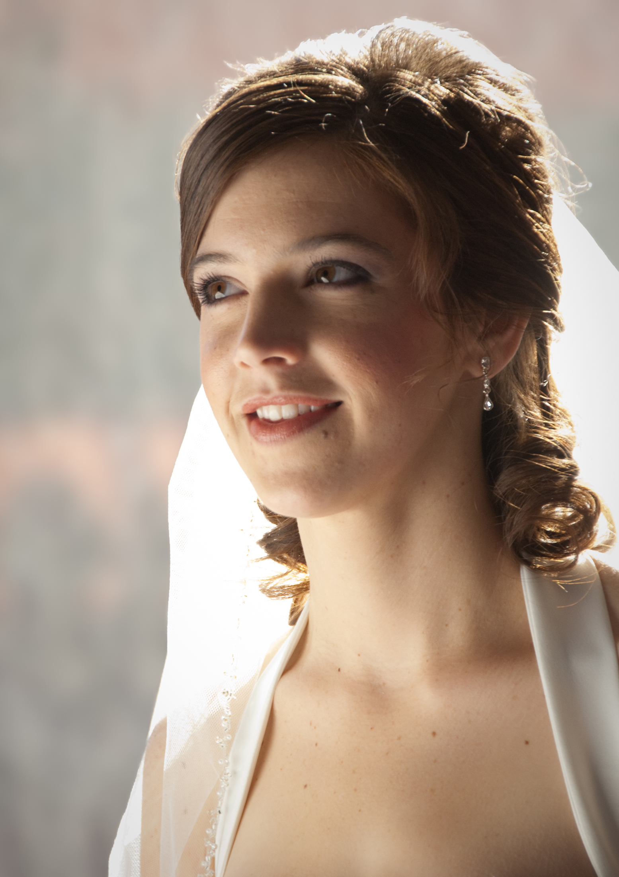
Notes:
3. e

Slide 30
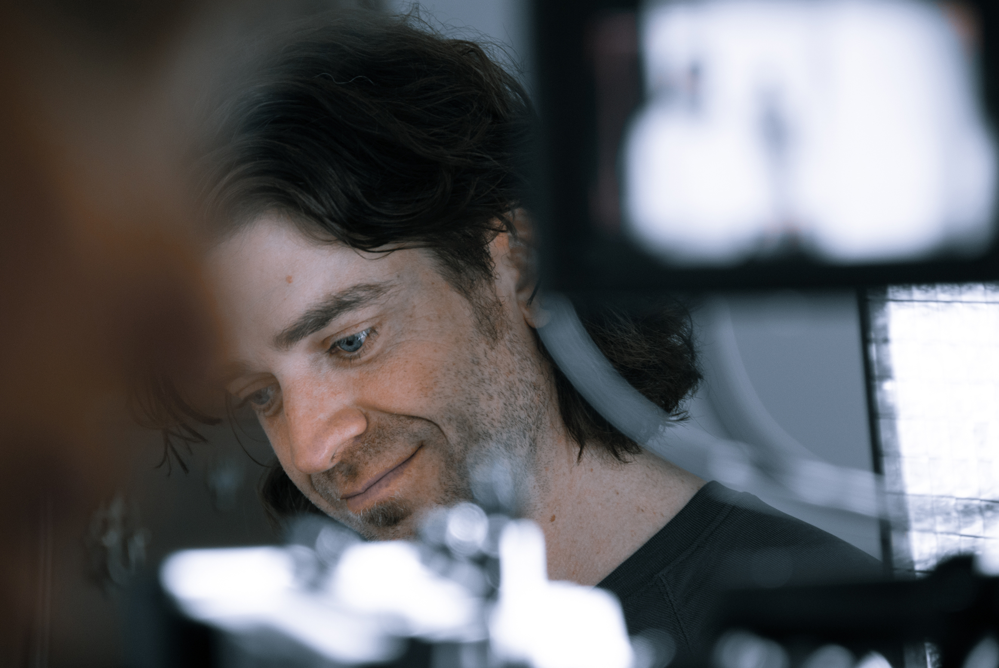
Notes:
3. e

Slide 31
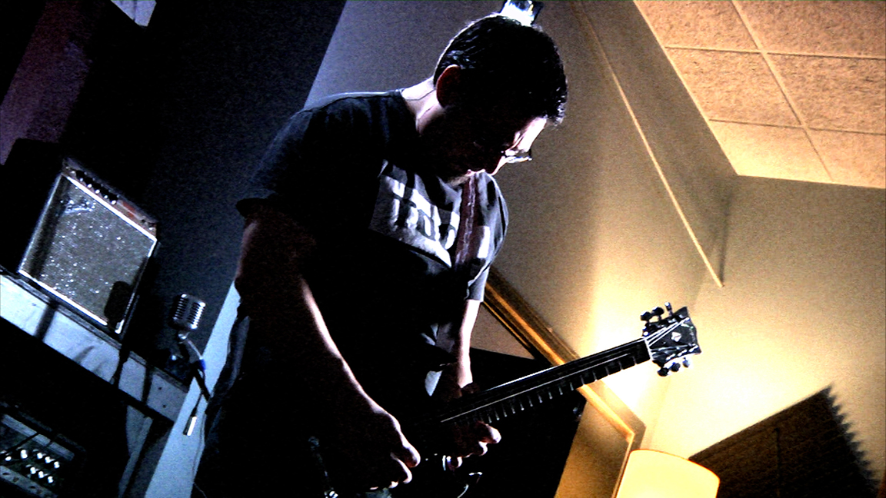
Notes:
3. e

Slide 32
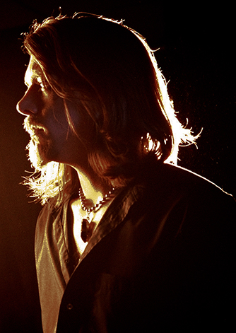
Notes:
3. e

Slide 33
Notes:
3. e

