Slide 1
Basic Qualities of Light
Power/Intensity
Color/Frequency
Direction
Reflectivity
Broadness/Diffusion

Slide 2
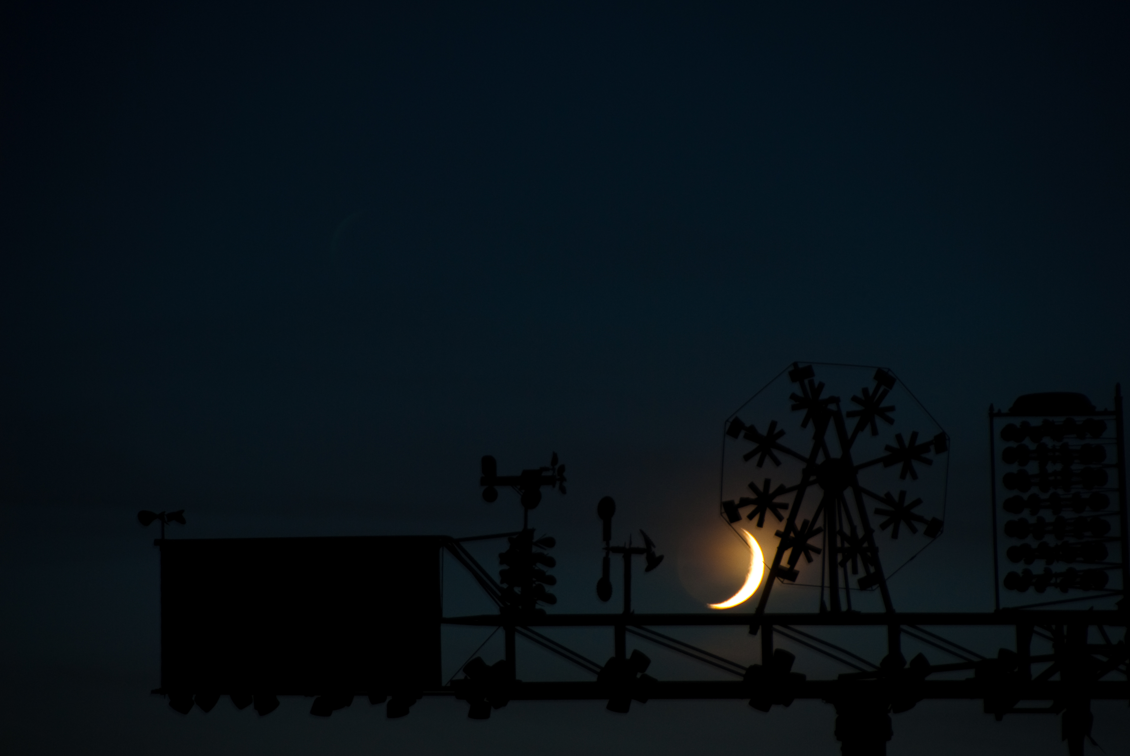
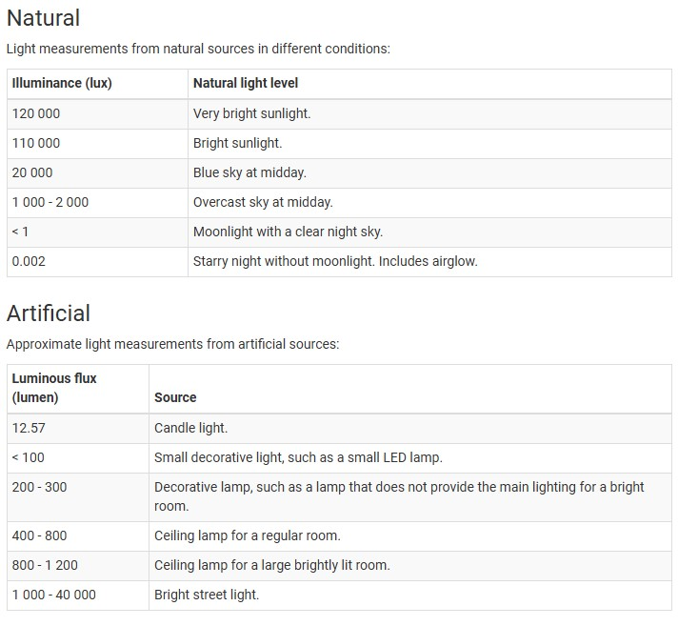
Volume/ Intensity
Film Lights:
Musco Light – 5,850,000 lumens
18K HMI Light – 150,558 lumens
Astera 600d – 62,187 lumens
Arri Skypanel: 51,809 lumens
Gemini Light Panel – 23,000 lumens
Ring Light: 2,500 lumens
Notes:
As it relates to other fixed sources exterior demo of FotodioX and Astra

Slide 3
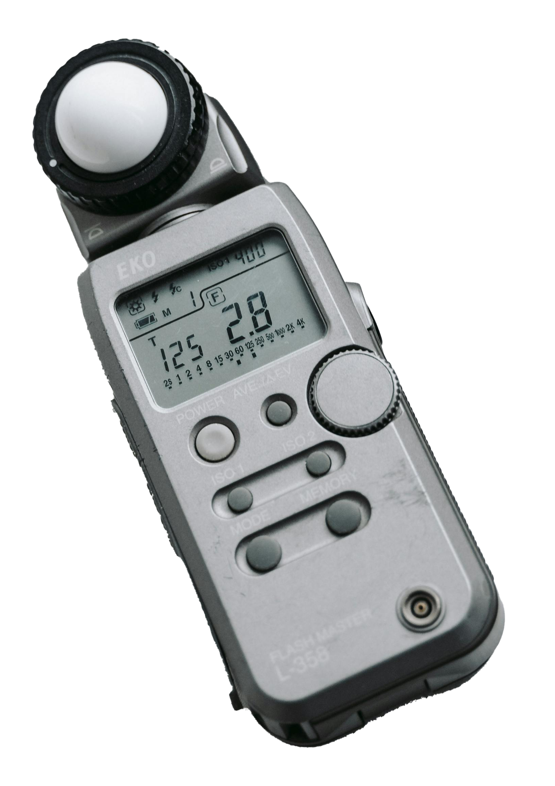
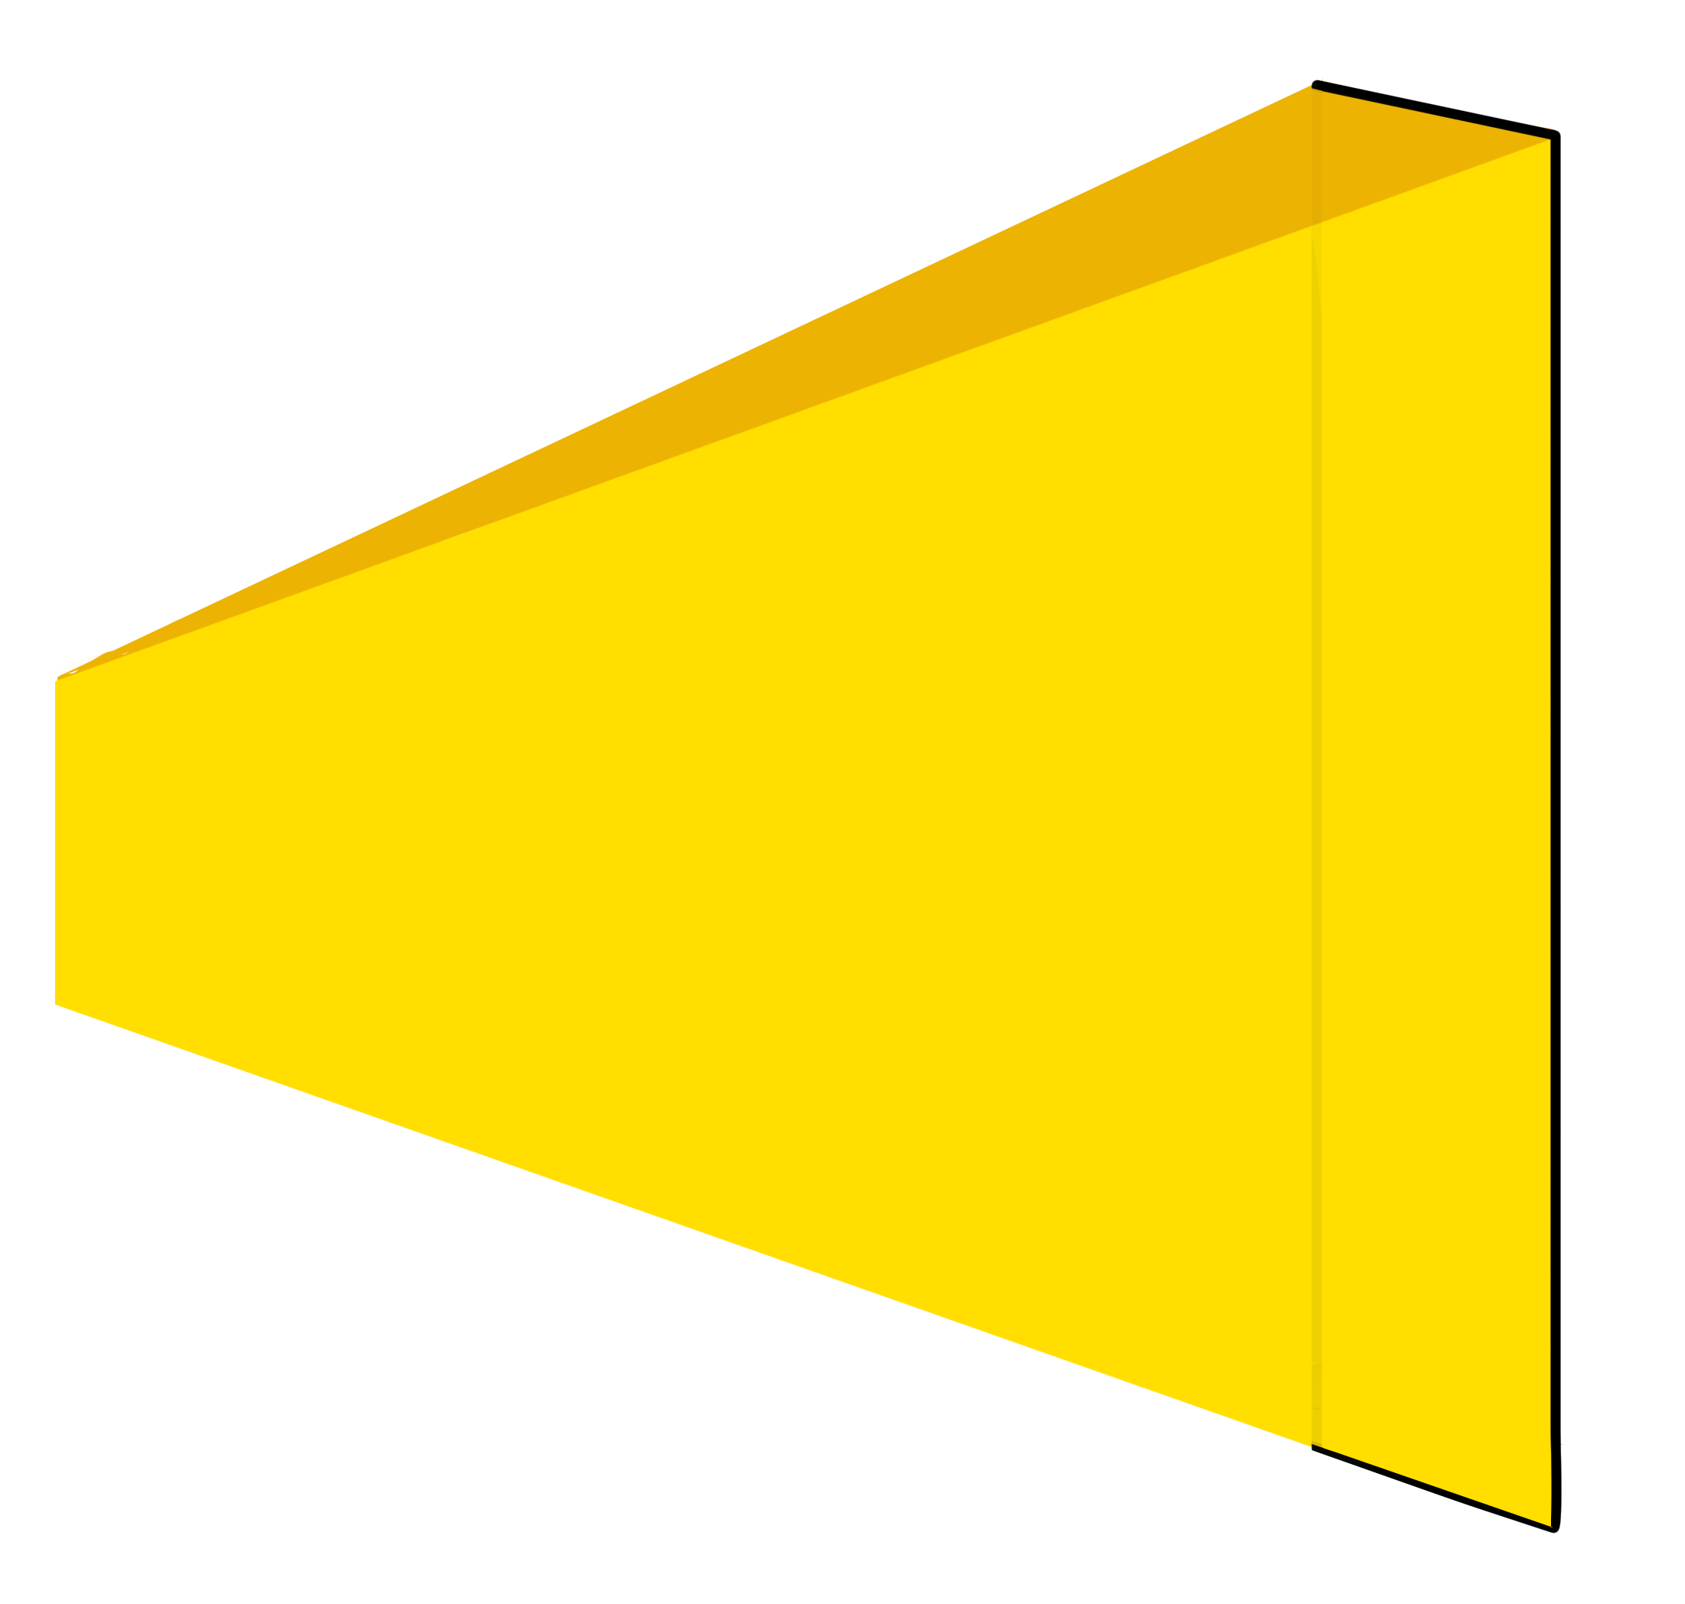
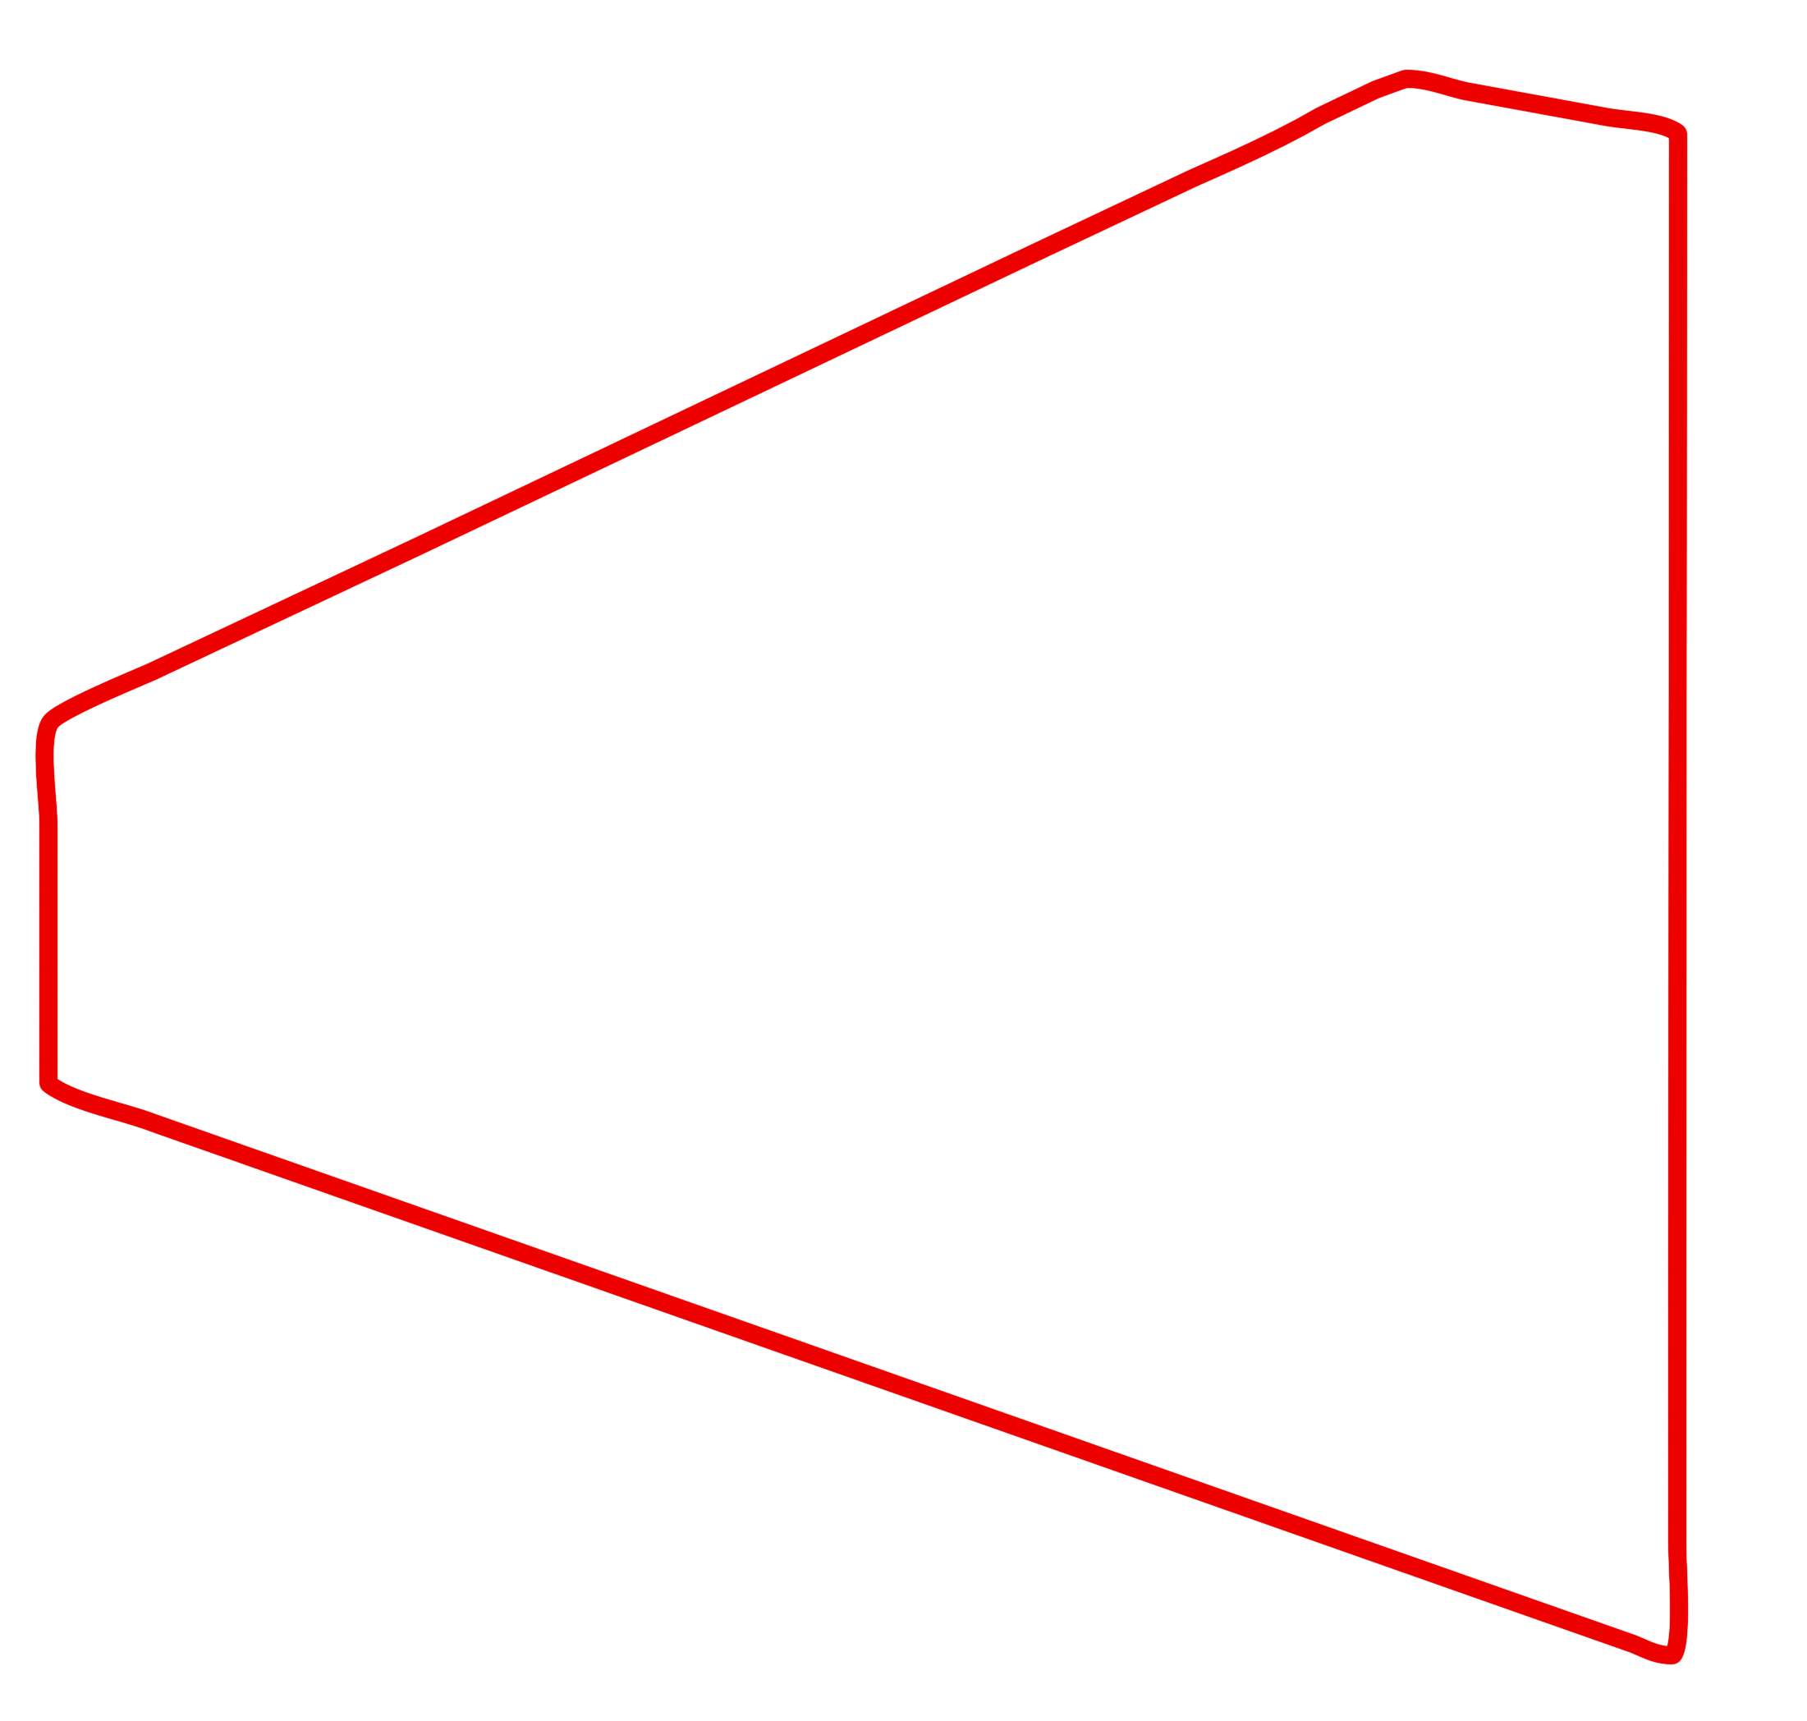
Measurement
Lumens
Total output
Lux (fc)
Brightness over an area

Slide 4
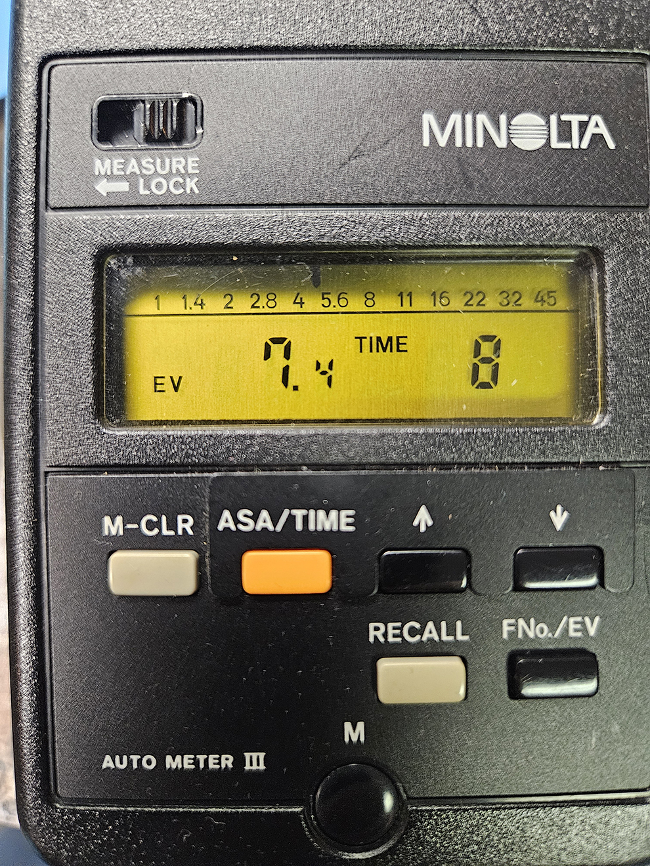
Measurement

Slide 5
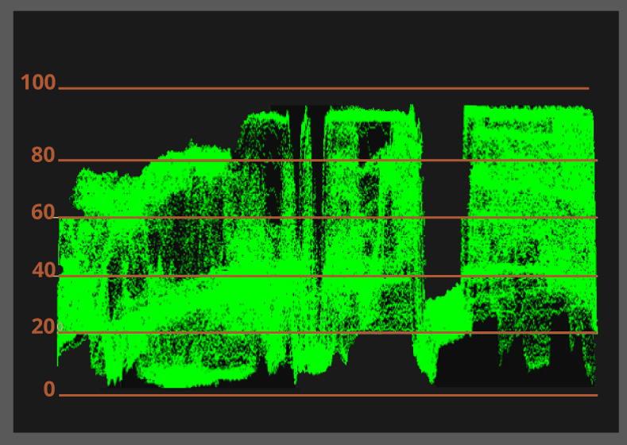
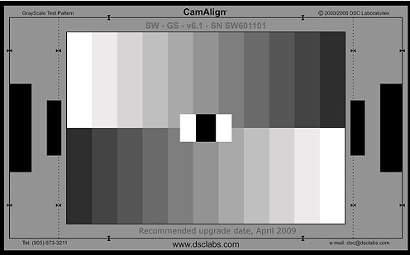
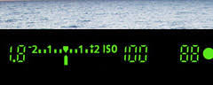
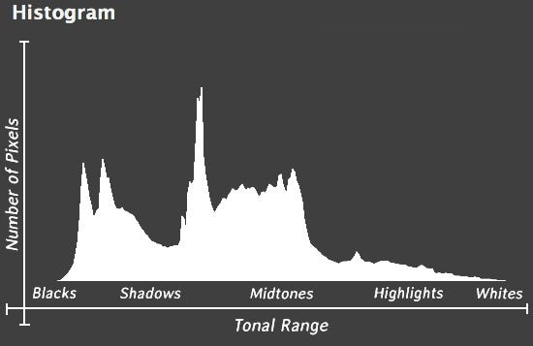
waveform
Measurement
50%
camera
0
18% gray
(middle gray)

Slide 6
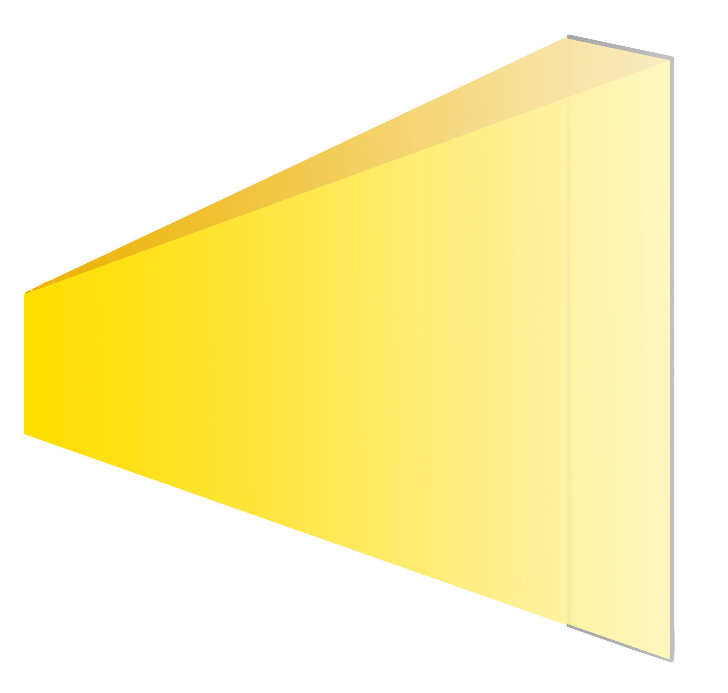
Inverse Square Law
2² = 4
1
4
4² = 16
1
16
1’
2’
4’
lux
100
25
6.25

Slide 7
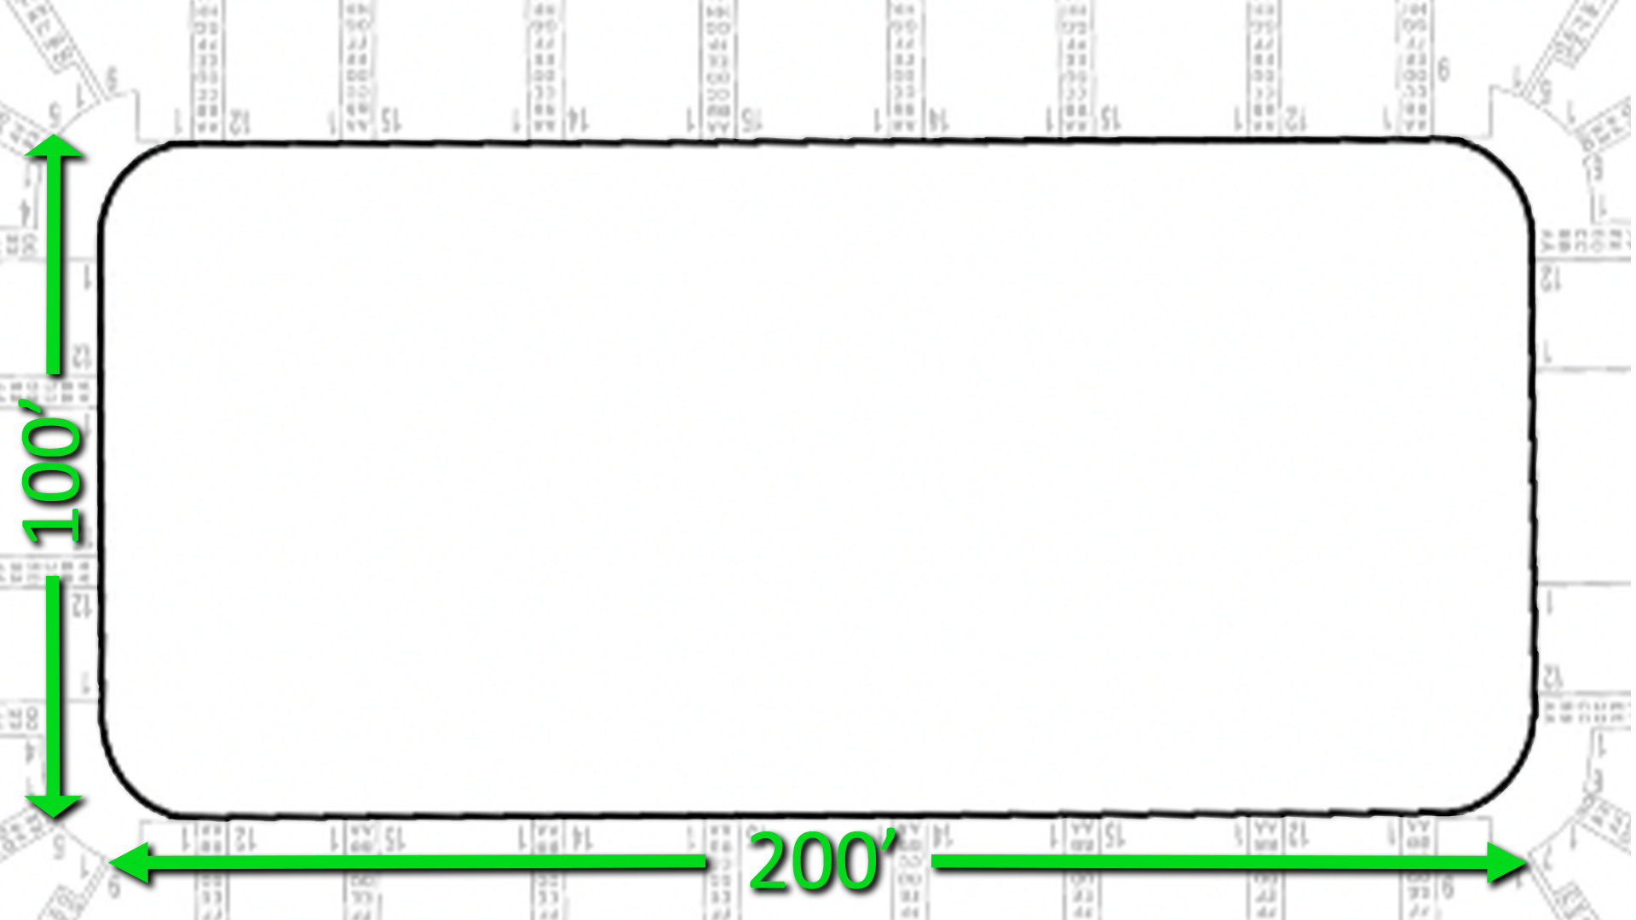
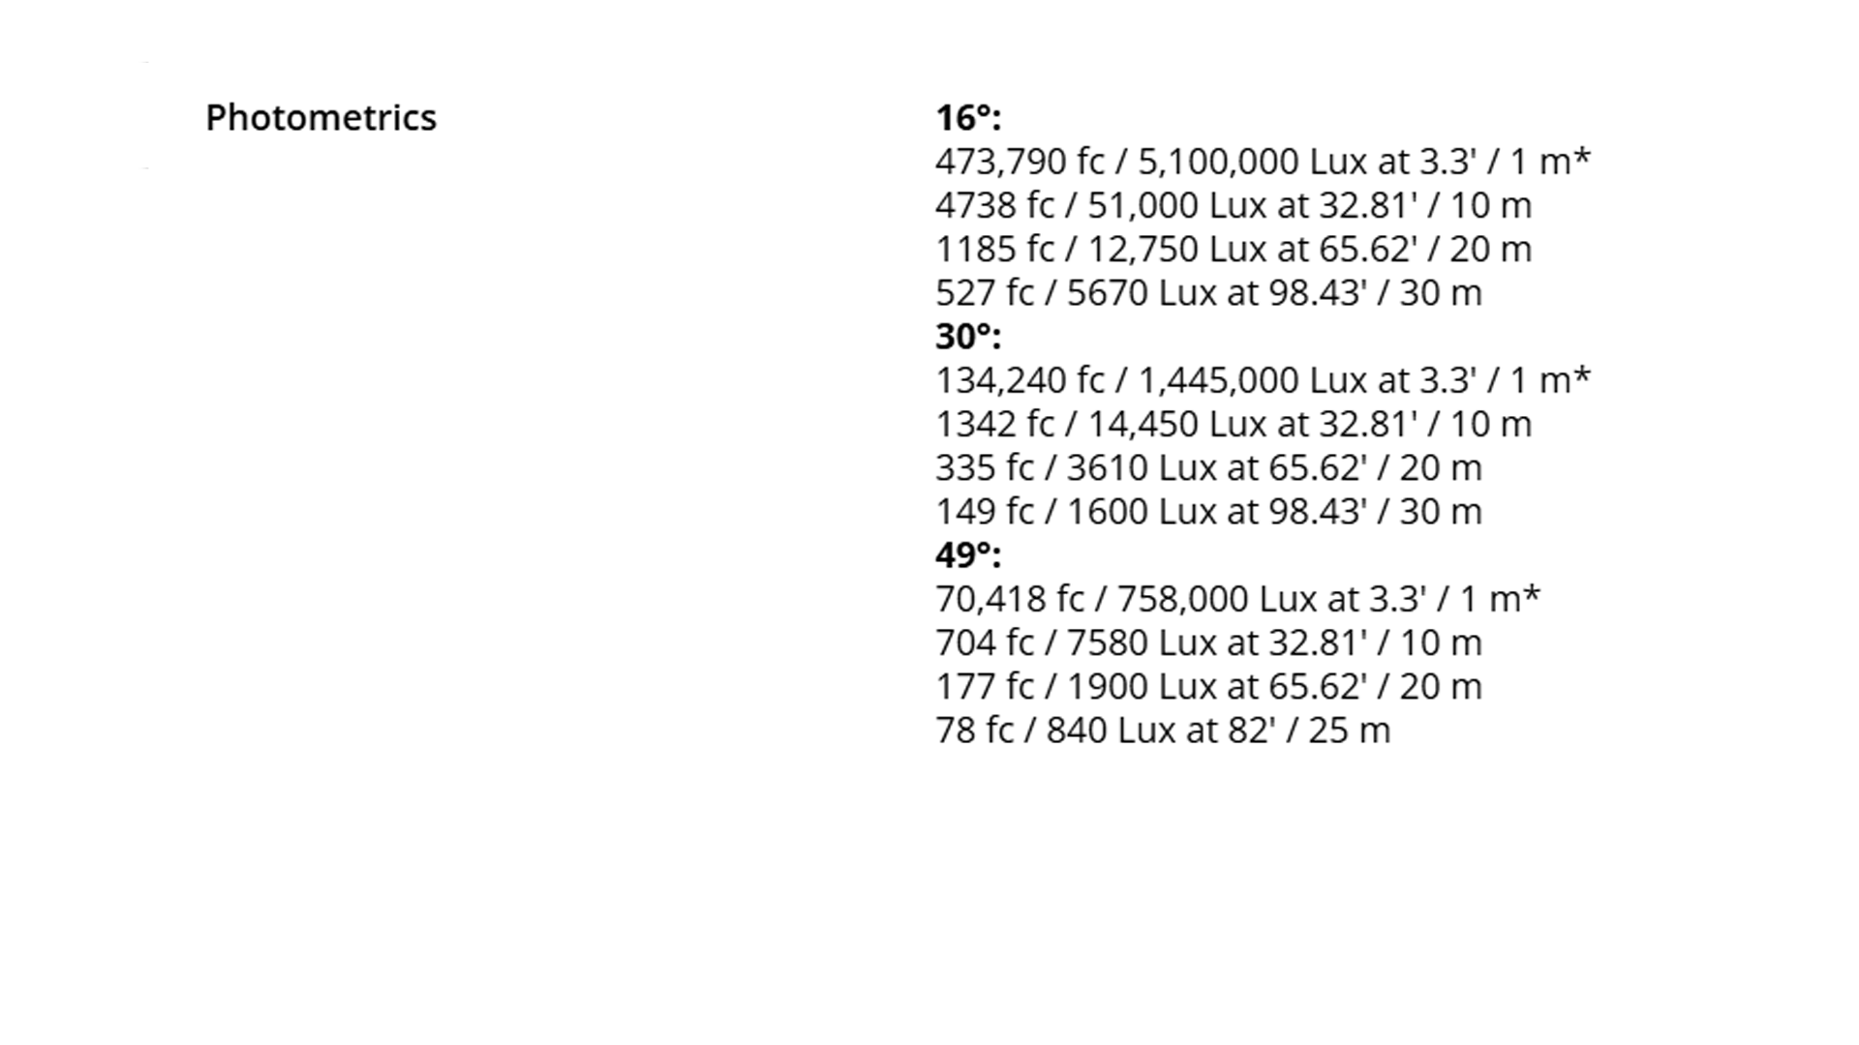
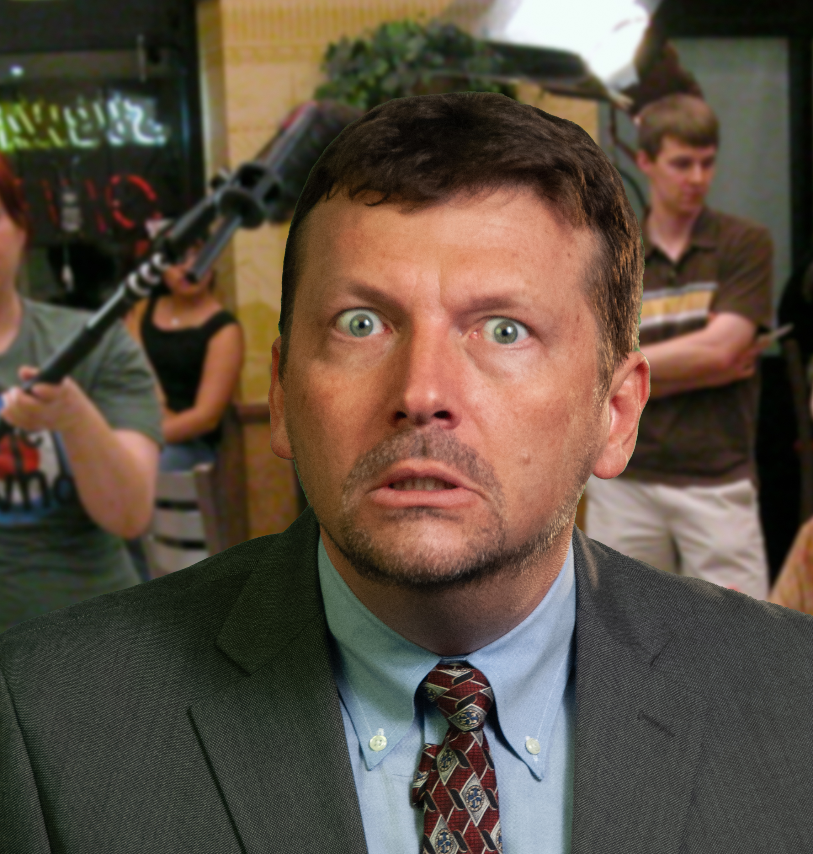
How much light does it take to get a “good” exposure?
You’re
FIRED!
If you walk the lights in to 25’ away, you need only ¼ the light, but the coverage is smaller.
Even at an F4 if the room started dark, you still need 20-30 lux or fc to get the exposure.
2500W HMI
1500W LED
300W LED
800 iso 1/60 f8

Slide 8
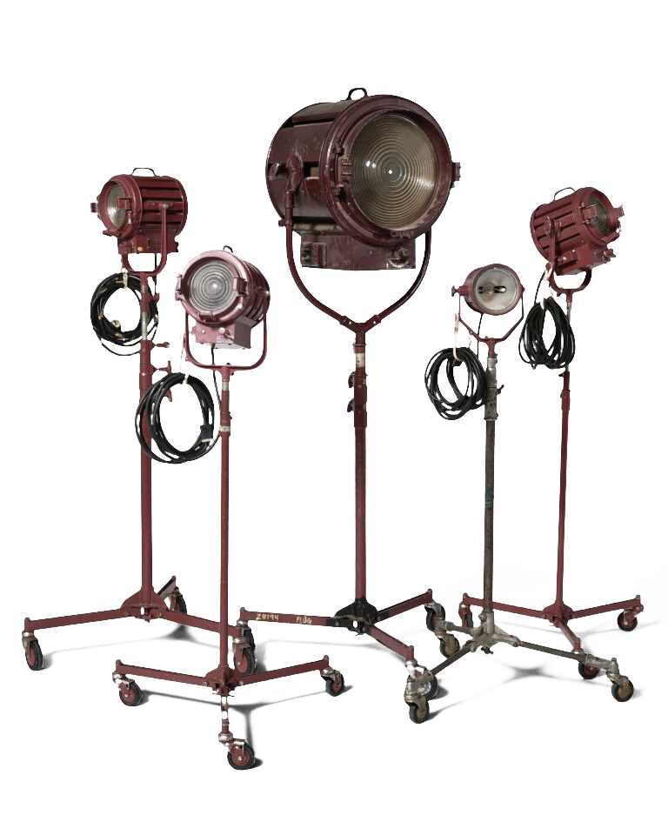
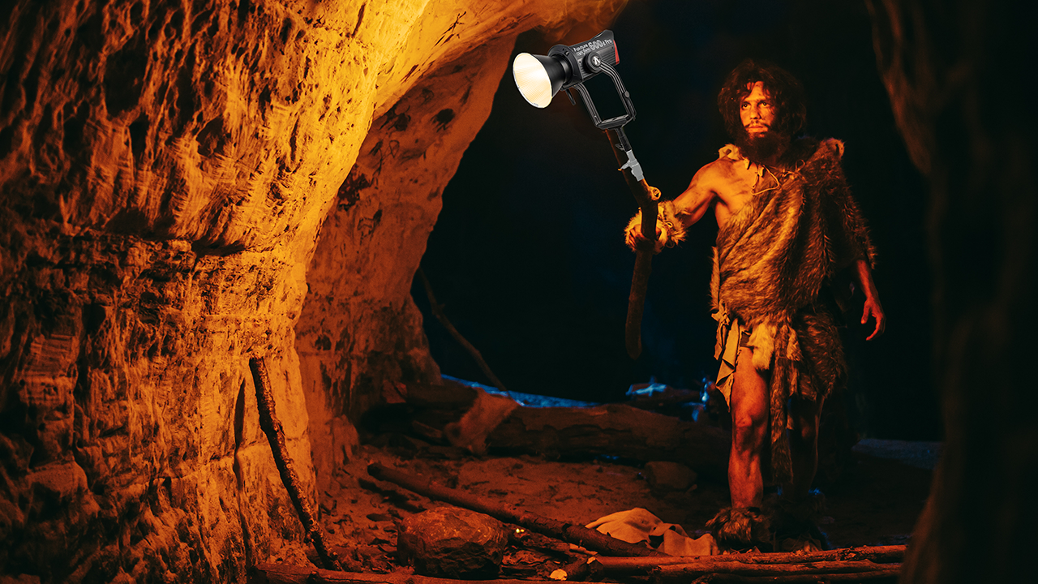
Rule of thumb
Wattage (power consumption)
Tungsten
150W
300W
650W
1K
2K
5K
10K
LED
23W
45W
98W
150W
300W
750W
1500W
/ 6.67
1K Demo + typical usage examples

Slide 9
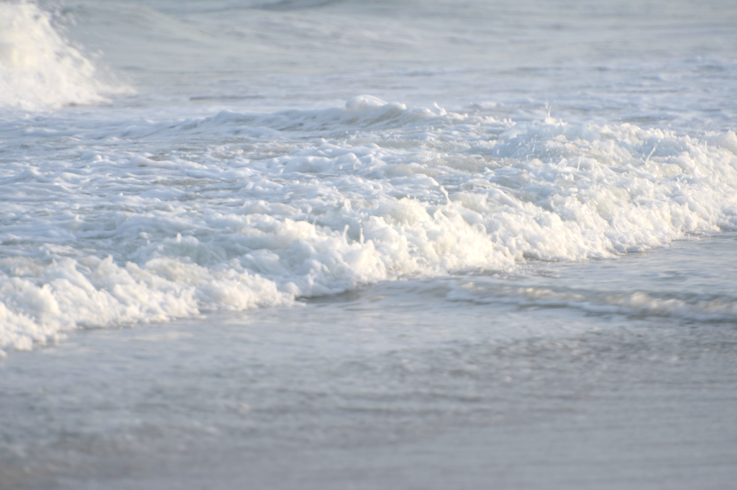

Slide 10
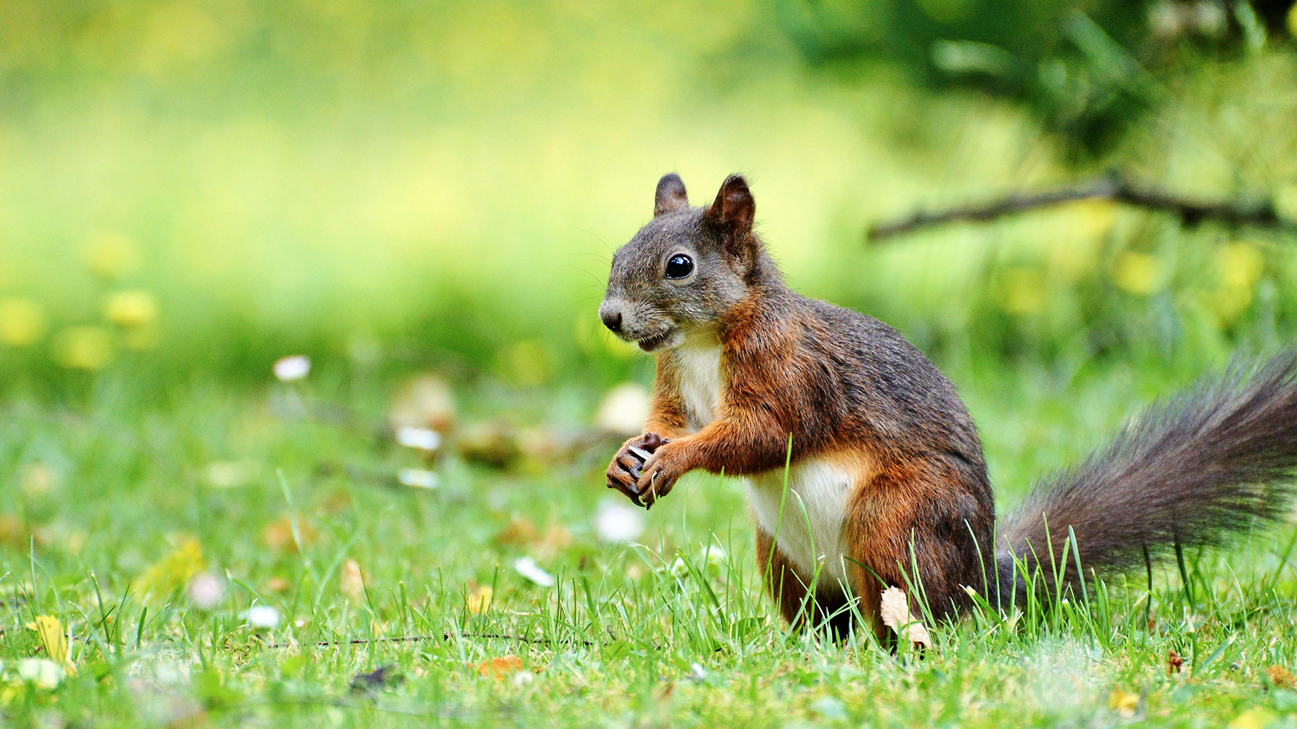
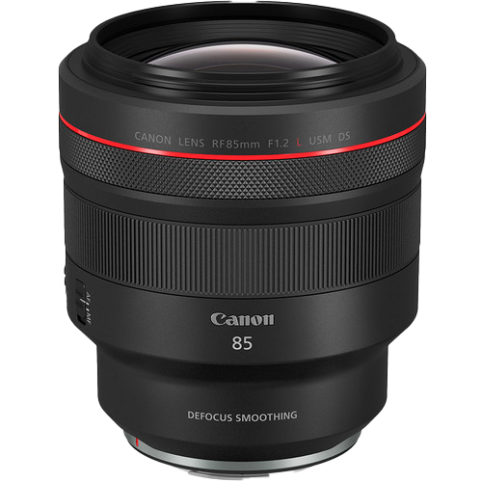
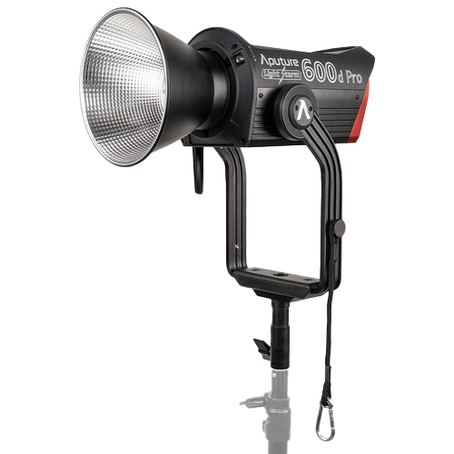
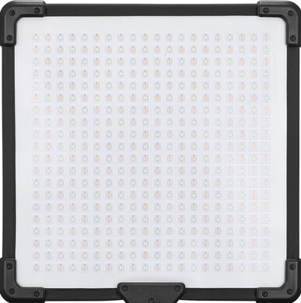
Exposure examples
Most commonly shoot 24 or 30 (23.98/29.97) fps
At 180° shutter (1/60 sec) and 800 ISO
1.
2.
3.
(36 thousand trillion trillion lumens)
Aputure 600d – 62,187 lumens (9554 lux @ 3 meters with 55° reflector)
9554 lux
@ 3 meters
w/55°
reflector
F 1.4

Slide 11
Exposure examples
Most commonly shoot 24 or 30 (23.98/29.97) fps
At 180° shutter (1/60 sec) and 800 ISO
1.
2.
3.
(10 lux)
Aputure 600d – 62,187 lumens (830 lux)
120fps
f/ 11
¼ exposure time
¹/₈₅ as much light
9554 lux

Slide 12
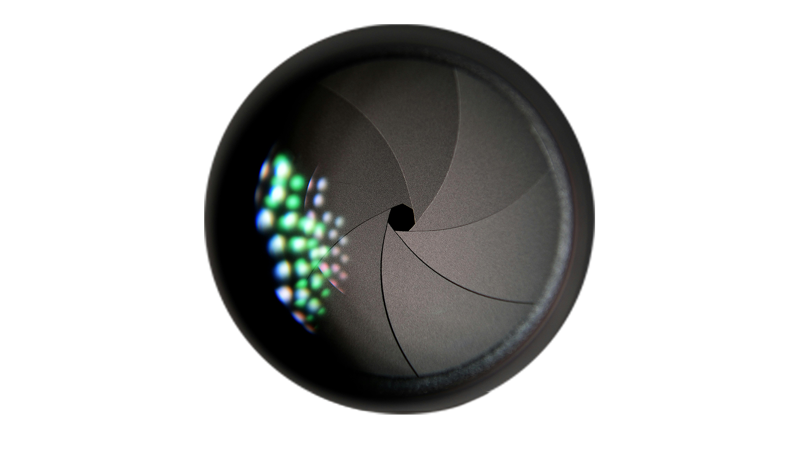
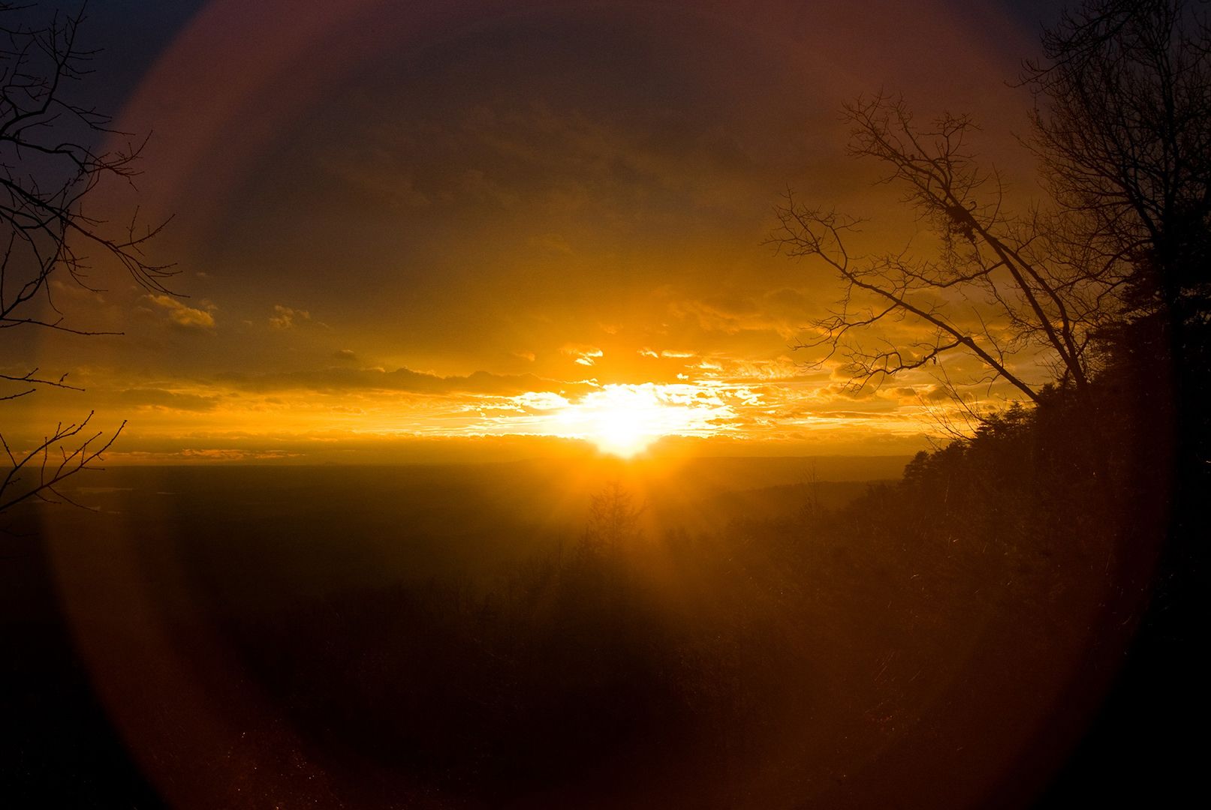
How much light do you need?
Existing sources
Aperture (DoF)
Shutter speed
(motion blur)
ISO (noise)

Slide 13
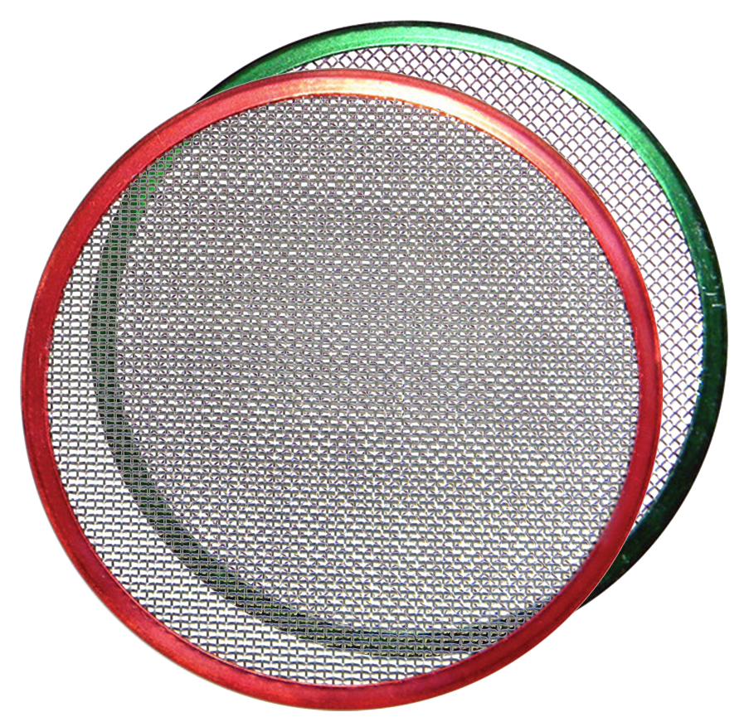
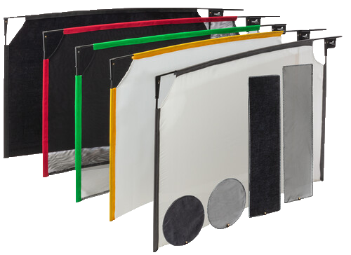
Control
Spot/flood
Zoom
Dimming
Scrim (incl window)
Net
Diffusion
ND (incl tint)
Bounce

Slide 14
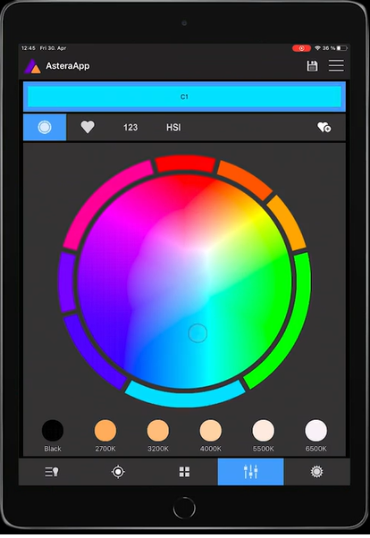
App control

Slide 15
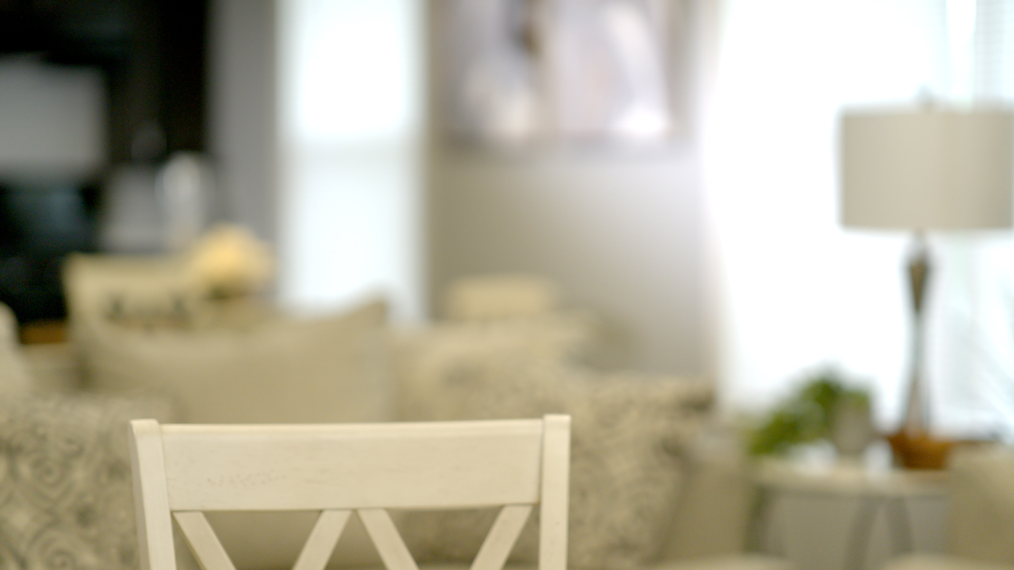
Adapting your lights to the ambience

Slide 16
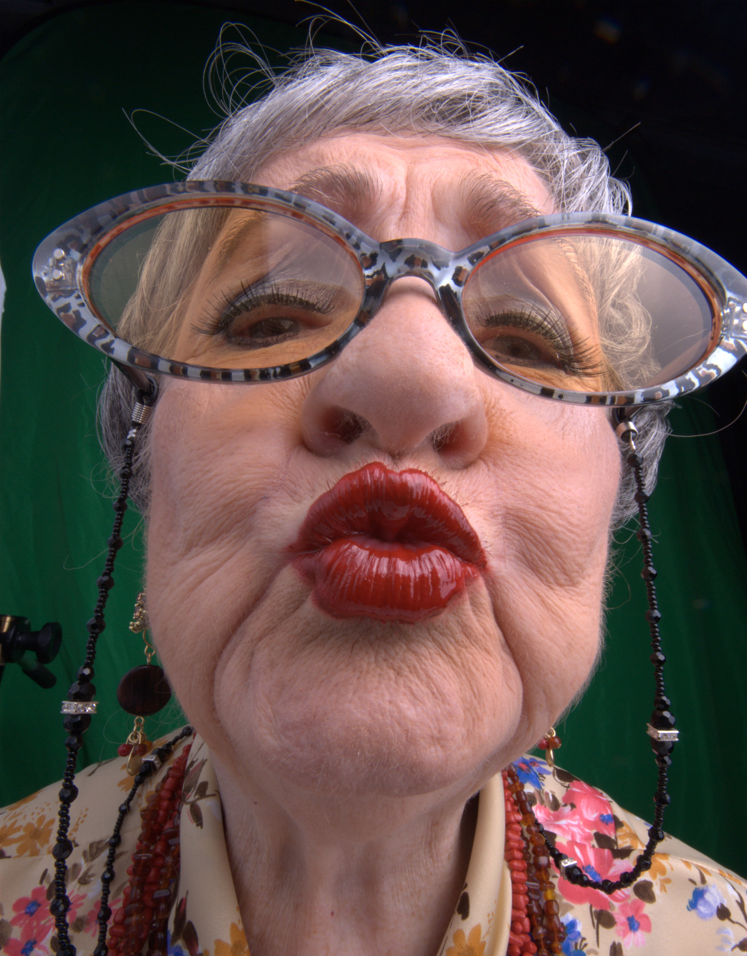
Contrast ratio
(and the limits of
overall dynamic range)

Slide 17
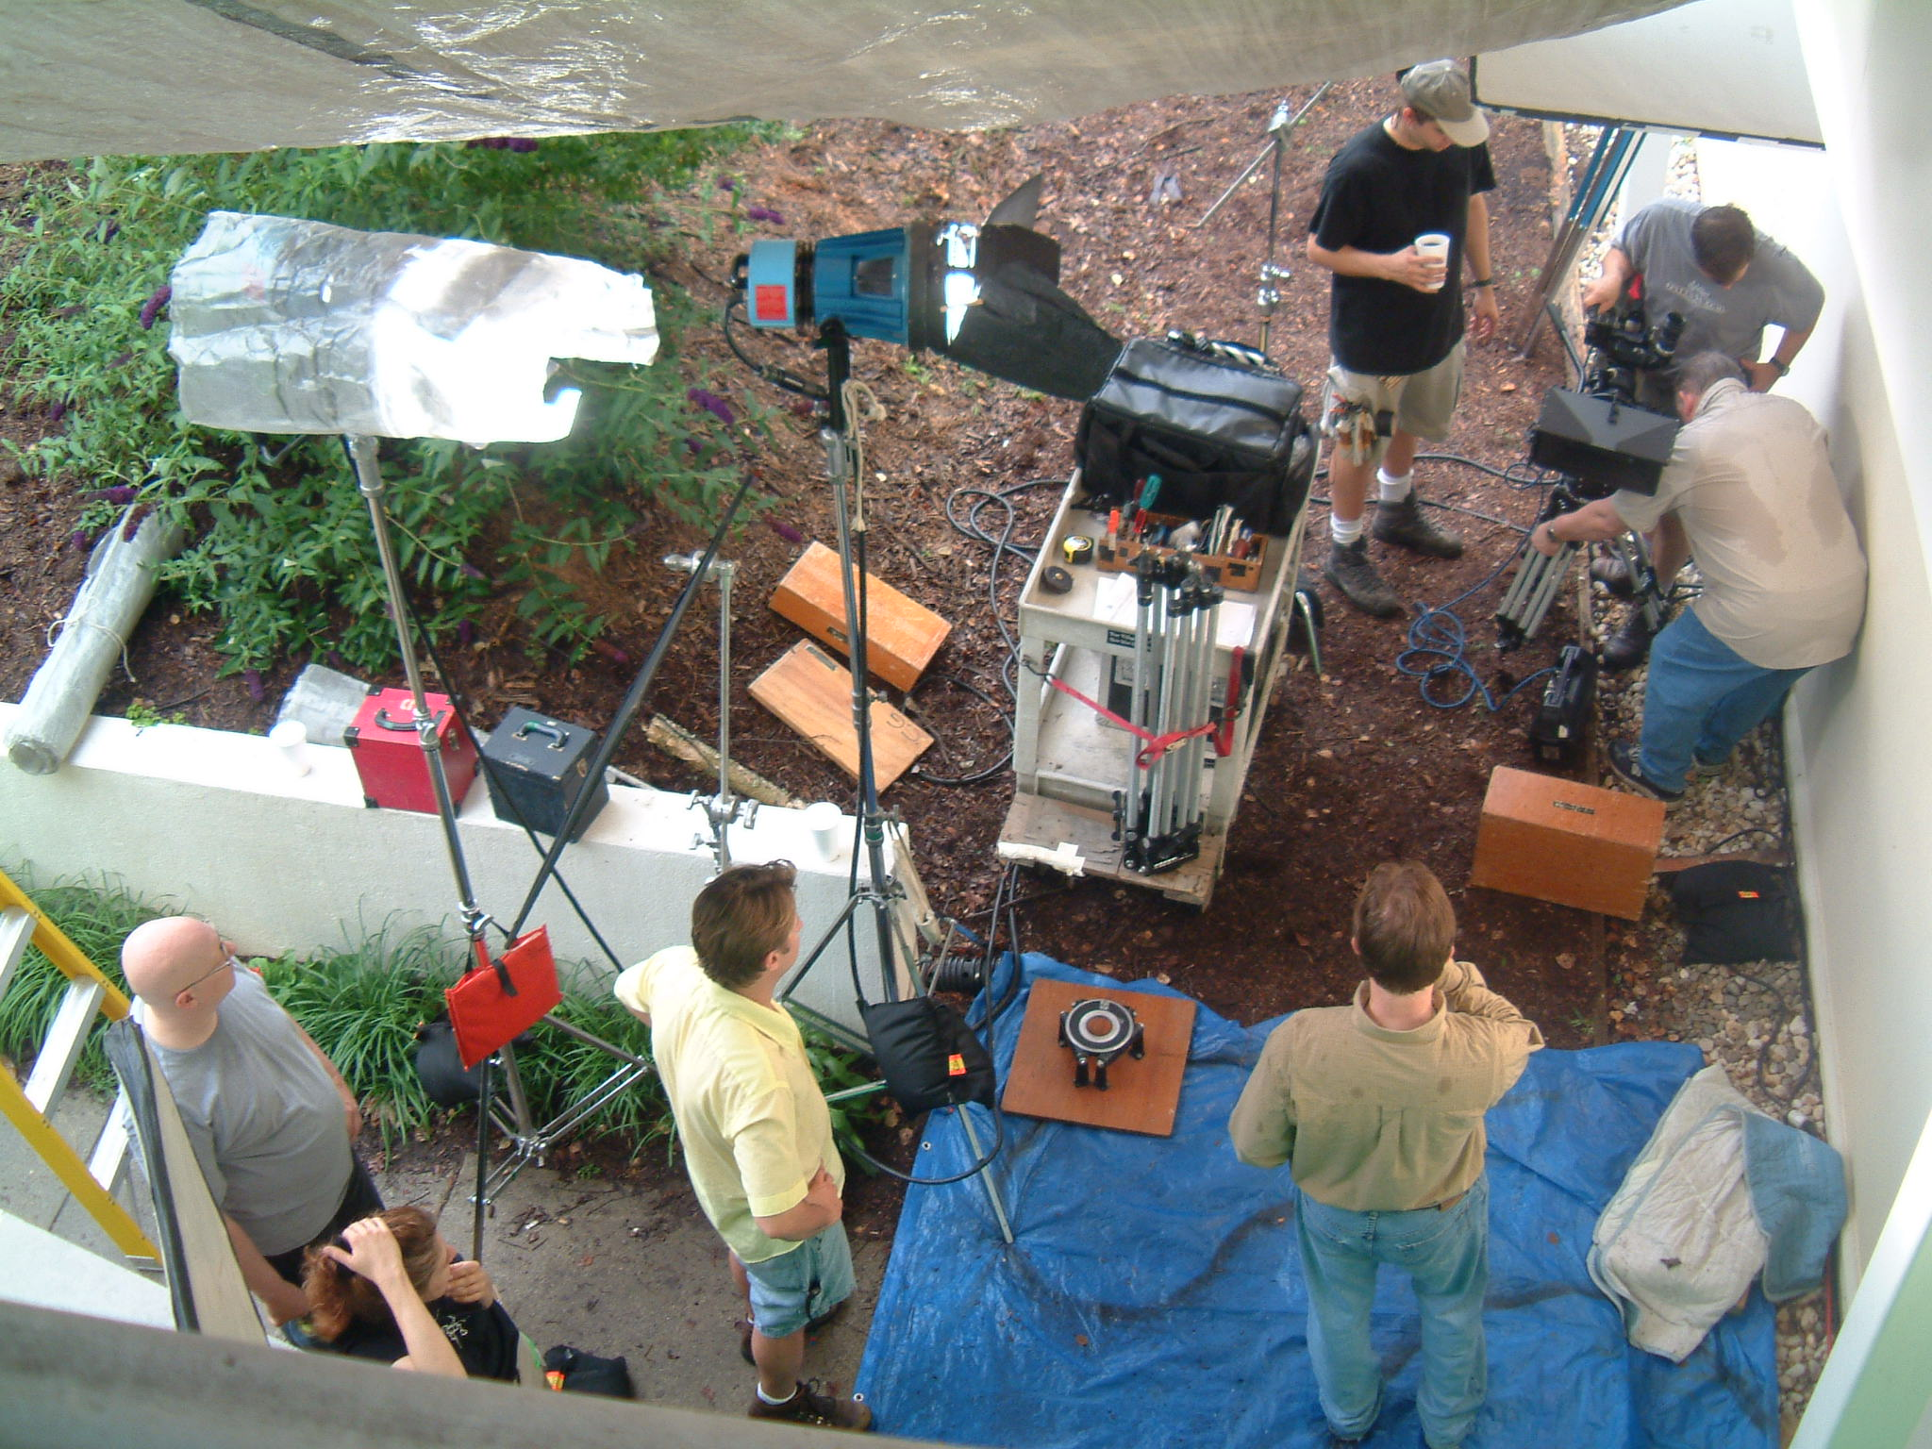
Practical concerns
Subject sensitivity
Power consumption
Conspicuousness
Cost
Crew requirements

